Slide 1
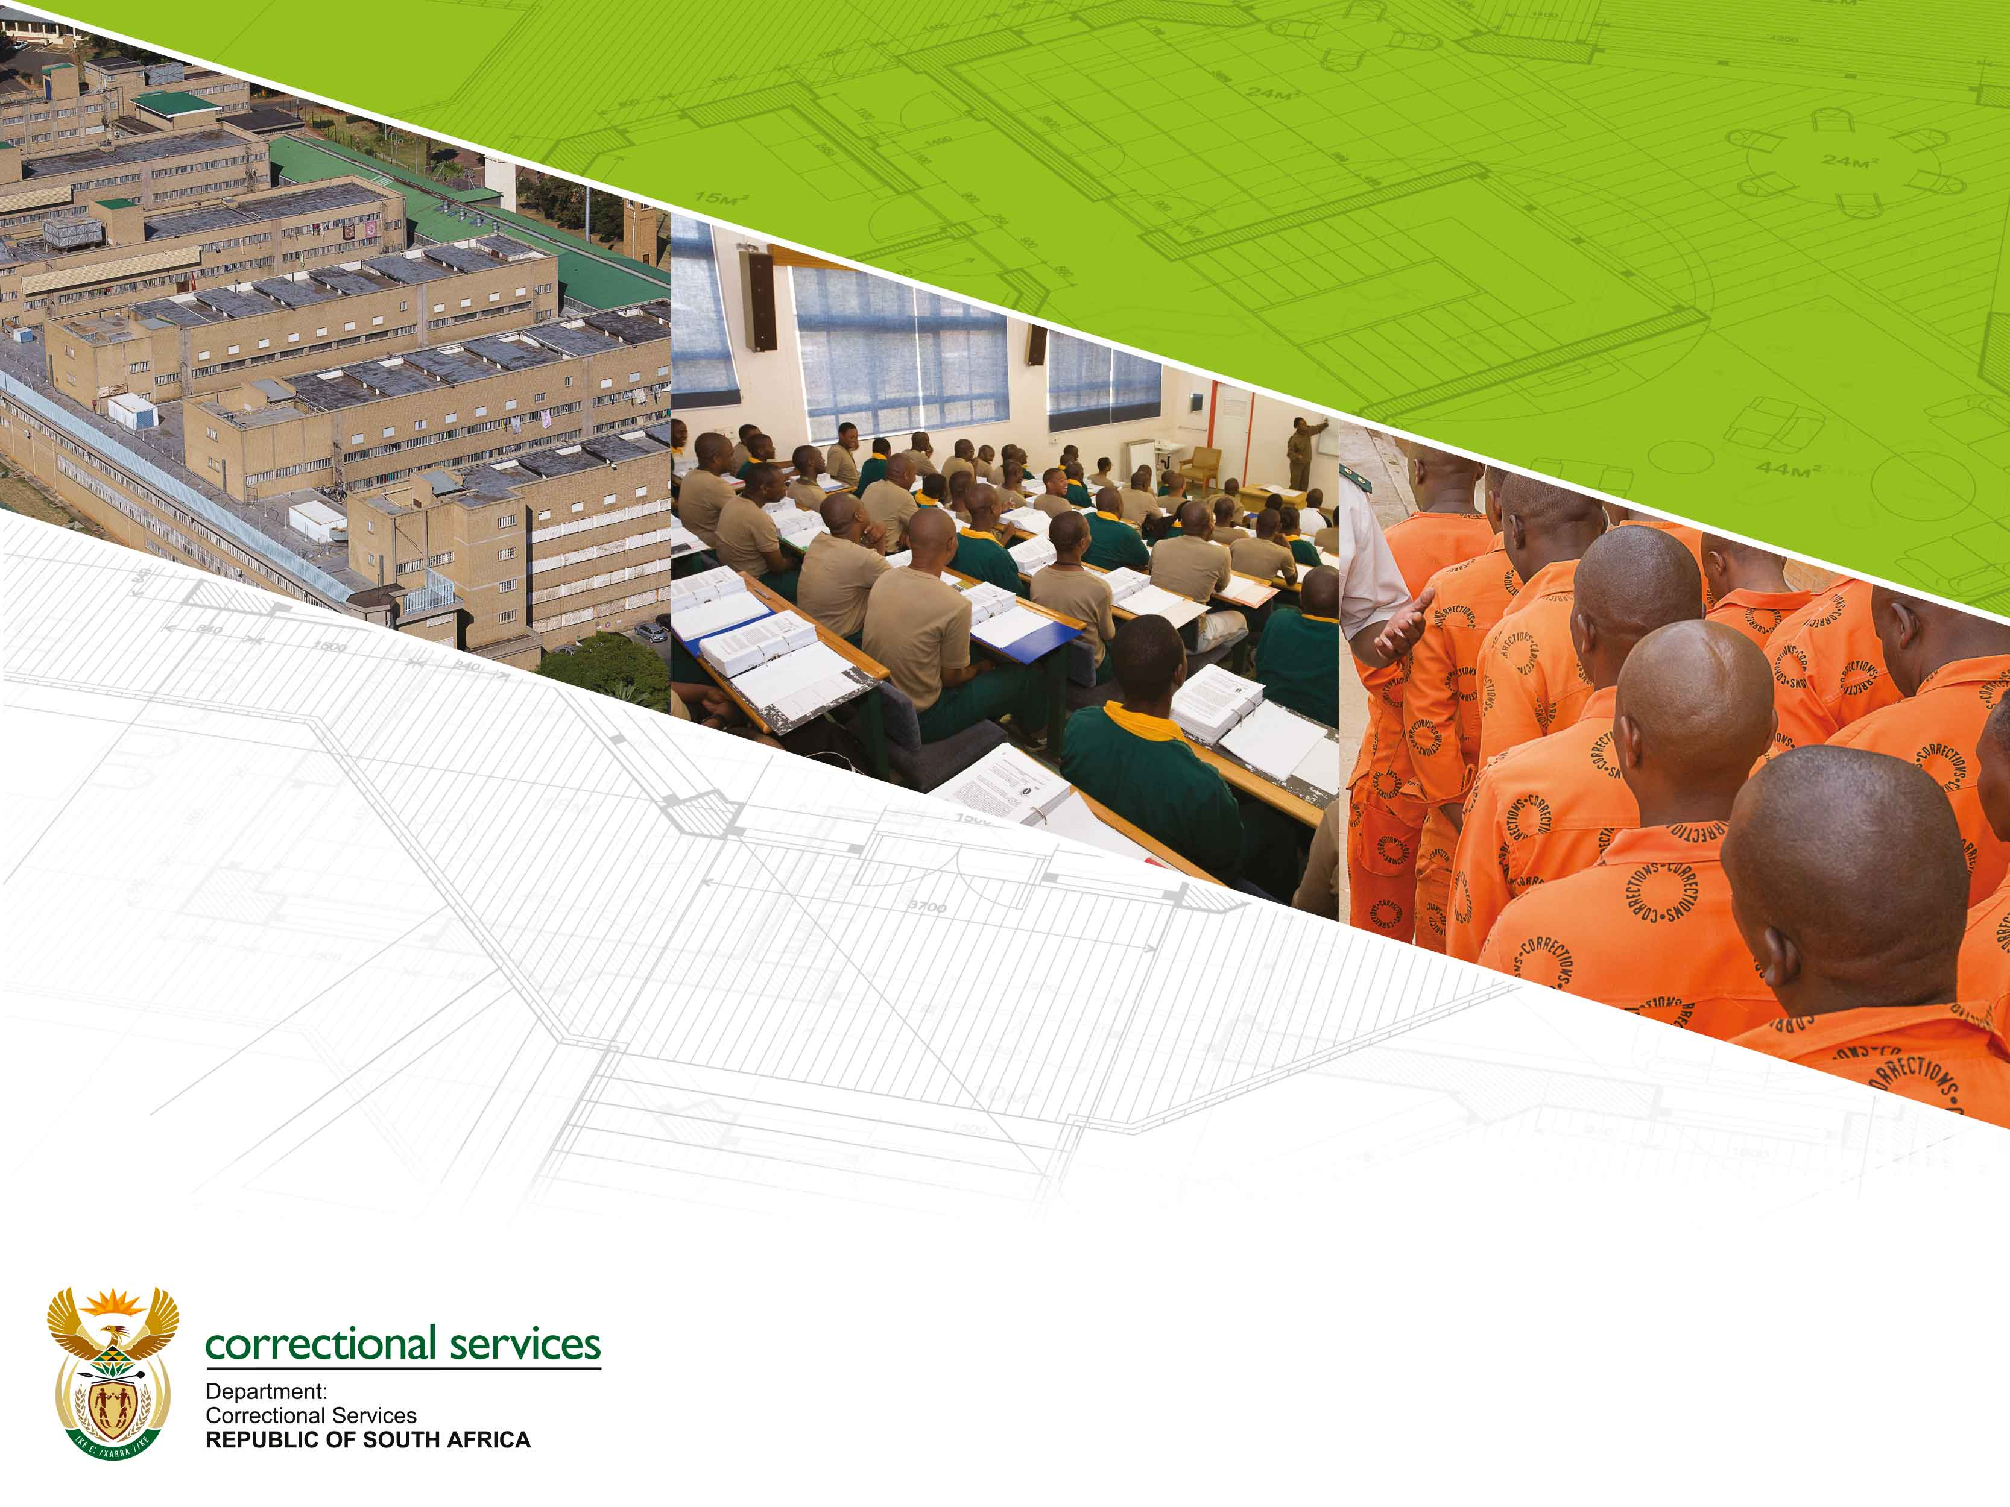
2019 Strategic Planning Session
14-16 August 2019
Facilities Commission Presentation

Slide 2
Contents
Summary of the 2018 Strategic Planning Session
Current Service Delivery Model
Historical Performance
Five (5) Year Strategic Plan - Results Chain
Five (5) Year Strategic Plan – Operational Plan
2020/21 Annual Performance Plan
Contextual Issues
Resource Considerations
Critical Success Factors and Dependencies
Strategic Risks
Paradigmatic Strategic Approach

Slide 3
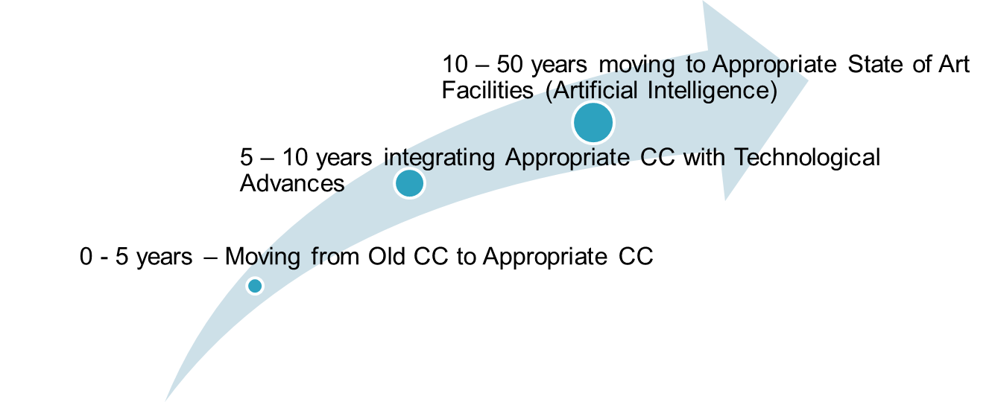
1. Summary of the 2018 Strategic Planning Session

Slide 4
1. Summary of the 2018 Strategic Planning Session
Impact:
Improved safety and security of inmates, officials, community, assets and information
Outcome:
Inmates incarcerated within safe, secure and humane conditions conductive for successful reintegration
Strategic intent
Infrastructure Transformation
5 Year Strategic Intent

Slide 5
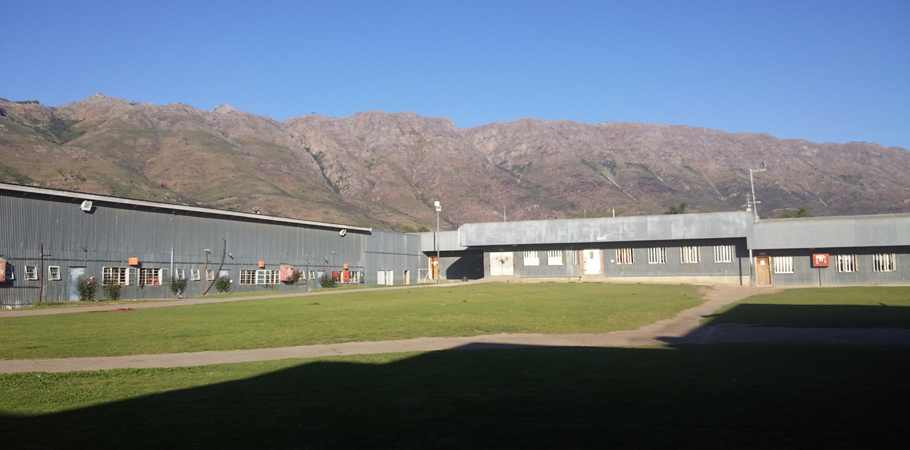
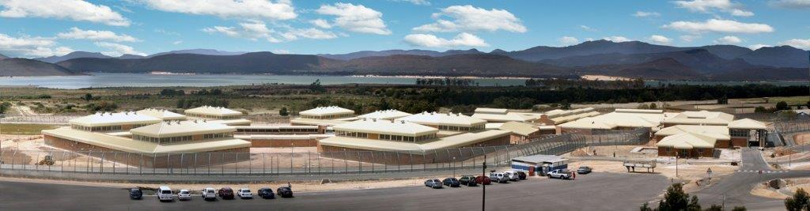
1. Summary of the 2018 Strategic Planning Session
5 Year Strategic Intent (Transform Infrastructure)
Voorberg
Correctional Center
Brandvlei Medium
Correctional Center

Slide 6
1. Summary of the 2018 Strategic Planning Session
10 Year Strategic Intent
Impact:
Improved safety and security of inmates, officials, community, assets and information
Outcome:
Inmates incarcerated within safe, secure and humane conditions conductive for successful reintegration
Strategic intent
Integrate Facilities with Technological Advances

Slide 7
1. Summary of the 2018 Strategic Planning Session
50 Year Strategic Intent
Impact:
Improved safety and security of inmates, officials, community, assets and information
Outcome:
Inmates incarcerated within safe, secure and humane conditions conductive for successful reintegration
Strategic intent
State of the Art Facilities (artificial intelligence)

Slide 8
2. Current Service Delivery Model
What are the core services |  | How are these delivered (service delivery arrangements) | Weaknesses with the current arrangements | High level interventions/alternative modes of delivery
Note: The poor condition of facilities impact on all aspects of rehabilitation and correctional activities and therefore hampers effective corrections in South Africa, due to the fact that only 4,9% (12/243) conform to new generation design.
Provide adequate Correctional Centres through construction (new, upgrade, refurbishment, security systems) | Construction of new correctional centres Upgrade and refurbishment of existing correctional centres |  | Lack of comprehensive & integrated Master Infrastructure Plan Current infrastructure not conducive for rehabilitation and corrections Poor performance by Implementing Agent (DPW) & contractors Current procurement strategies Cost/time overrun |  | Review the infrastructure delivery model and agreements with implementing agents Rationalising of Correction Centres Devolve uneconomically operated correctional centres to Department of Social Development

Slide 9
2. Current Service Delivery Model
What are the core services | How are these delivered (service delivery arrangements) | Weaknesses with the current arrangements | High level interventions/alternative modes of delivery
Maintenance | Major Repair and Renovations Planned and Unplanned maintenance Own Resources maintenance (offender utilization) Day-to-day maintenance | Poor performance by Implementing Agent (DPW) Poor performance by contractors Current procurement strategies Lack of in-house technical staff to perform own resources projects Budget constraints | Implement DCS maintenance contracts (in-house) Enhance Offender training

Slide 10
2. Current Service Delivery Model
What are the core services | How are these delivered (service delivery arrangements) | Weaknesses with the current arrangements | High level interventions/alternative modes of delivery
Property Management | Provisioning through private leases Provisioning through state owned buildings | Poor condition of buildings Over committed allocation Over dependency on private leases Lack of state owned buildings | Enhance maintenance processes Relocate Area Commissioners to Correctional Centres Renegotiate leases

Slide 11
3. Historical Performance
What has been achieved in the past 5 years and what has worked well | What have we failed to achieve in the past 5 years and why | What need to be done differently / change
Revived the own resources capacity for infrastructure maintenance Various own resources projects finalised | Own resources programme were unable to reach full potential | Optimise offender labour Appointment of in house artisans and retain the skills Change appointment classification of artisans
Creation of bed space Various construction projects were finalised (Standerton, Estcourt, C Max, Glencoe) Design for Parys finalised and currently under construction. Emthonjeni Youth Centre currently under construction (upgrade and refurbishment) | Unable to create bed space as per the Annual Performance Plan due to poor performance of contractors (liquidation of contractors) | Expedite the creation of bed space through a revised procurement strategy and appointment of alternative Implementing Agents

Slide 12
3. Historical Performance
What has been achieved in the past 5 years and what has worked well | What have we failed to achieve in the past 5 years and why | What need to be done differently / change
Security systems and Infrastructure Finalise various Fencing Projects | The Fencing Programme experienced a time and cost over run | A new steering committee was appointed A project driven methodology to be implemented Replace dilapidated perimeter fencing to virtual fencing
Infrastructure Transformation (Standerton, Estcourt, C Max, Glencoe) Emthonjeni Youth Centre currently under construction (upgrade and refurbishment) | Unable to transform most correctional Centres to support rehabilitation programmes | Accelerate phasing out inadequate infrastructure (Zink/Asbestos) Construct new Correctional Centres that support rehabilitation programmes

Slide 13
4. Five (5) Year Strategic Plan - Results Chain
Own Resources Maintenance / Construction of Class Rooms: Regain unused bed space (500)
Impact (Impact Statement)
Outcome (5 year target)
Primary Outputs (KPI’S)
Secondary Outputs (AOP)
Number of new bed space created through construction of new facilities & upgrading
Adequate accommodation for administration and community corrections (leases & state owned)
Facilities maintenance and renovations
Municipal charges
Own Resources Programme
Implementation of security system infrastructure projects
User Asset Management Plan
Conduct bed space audit
Optimise and automate bed space use
Improved safety and security of inmates, officials, community, assets and information
Infrastructure Master Plan implementation
Inmates incarcerated within safe, secure and humane conditions conductive for successful reintegration
Maintain infrastructure
Bulk Services
Staff Accom
Office Accom
Engineering Services
5 year target:
Increase by 4248
Notes:
A new dynamic outlook to reposition the Department

Slide 14
5. Five (5) Year Strategic Plan - Results Chain: Operational Plan
No | Activity (Transform Infrastructure) | Timeframe | Responsibility
1 | Finalise the national approved bed space audit and upgrade accommodation determination system in order to manage bed space utilisation | 2019-12-30 | DC Facilities Regional Heads Facilities
2 | Revise all lease agreements & optimise floor space in order to provide adequate accommodation for administration and community corrections | 2020-03-30 | DC Facilities Regional Heads Facilities
3 | Finalise Own Resources Policy: Enhance the Own Resources Programme in order to maintain facilities | 2021-03-30 | DC Facilities Regional Heads Facilities
4 | Partner with external institutions and departments to enhance implementation of alternative energy and green technologies | 2021-03-30 | DC Facilities Regional Heads Facilities

Slide 15
5. Five (5) Year Strategic Plan - Results Chain: Operational Plan
No | Activity (Transform Infrastructure) | Timeframe | Responsibility
5 | Automate the User Asset Management Plan & Maintenance System | 2021-03-30 | DC Facilities Regional Heads Facilities
6 | Adopt (from DPW) and automate Municipal charges and verification | 2021-03-30 | DC Facilities Regional Heads Facilities
7 | Implement maintenance term contracts on all insourced kitchens in order to support nutritional services and in order to comply with municipal by-laws | 2021-03-30 | DC Facilities Regional Heads Facilities
8 | Regain 500 unused bed space through the construction of class rooms and repurpose of cells at 38 Correctional Centres | 2024-03-30 | DC Facilities Regional Heads Facilities

Slide 16
5. Five (5) Year Strategic Plan - Results Chain: Operational Plan
No | Activity (Transform Infrastructure) | Timeframe | Responsibility
9 | Enhance equipment maintenance on electrical and mechanical services through the implementation of DCS term contract at the big five correctional centres | 2021-03-30 | DC Facilities Regional Heads Facilities
10 | Partner with external institutions and departments to enhance implementation of alternative energy and green technologies | 2021-03-30 | DC Facilities Regional Heads Facilities
11 | Accelerate construction and maintenance implementation and delivery through appointment of additional implementing agents | 2021-03-30 | DC Facilities Regional Heads Facilities
12 | Implement Integrated Security Systems at 24 Correctional Centres | 2024-03-30 | DC Facilities Regional Heads Facilities

Slide 17
6. 2020/21 Annual Performance Plan
Outputs, Indicators and Targets
No. | Output Indicator | Annual Targets
 |  | Audited/ Actual Performance |  |  |  | Estimated Performance | MTEF Period
 |  | 2016/17 | 2017/18 |  | 2018/19 | 2019/20 | 2020/21 | 2021/22 | 2022/23
Outcome 1.1:
1.1.1 | Creation of bed space through new construction |  |  |  |  | Tzaneen (435) |  | Parys (176) | Burgersdorp (311)
1.1.2 | Creation of bed space through upgrade | 328 Vanrhynsdorp (328) |  | 0 | Pretoria C-Max | Estcourt (309), Standerton (787), Glencoe (666) | Emthonjeni (640), Brandvlei (690) |  | Lichtenburg (234)

Slide 18
7. Contextual Issues
The Department’s facilities planning and building programme must
be;
Needs-driven and informed by an integrated justice system analysis,
Designed to function as tools for rehabilitation,
Creating performance infrastructure that embraces self-sufficiency,
Smart emerging technologies to enable safe environment for incarceration, adequate security, and
Conditions consistent with human dignity.

Slide 19
8. Resource Considerations
Infrastructure challenges are mainly attributed to the following;
Inadequate and outmoded infrastructure: The majority of Correctional Centres are older than 50 years. The architectural design of the majority of infrastructure does not cater for new democratic reform in the new South Africa. With the shift and emphasis on rehabilitation, in post-apartheid South Africa, it should be noted that the vast majority of centres which were constructed during the apartheid area do not fully cater for rehabilitation programmes since they do not have facilities for rendering rehabilitation and care programme services.

Slide 20
9. Critical Success Factors and Dependencies
CRITICAL SUCCESS FACTORS | DEPENDENCIES
Enabling environment for infrastructure delivery | Approved strategy for infrastructure delivery
 | Enabling policies in support of infrastructure development
Adequate resource allocation | Approved allocation in support of critical projects
 | Filling of critical technical positions (artisans)
Allocation of projects to implementing agents | Appointment of additional implementing agents
 | Enforcement of SLA / MOU conditions

Slide 21
Critical Success Factors and Dependencies
CRITICAL SUCCESS FACTORS | DEPENDENCIES
Implementation of Own Resources Projects | Filling of critical technical positions (artisans) & skilling of inmates
 | Enabling policies in support of own resources projects
Upgrade (transform) outmoded infrastructure & regain unused bed space Construction of new correctional centres | Approved allocation in support of critical projects
 | Appointment of additional implementing agents
 | Enabling policies in support of infrastructure development
 | Partner with Government Entities such as Municipalities and Department of Environmental Affairs

Slide 22
Critical Success Factors and Dependencies
CRITICAL SUCCESS FACTORS | DEPENDENCIES
Implementation and maintaining security infrastructure, such as integrated security systems | Integration of current systems
 | Upgrade of outmoded technologies
 | Maintaining current and new systems
Optimize available bed space at correctional centres | Regain unused bed space
 | Maintain exiting bed space
 | Construct class room in order to regain bed space
Optimize available office accommodation & Community Corrections buildings | Renegotiate lease contracts
 | Explore state owned building
 | Partner with other Government departments for co-use

Slide 23
10. Strategic Risks
Outcome | Risk | Probability (High/ Medium/ Low) | Impact (High/ Medium/ Low) | Mitigation Strategy
Safe human incarceration | Poor reputation, Overcrowding, Litigation, escapes ,assaults Infrastructure failure, condemnation of buildings | High | High | Accelerate infrastructure development and delivery Appoint additional implementing agents. Implement green technologies

Slide 24
Strategic Risks
Outcome | Risk | Probability (High/ Medium/ Low) | Impact (High/ Medium/ Low) | Mitigation Strategy
Uninterrupted basic services (bulk infrastructure) | Operational disruption, Poor reputation, litigation, injury and lost of life, | Medium | High | Adoption of municipal services from the DPW (in progress) Implement and maintain standby power Implement green technologies Reduce over reliance on municipality for water

Slide 25
Strategic Risks
Outcome | Risk | Probability (High/ Medium/ Low) | Impact (High/ Medium/ Low) | Mitigation Strategy
Uninterrupted services and operations | Closure of facilities | High | High | Accelerate infrastructure development and delivery Implement day-to-day maintenance Implement own resources projects

Slide 26
11. Paradigmatic Strategic Approach
The current infrastructure strategy requires urgent review, which is formulated in the Master Infrastructure Plan.
The following fundamentals will be revised in order to achieve accelerated infrastructure transformation;
The adoption of a paradigmatic strategic approach to the mitigation of a reactive facility management philosophy,
Maintenance Projects on existing infrastructure should not be seen as secondary importance to the apparently more attractive prospect of new infrastructure,
Enhance self-sufficient capacity for planned and unplanned maintenance,

Slide 27
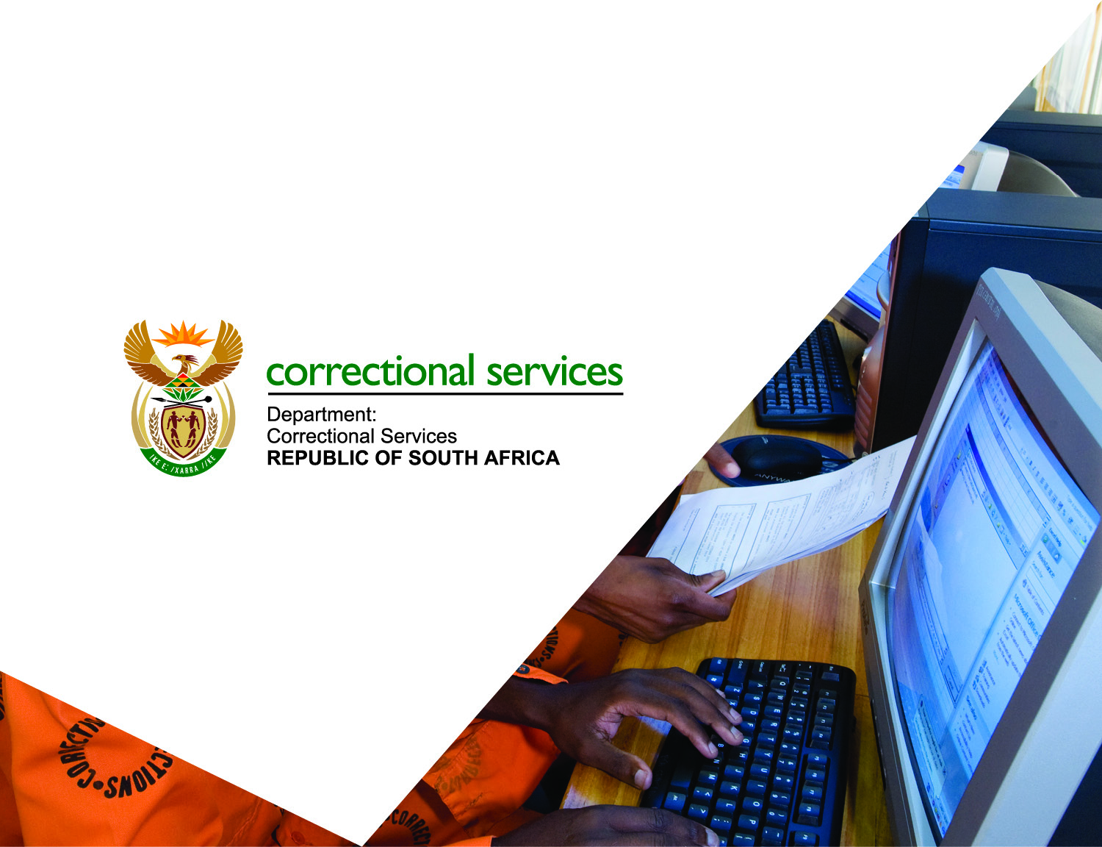
Thank You
Thank You

