Slide 1
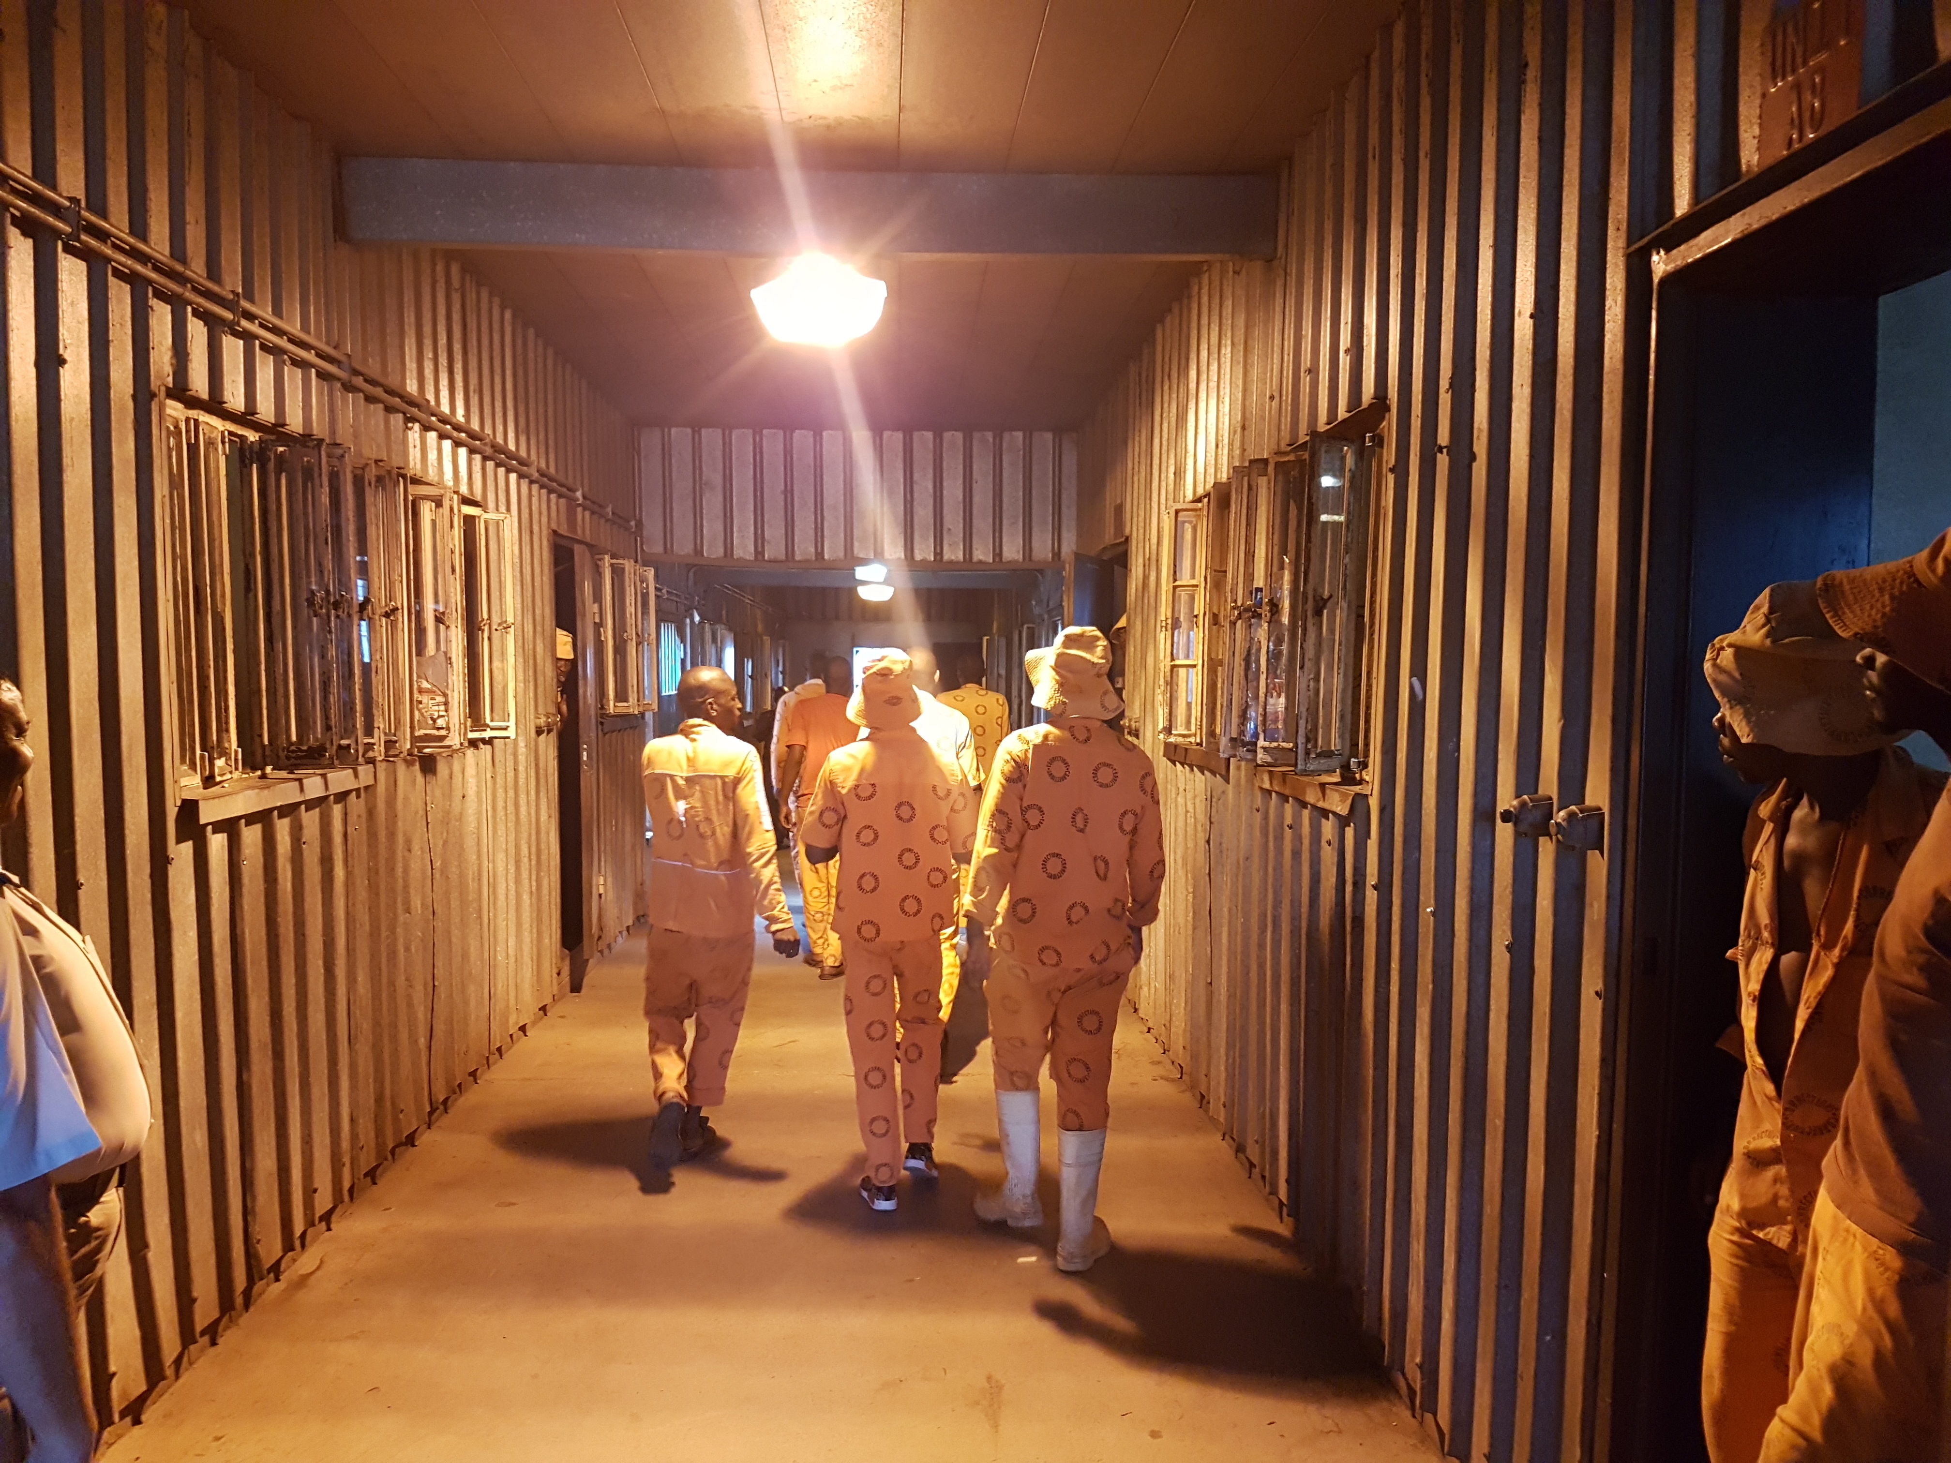

5 year Observation of Correctional Services
An Oversight report by the Judicial Inspectorate for Correctional Services (JICS) by
Mr. Mike Masondo
Director: Management Regions

Slide 2

BACKGROUND
JICS is an independent office under the control of the Inspecting Judge established in accordance to section 85 of the Correctional Service Act 111 OF 1998.
The objective of JICS is to facilitate the inspection of correctional centres to enable the Inspecting Judge (IJ) to report on the treatment of inmates in correctional centres; conditions of the correctional centres and any corrupt DCS officials.
Judicial Inspectorate for Correctional Services

Slide 3
Strategic overview
Vision
To uphold the human dignity of inmates through independent, proactive, and responsive oversight.
Mission
To impartially inspect, investigate, report and make recommendations on the conditions in correctional centres and remand detention facilities and on the treatment of inmates in order to ensure the protection of the human rights of inmates.
Judicial Inspectorate for Correctional Services

Slide 4
Values
JICS ascribes to the following values:
        Human Dignity
        Independence
        Fairness
        Efficiency
        Integrity
        Professionalism
        Accountability
        Legality
Reflections
- Our dignity
Judicial Inspectorate for Correctional Services

Slide 5
OVERVIEW OF JICS
JICS was established in 1998 and has been functioning with skeleton structure ever since. The organisation has three directorates, namely Support Services, Legal Services and Management Regions.
JICS is regulated within the CSA (Chapter IX and X)
Judicial Inspectorate for Correctional Services

Slide 6
OUR MANDATE
Our core mandate is in accordance with Section 15, 30, 31, 32, 90, 91, 92, 93 & 94 of the Correctional Service Act, 111 of 1998.
Judicial Inspectorate for Correctional Services

Slide 7
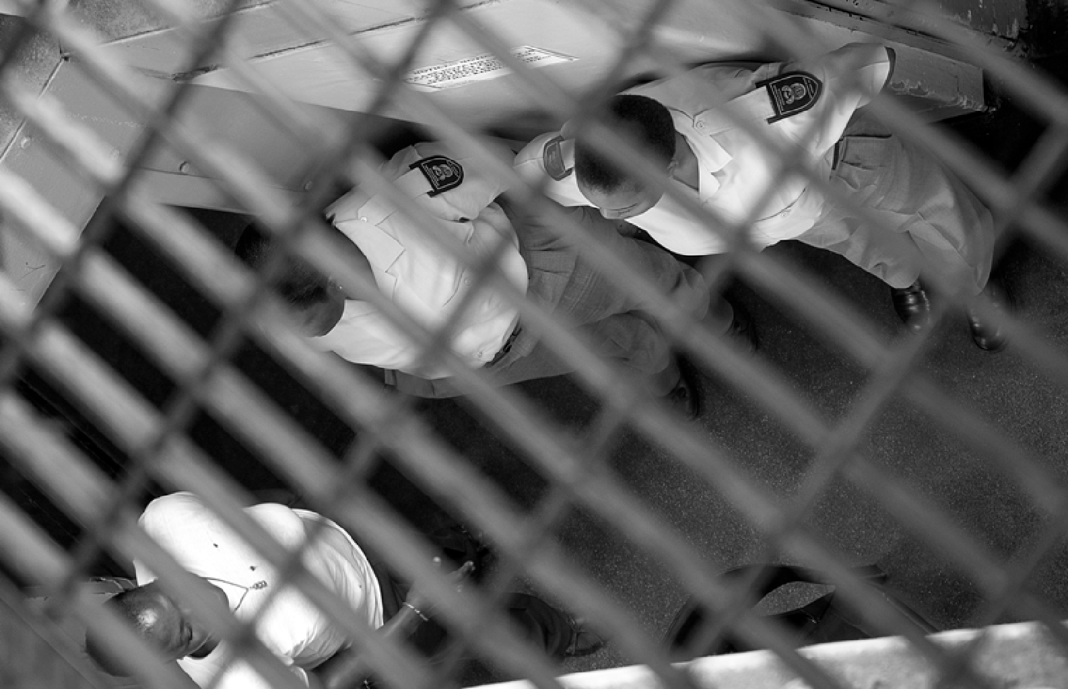
INSPECTIONS AND INVESTIGATIONS
Judicial Inspectorate for Correctional Services

Slide 8
INSPECTIONS
JICS inspectors visit all housing units, including the ablution areas, during each inspection. HCCs sited, amongst others, overcrowding, old infrastructure and lack of proper maintenance as the main contributing factors to the poor conditions of correctional facilities.
Judicial Inspectorate for Correctional Services

Slide 9
INSPECTIONS
Electricity supply remains a challenge, exacerbated by old infrastructure and illegal electricity connections in cells by inmates after they are locked up for the night. The Department of Public Works (DPW) is the national department responsible for infrastructure maintenance
and HCCs voiced their frustration at either the long wait they endured, or appointed contractors not completing the job or rendering poor workmanship. HCCs, especially in rural areas, further reported that inadequate water supply from the local municipality not only affected the correctional facility but also the houses of correctional
officials living on the precinct.
Judicial Inspectorate for Correctional Services

Slide 10
FINDINGS (CORRECTIONAL CENTRE INFRASTRUCTURE)
Judicial Inspectorate for Correctional Services

Slide 11
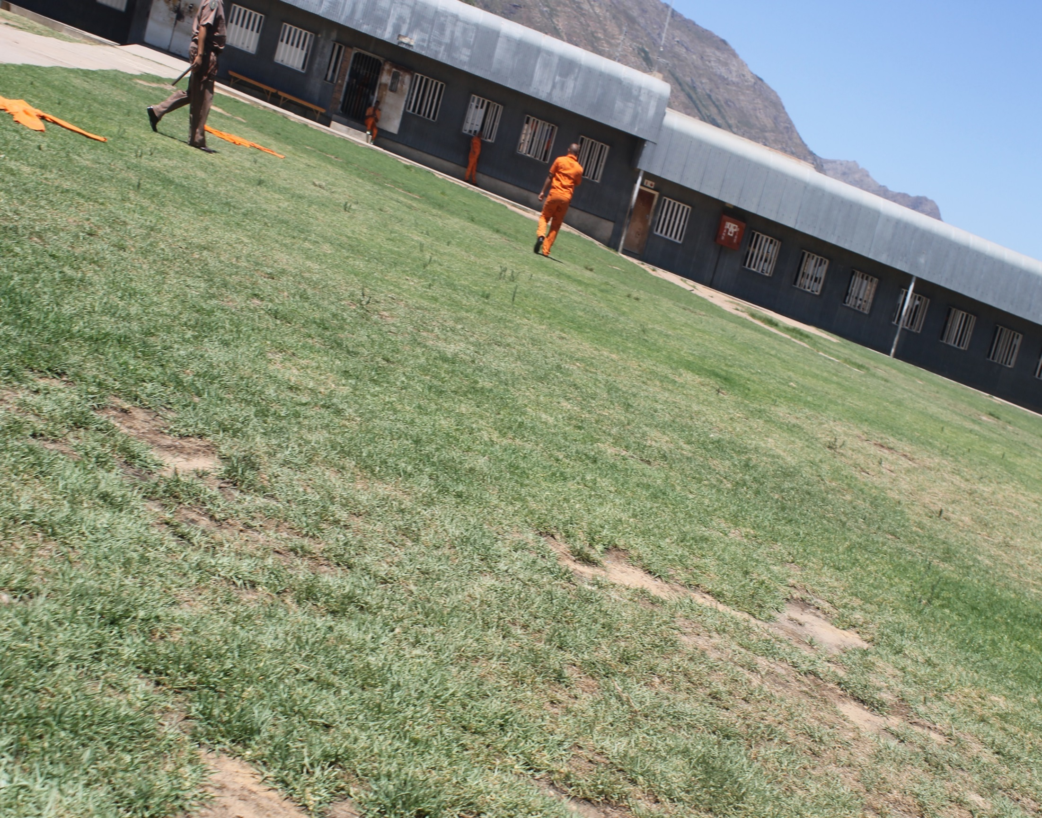

Slide 12

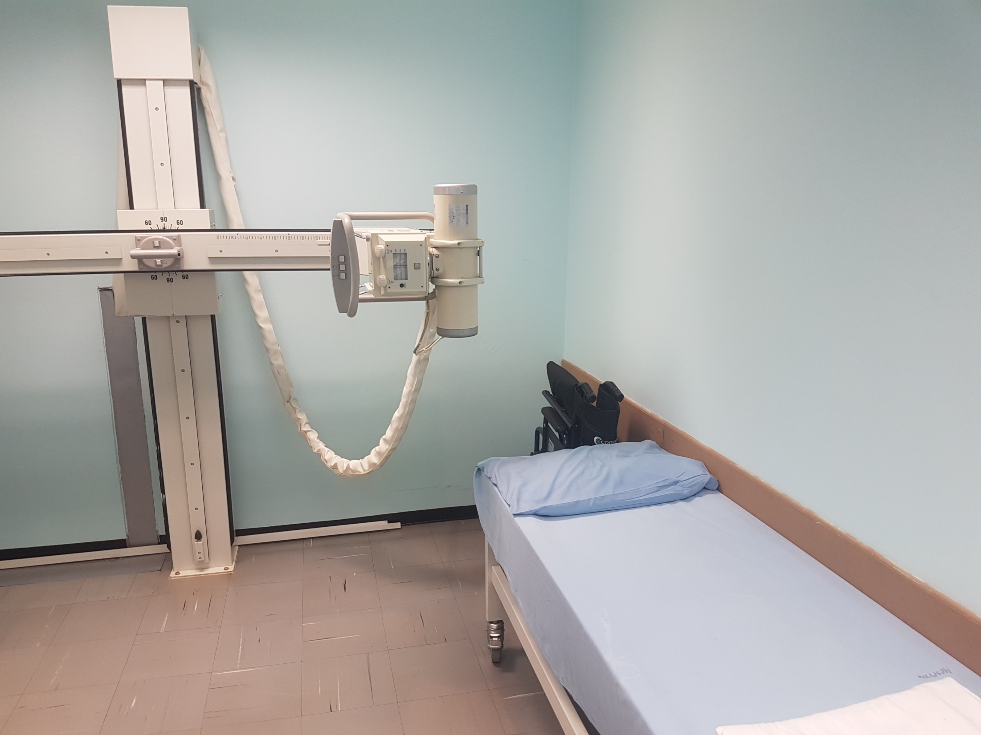

Slide 13
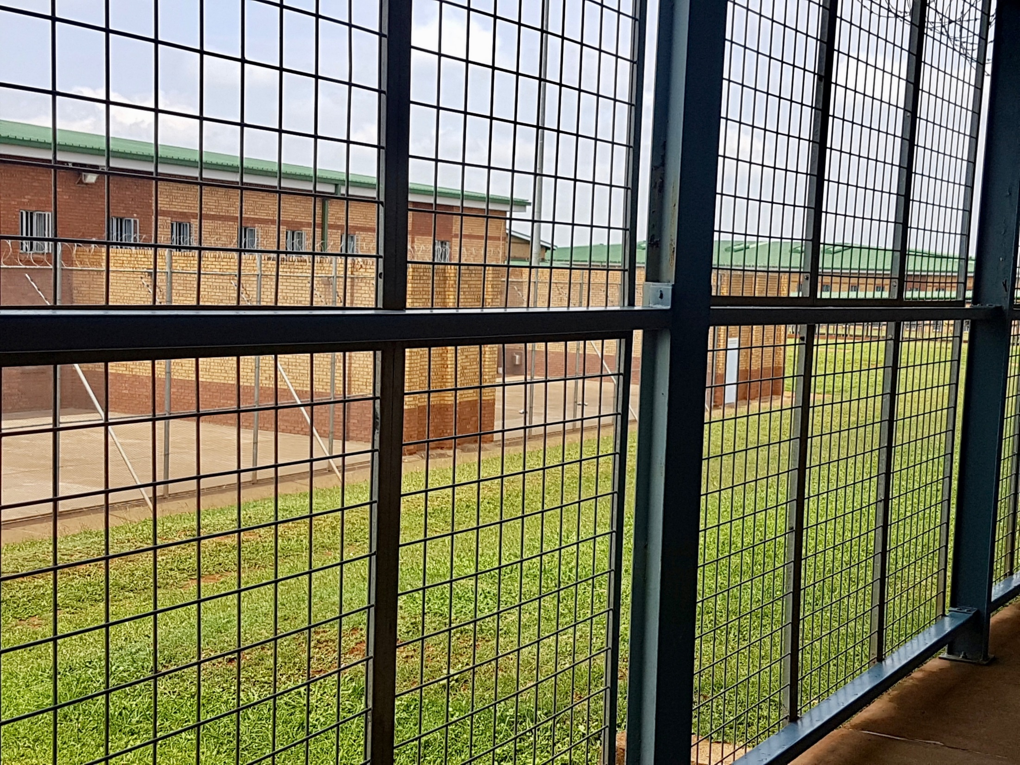

Slide 14
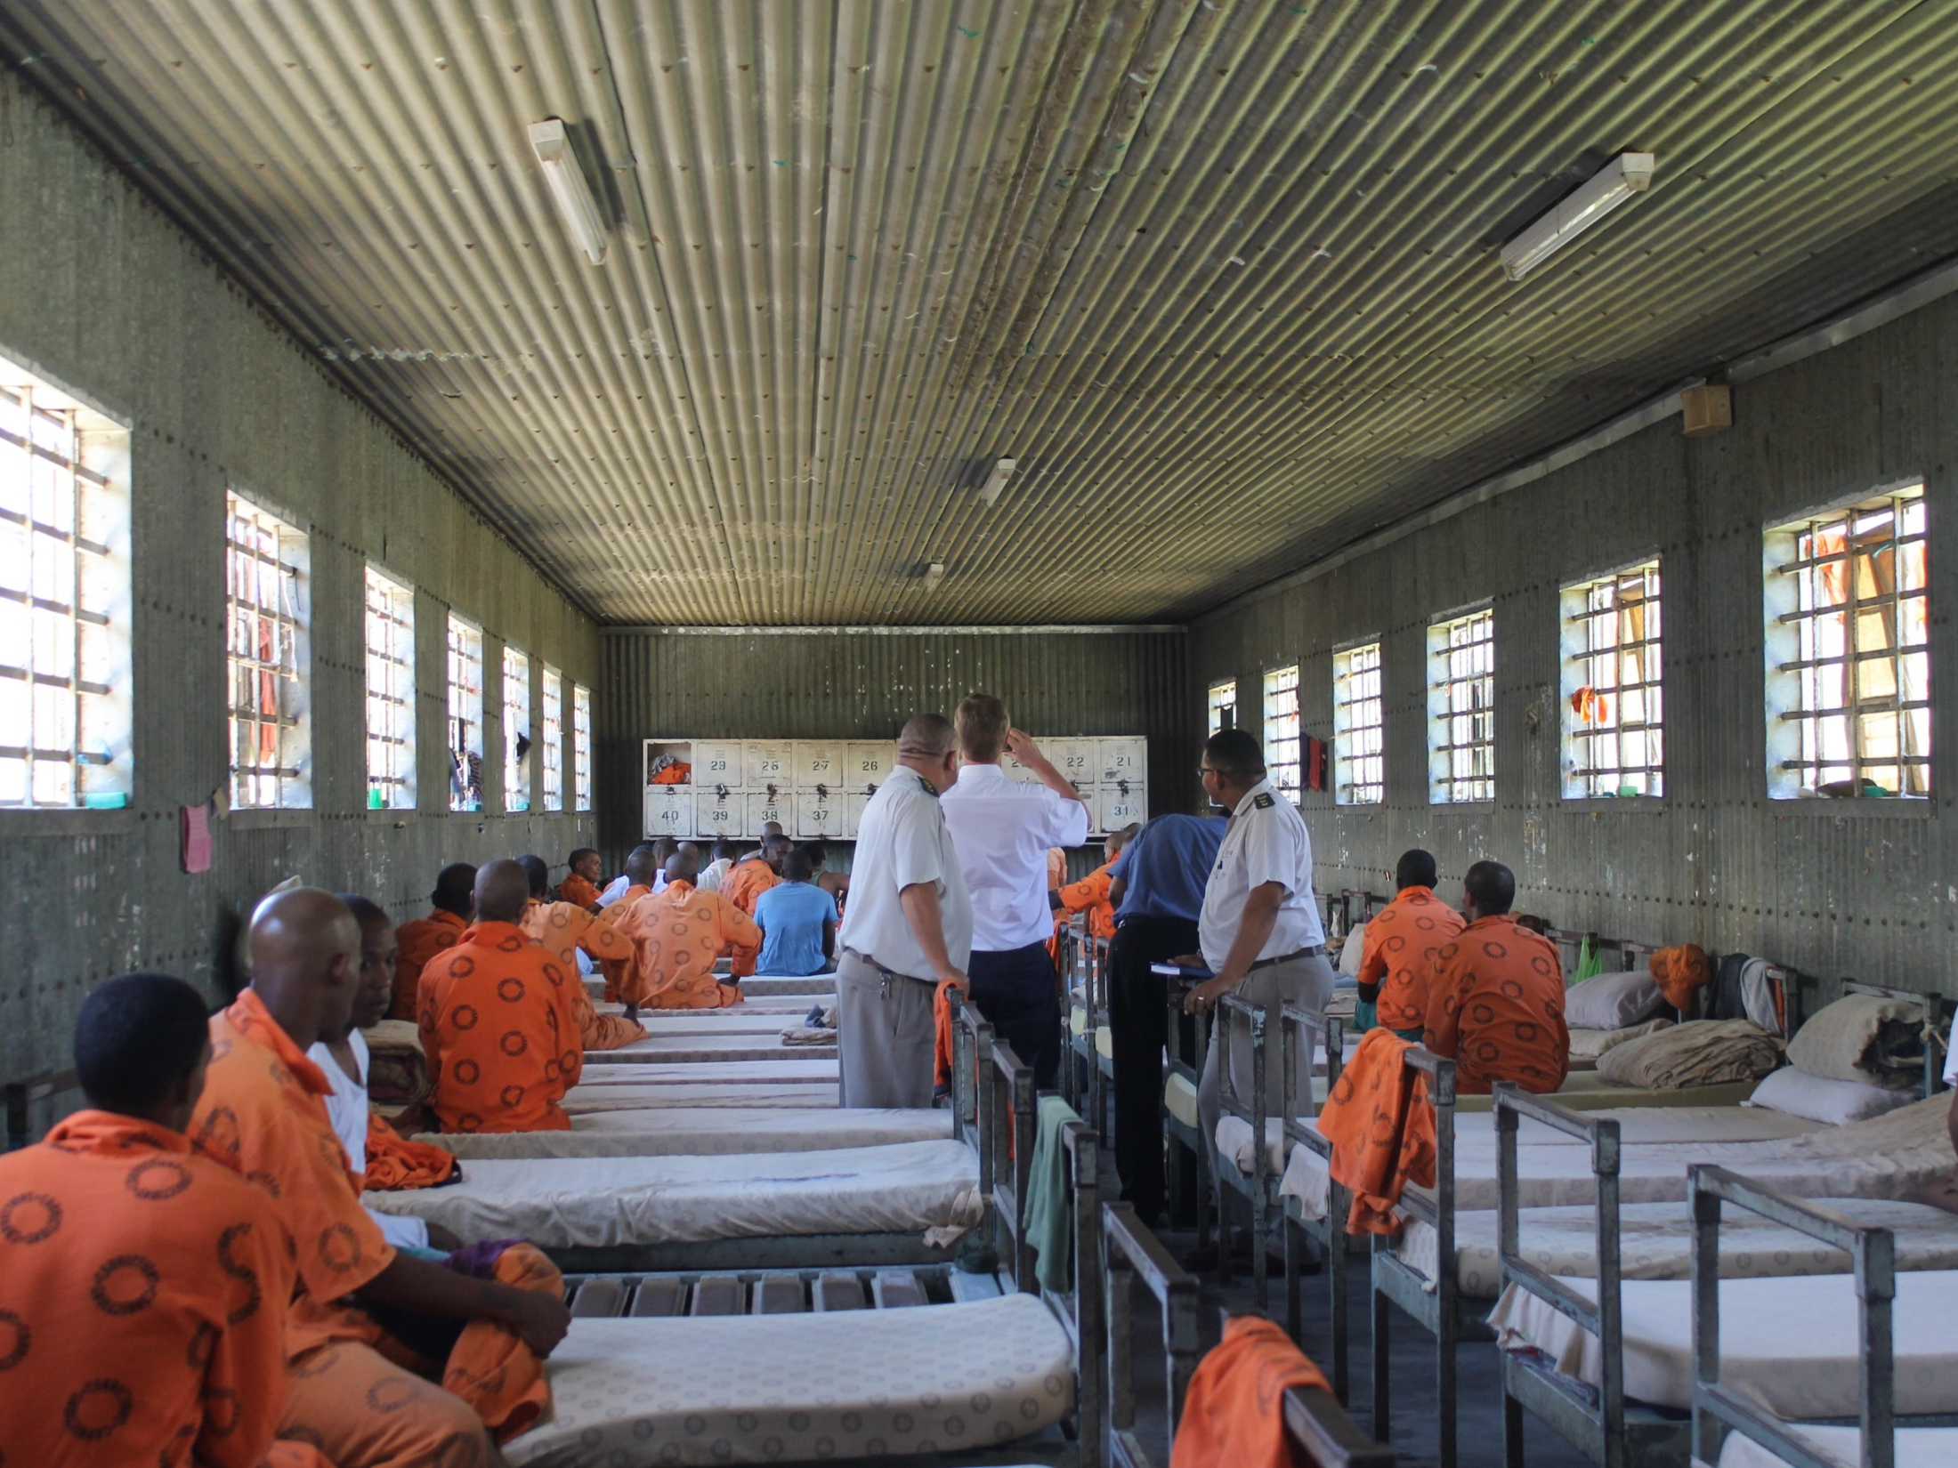

Slide 15
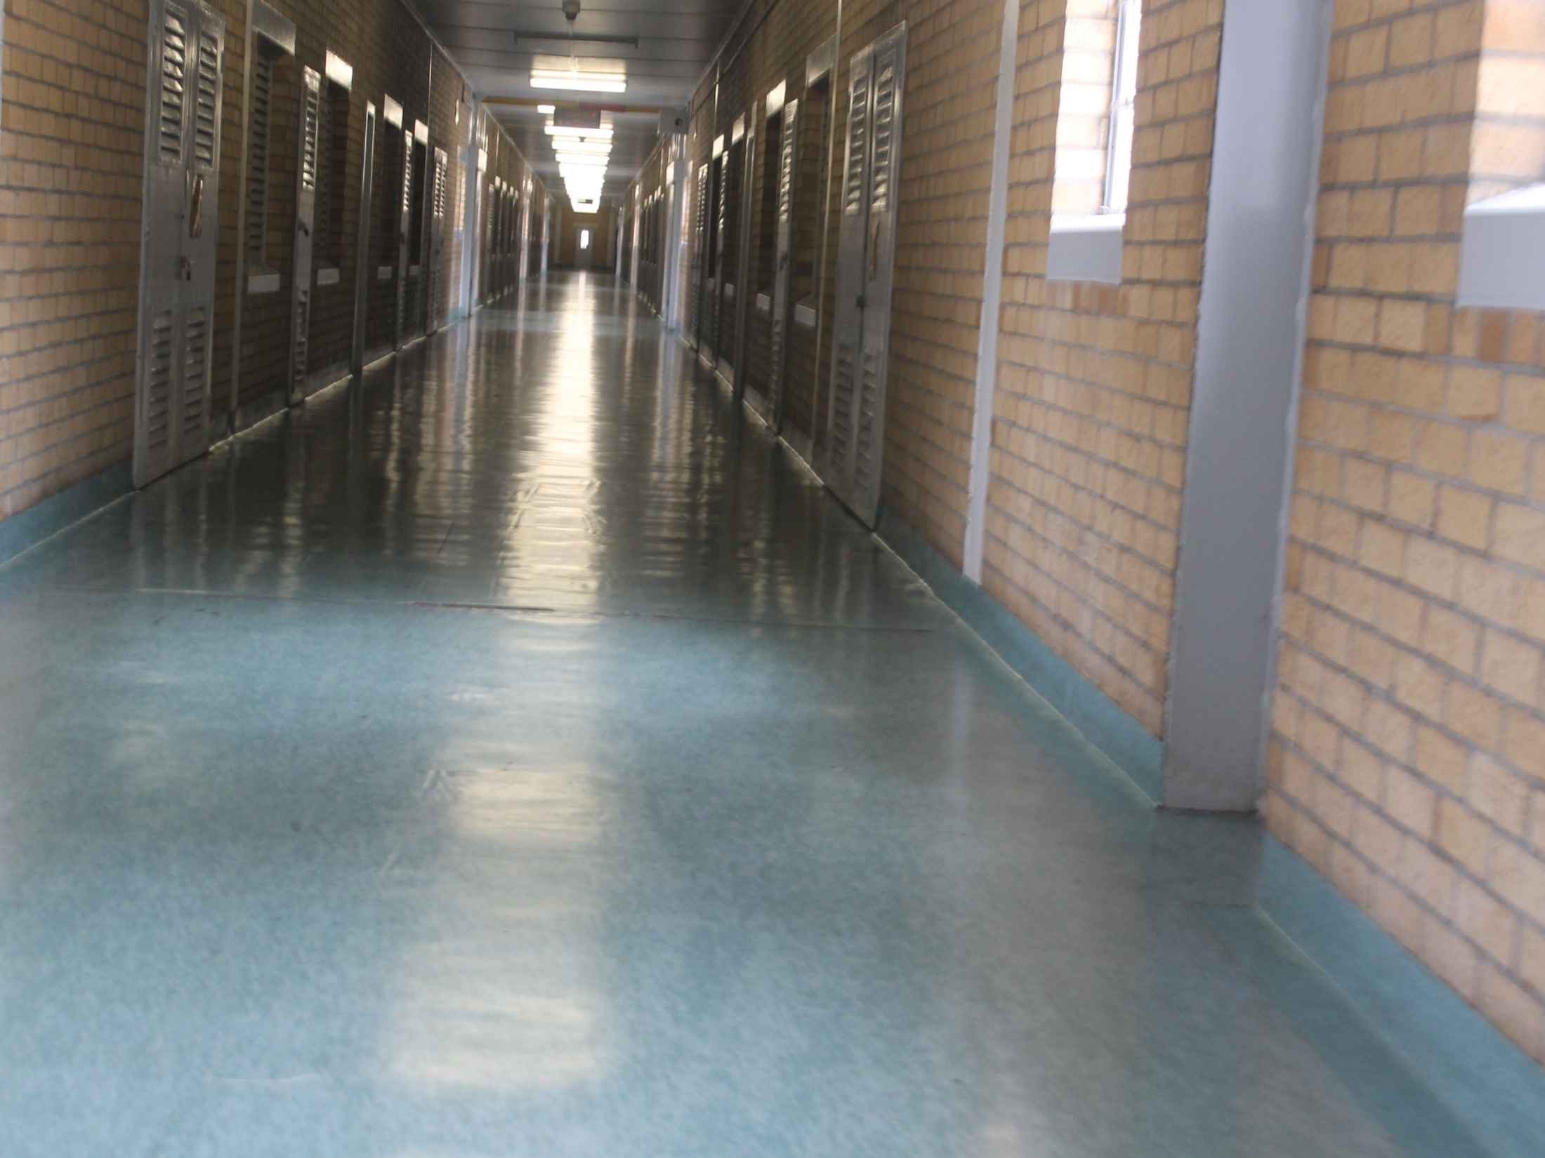

Slide 16
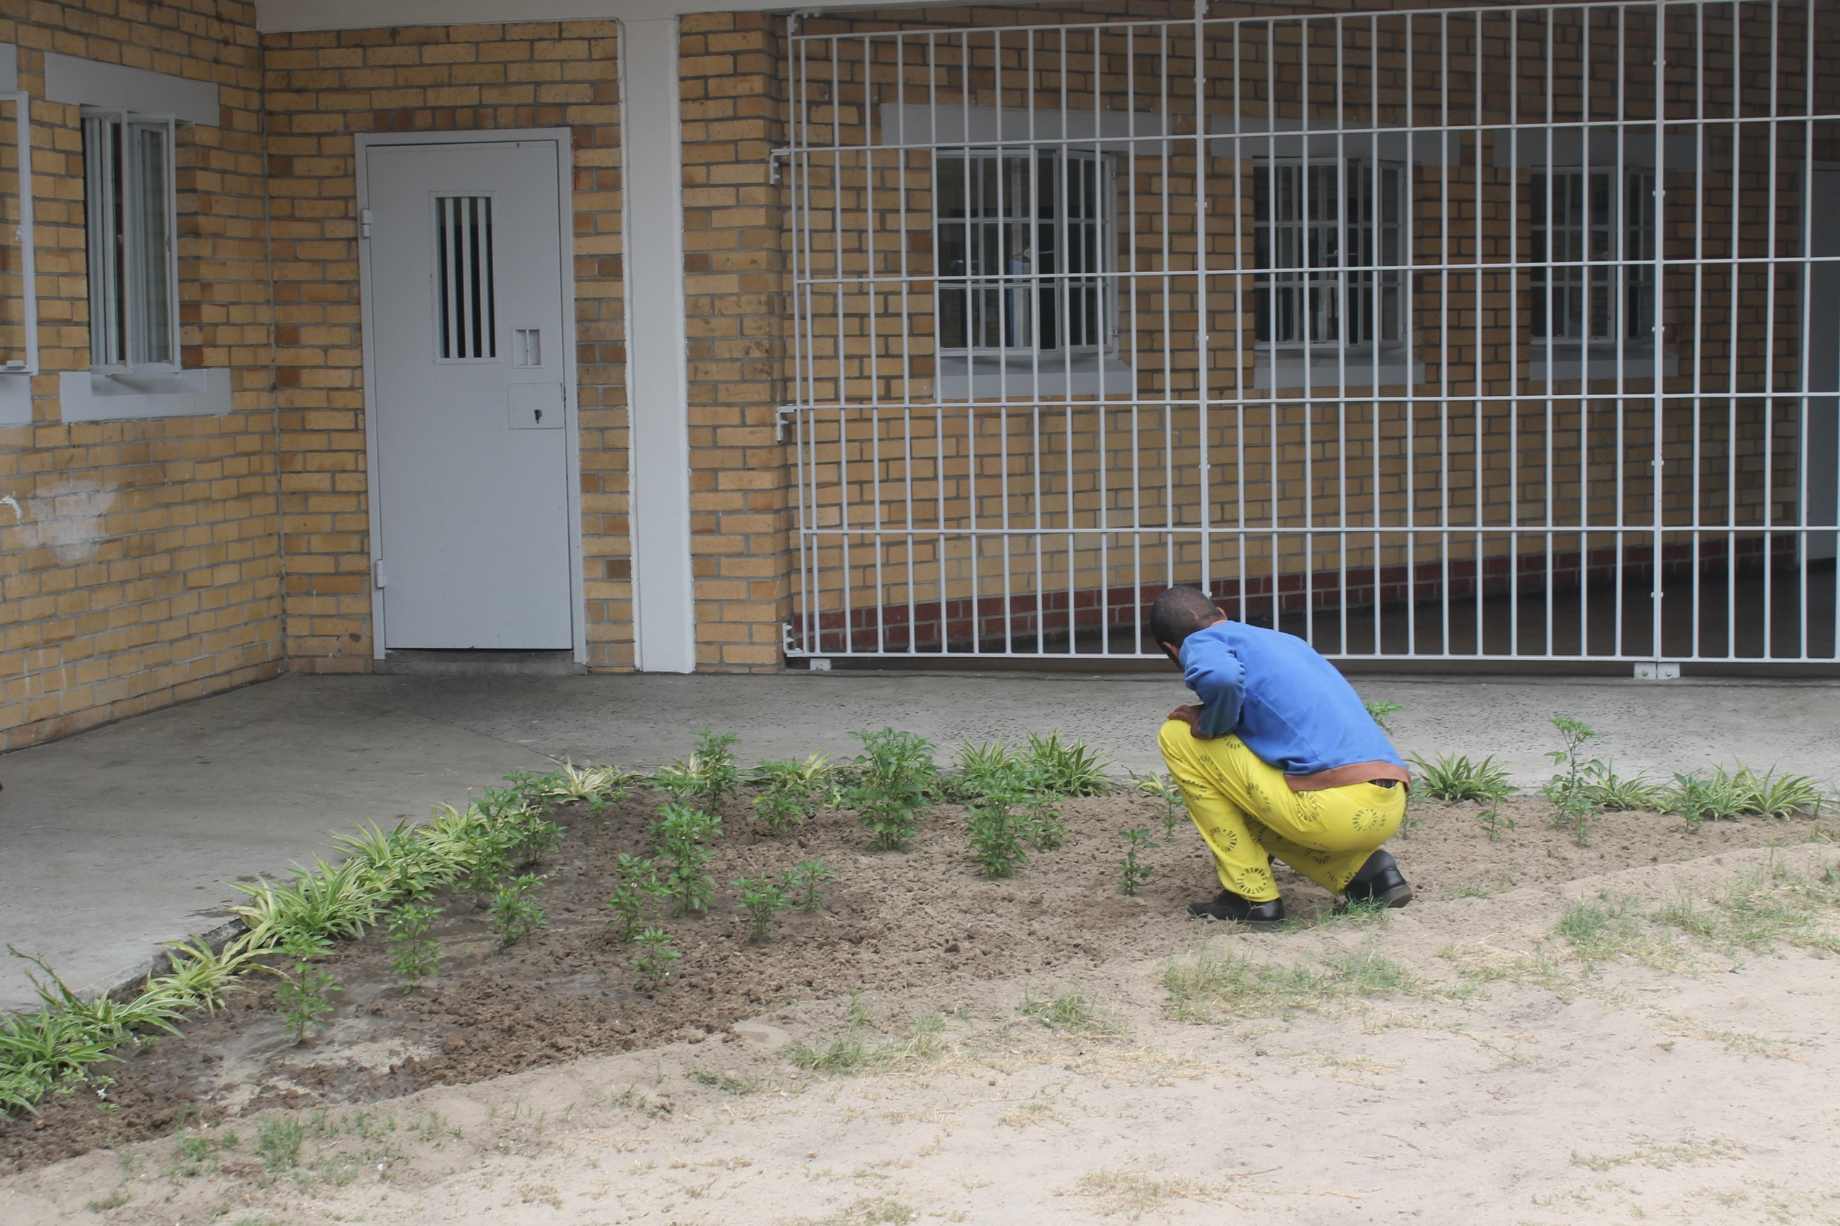

Slide 17
FINDINGS (OVERCROWDING)
South Africa still has the highest prison population in Africa and the 12th highest in the world, according to the World Prison Brief.
Judicial Inspectorate for Correctional Services

Slide 18
FINDINGS (OVERCROWDING)
Centres with the highest overcrowding in 2018/19
Region | Centre name | Approved capacity | Actual number of inmates | Overcrowding percentage
Gauteng | Johannesburg Medium B | 1 300 | 2 750 | 111%
 | Kgosi Mampuru II Female | 166 | 282 | 72%
 | Modderbee | 2 492 | 4 213 | 58%
Western Cape | Pollsmoor Medium A | 1 111 | 2 471 | 122%
 | Pollsmoor Medium B | 437 | 1 686 | 286%
 | Knysna | 179 | 401 | 124%
KwaZulu Natal | Kokstad Medium B | 340 | 615 | 81%
 | Port Shepstone | 150 | 275 | 83%
 | Waterval Medium A | 603 | 1 055 | 75%
Eastern Cape | Flagstaff | 37 | 90 | 143%
 | Lusikisiki | 109 | 293 | 169%
 | Mount Frere | 32 | 93 | 191%
LMN Region | Polokwane | 557 | 1 717 | 208%
 | Potchefstroom | 1 929 | 867 | 122%
 | Makado | 614 | 324 | 90%
Judicial Inspectorate for Correctional Services

Slide 19
INVESTIGATIONS
Judicial Inspectorate for Correctional Services

Slide 20
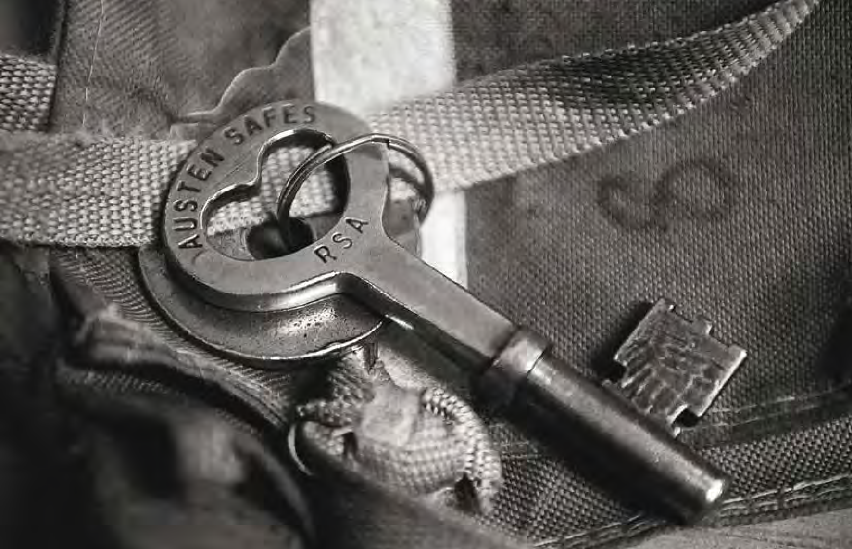
MANDATORY REPORTING & MANAGEMENT INFORMATION SYSTEMS
Judicial Inspectorate for Correctional Services

Slide 21
DEATHS
Judicial Inspectorate for Correctional Services

Slide 22
Detail on unnatural deaths
A closer look at the causes of unnatural deaths, however, reveals that, in most cases, the deaths were reported as “unknown other” for the past financial year. All deaths where the cause is not immediately apparent (e.g. a seemingly healthy inmate collapses and dies suddenly or is found dead in his bed) are classified as “unnatural other”. This is a temporary classification and the cause of death is officially determined once the autopsy report is received. The backlog by the department of Health (DoH) of autopsy and other scientific reports, for up to five years in some provinces, is a perennial problem.
Judicial Inspectorate for Correctional Services

Slide 23
Judicial Inspectorate for Correctional Services

Slide 24
MECHANICAL RESTRAINTS
The use of mechanical restraints is regulated by section 31 of the CSA. The dysfunctionality of the electronic reporting system was also evident in the obvious underreporting by DCS. A comparison on the number of reports on mechanical restraints received over the past five years shows the steady decline in reporting from DCS.
Judicial Inspectorate for Correctional Services

Slide 25
SEGREGATIONS
In terms of section 30 (7) of the CSA, any inmate who is subject to segregation may refer the matter to the IJ, who must decide thereon within 72 hours of the receipt. JICS’ rulings in these matters are often complicated and rest on technical considerations.
On cases where JICS finds out that DCS did not follow their own procedures as set out in the CSA. The inmate’s appeal becomes successful.
Judicial Inspectorate for Correctional Services

Slide 26
SEGREGATIONS cont….
In previous years, DCS reported on about 10 000 segregations each year. It seems, therefore, that only around 10% of all segregations are currently reported to JICS.
Judicial Inspectorate for Correctional Services

Slide 27
USE OF FORCE
It is important to note that section 32 of the CSA
permits and regulates the use of force by DCS officials. Minimum force can be used for self defence, for the defence of another person, to prevent an inmate from escaping, and for the
protection of property.
The dysfunctionality of the JICS electronic reporting system was again evident in the obvious underreporting by DCS as illustrated on the next graph.
Judicial Inspectorate for Correctional Services

Slide 28
USE OF FORCE cont….
Judicial Inspectorate for Correctional Services

Slide 29
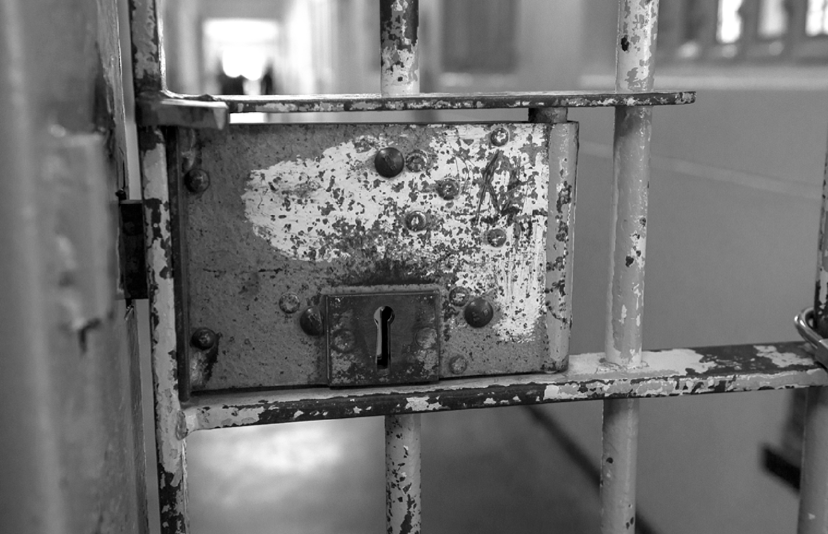
COMPLAINTS
Judicial Inspectorate for Correctional Services

Slide 30
Complaints
section 90(2) of the Correctional Service Act states that JICS should deal with complaints of inmates on its own volition or from other organs, including from Independent Correctional Centre Visitor Committees and individual ICCV’s in urgent matters. The number of complaints fluctuates per financial year as illustrated below:
Judicial Inspectorate for Correctional Services

Slide 31
Complaints
The graph on the next slide highlights an obvious drop in violent complaints in the correctional facilities due to the dysfunctional Management Information System. Although JICS developed a manual flow of information from the centres to the JICS office there are still discrepancies on the reporting.
Judicial Inspectorate for Correctional Services

Slide 32
Judicial Inspectorate for Correctional Services

Slide 33
FINDINGS AND RECOMMENDATIONS BY JICS ON COMPLAINTS
JICS findings and recommendations were made in different matters. The process of evaluating the merits of complaints and crafting findings and recommendations is achieved by abiding to the following principles and
legislation:
An understanding of the merits of each case.
A determination and application of the legal principles involved by consulting the Constitution, the CSA and other relevant legislation.
Taking relevant international instruments into consideration.
Judicial Inspectorate for Correctional Services

Slide 34
FINDINGS AND RECOMMENDATIONS BY JICS ON COMPLAINTS
Coming to a logical conclusion and making feasible recommendations.
One of the key considerations is if DCS officials followed their own policies and work procedures when they dealt with an inmate’s complaint. It must be borne in mind that JICS does not resolve inmates’ complaints; rather it monitors the way in which DCS deals with, and resolves these complaints.
Most of the complaints are resolved at Centre level. In cases where the complaints are not resolved at a centre level Visitors Committees are established and complaints are referred thereto.
Judicial Inspectorate for Correctional Services

Slide 35
Stakeholder Engagement and Visitors Committee
Judicial Inspectorate for Correctional Services

Slide 36
Visitors Committee
There were 56 Visitors Committee (VC) seats established all around the country in the previous 3 years in accordance to section 94(1&2) of the CSA, however JICS has decreased the number of VC seats to 36 by clustering centres that are closer together in one VC meeting.
However there were a few challenges:
Judicial Inspectorate for Correctional Services

Slide 37
Visitors Committee cont…..
Unavailability HCC to attend.
Stakeholder not attending the VC meetings.
Recommendations of the VC not implemented.
Complaints not being followed through by stakeholders.
Judicial Inspectorate for Correctional Services

Slide 38
Stakeholder engagement.
Since 2016 JICS has engaged numerous stakeholders through Seminars on specific themes and hosted the events on Correctional Facilities:
2016: Seminar on Overcrowding
2017: Seminar on security and treatment of inmates.
2018: Seminar on Mentally ill and state patients.
2019: Seminar on Death in Correctional facilities.
This have increased stakeholder and media engagement with regards to correctional facilities in South Africa.
Judicial Inspectorate for Correctional Services

Slide 39

QUESTIONS
THANK
YOU

