Slide 1
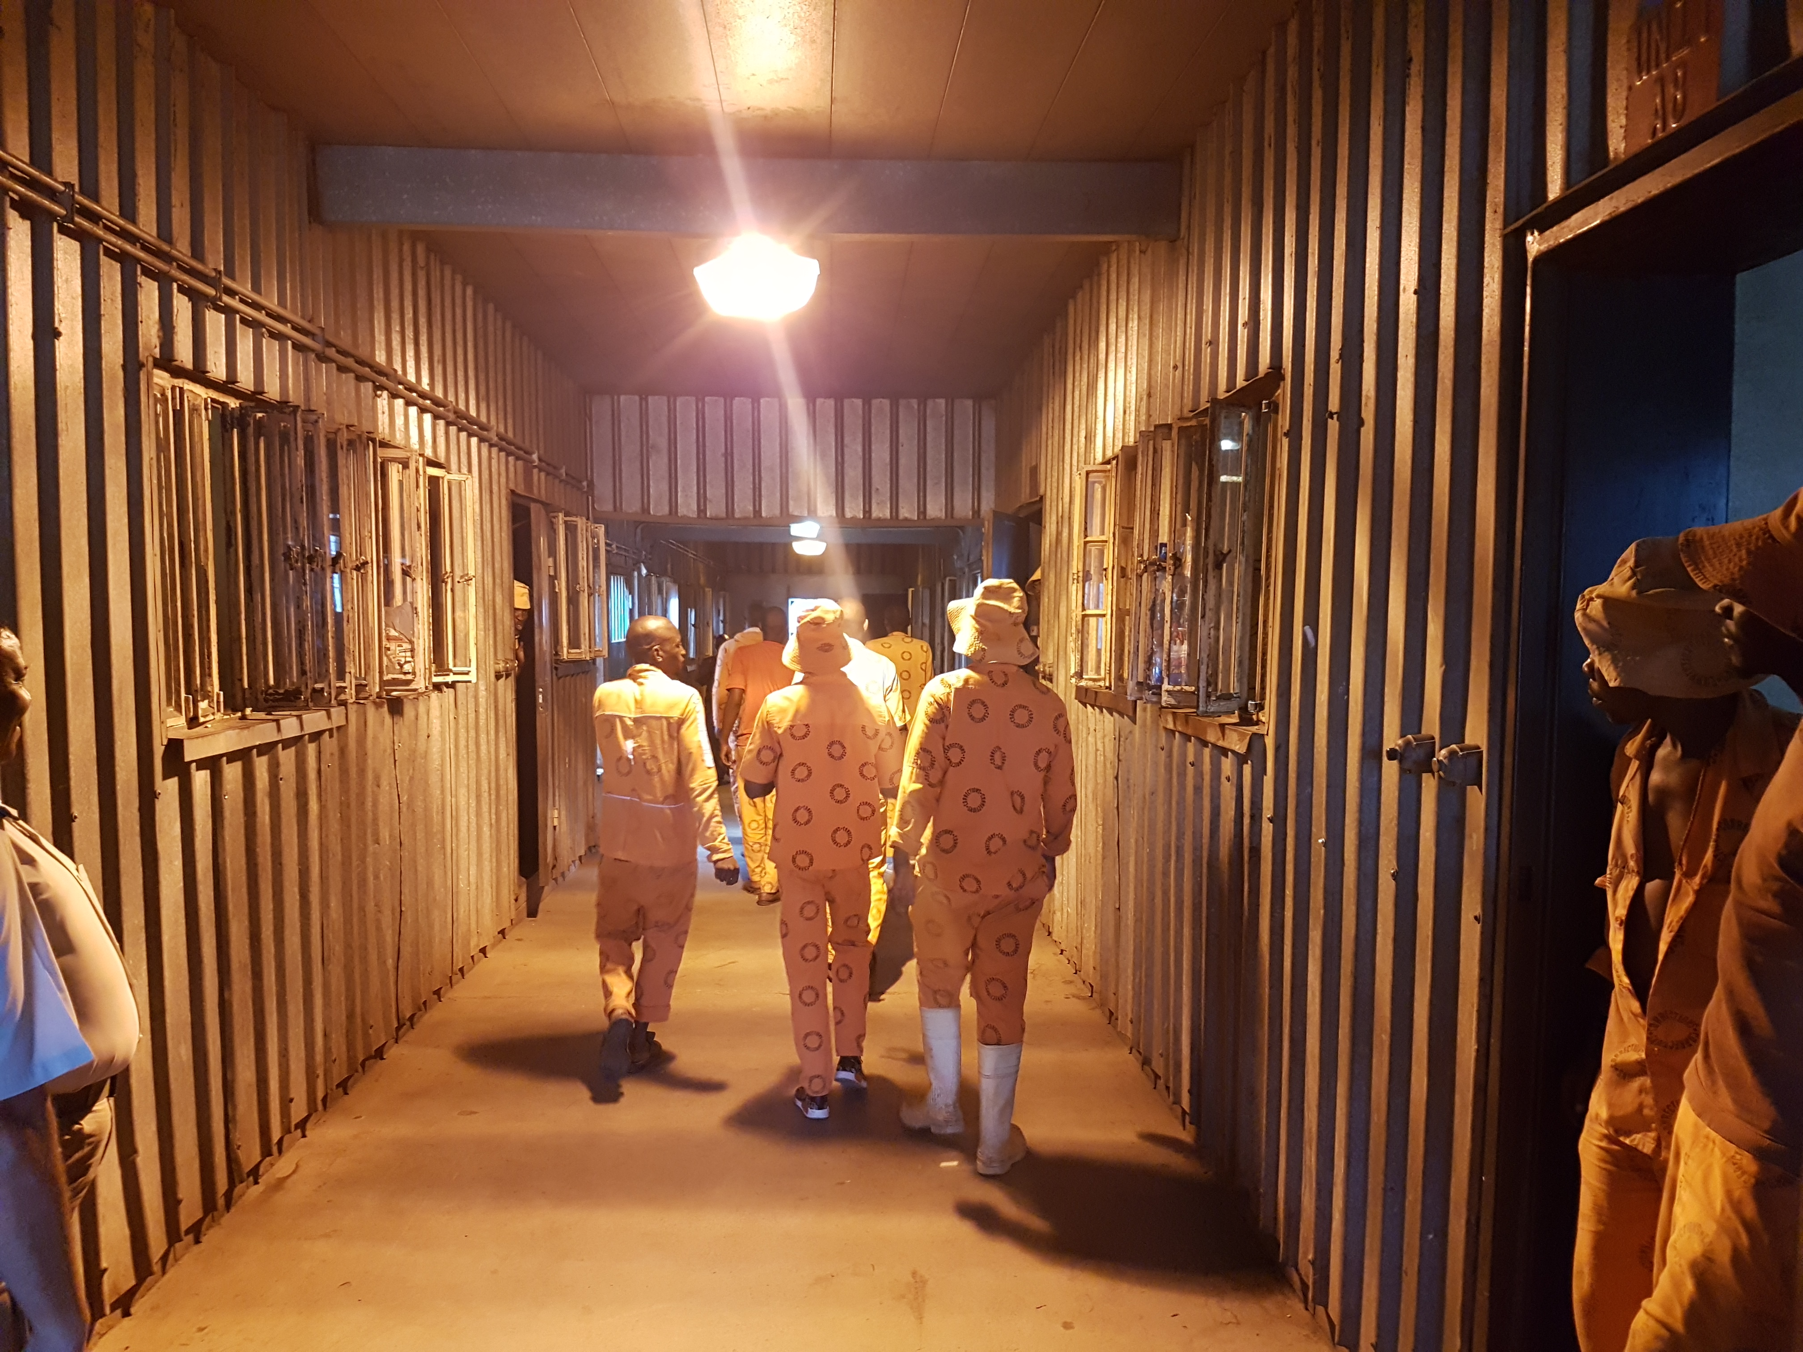
Judicial Inspectorate for Correctional Services (JICS) Summary of findings on DCS and way forward by Mr. Mike Masondo Director: Management Regions

Slide 2
SUMMARY OF GENERAL FINDINGS ON CORRECTIONAL SERVICES
Dysfunctional Management Information System (MIS)
Officials unlawfully segregating and mechanically restraining inmates.
Excessive use of force by DCS on inmates.
Challenges with water and electricity supply in correctional centres in the rural areas. In some centres the challenge is cause by municipal service delivery challenges or disruption. i.e Barkley East CC in 2017/18 FY.
More professional staff are required in correctional centres i.e. Doctors, Nurses, Educators.
Judicial Inspectorate for Correctional Services

Slide 3
SUMMARY OF FINDINGS ON CORRECTIONAL SERVICES
No connectivity due to lack of IT cabling is a challenge in other centres.
The layout of the building makes it difficult to separate remand detainees from sentenced inmates. i.e. De Aar CC (2017/18 FY).
Shortage of DCS staff members in the correctional centres which result in rehabilitation programmes not being offered, i.e. Daily exercise, Three meals per day as per legislation.
High rates of suicides and attempted suicides in correctional centres.
Unnecessary complaints that can be handles in correctional centres escalated with IJ while the head of centre can resolve them. i.e. Need of clothes and shoes.
Judicial Inspectorate for Correctional Services

Slide 4
SUMMARY OF FINDINGS ON CORRECTIONAL SERVICES
State patients not being moves into mental hospitals.
High rate of gang violence in the Western cape, Gauteng and KZN.
Overcrowding of correctional centres.
Prolonged finalisation of autopsy reports with regards to unnatural deaths
Judicial Inspectorate for Correctional Services

Slide 5
WAYFOWARD
GITO to assist in the expediting lack of connectivity for JICS and correctional centres.
DCS officials to be trained on procedure of use of force and mechanical restraints, official guilty of unlawfully restraining or segregating inmates to undergo disciplinary proceedings (policy provisions).
DCS to comply with the three meal system according to the Act.
Public Works to assist to provide backup systems to assist the correctional facilities with water and electricity.
Judicial Inspectorate for Correctional Services

Slide 6
WAYFOWARD
5. DCS to engage other departments to assist in capacitating centres with professional staff. i.e to have MoU/MoA with other departments.
DCS to engage with DPW with the necessary infrastructure to separate remand detainees.
DCS to recruit more staff member and provide training.
DCS to frequently visit inmates who are segregated. Restrain from issuing of bulk medication to inmates without monitoring.
Head of centre to play an active role in complaints handling.
Judicial Inspectorate for Correctional Services

Slide 7
WAYFOWARD
DCS should engage DoH to expedite the allocation of beds in mental institutions. Head of centre should implement section 49(e) and 79 with regards with state patients, where they can apply to the courts and medical parole.
DCS to effectively execute the Gang violence strategy.
DCS to use develop strategies that might help in reducing the inmate populations.
DCS to do regular follow ups with DoH to ensure that the waiting period for the autopsy reports are reduced.
Judicial Inspectorate for Correctional Services

Slide 8
INTERVENTIONS REQUIRED BY JICS
Ministry to intervene on the Business Case for JICS independence.
Office space/accommodation for JICS is an urgent need.
Financial support and personnel increase.
MIS that is owned by JICS
Judicial Inspectorate for Correctional Services

Slide 9
QUESTIONS
THANK
YOU

