Slide 1


Presentation on
DCS 2nd Quarter Actual Performance Report (2016/2017)
November 2016
2019 STRATEGIC PLANNING SESSION
Update on Phase II of the OMF
14-16 August 2019

Slide 2
Update on Phase II of the Operations Management Frameworks as at August 2019
PURPOSE

Slide 3
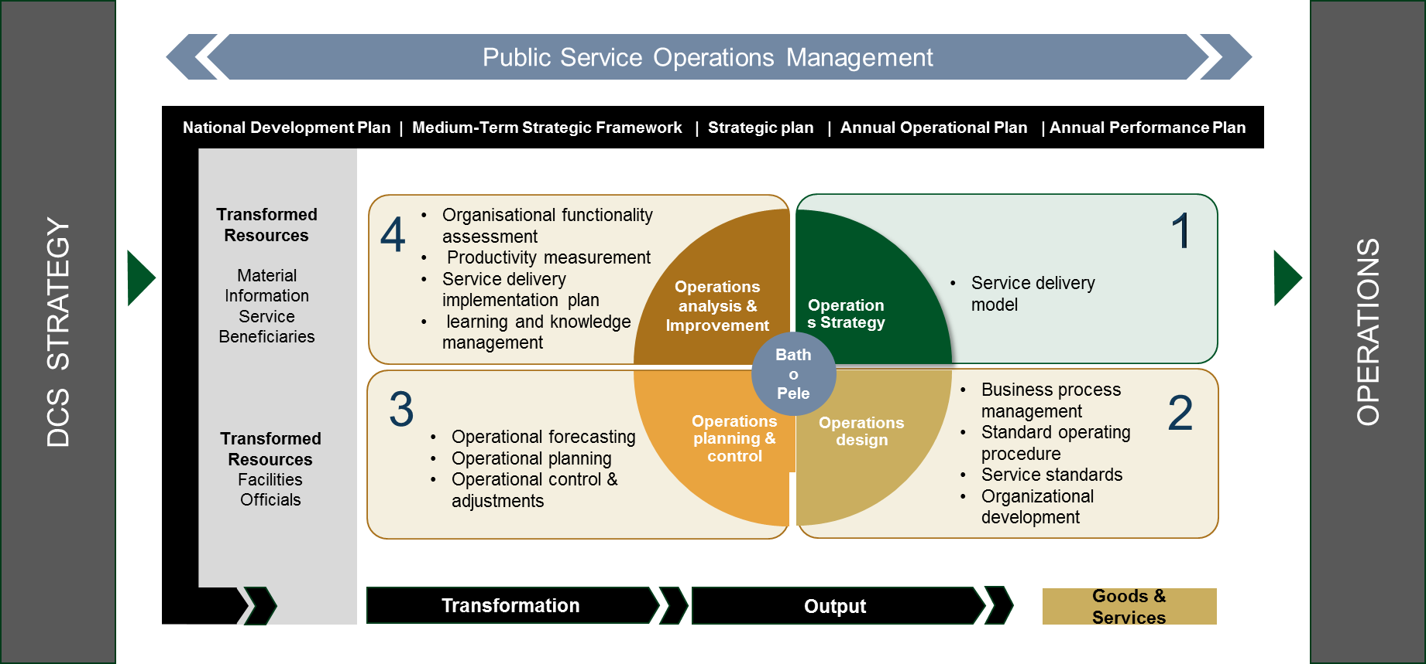
The Public Service Operations Management Framework outlines the process for the development of the SDM within the Public Sector…

Slide 4
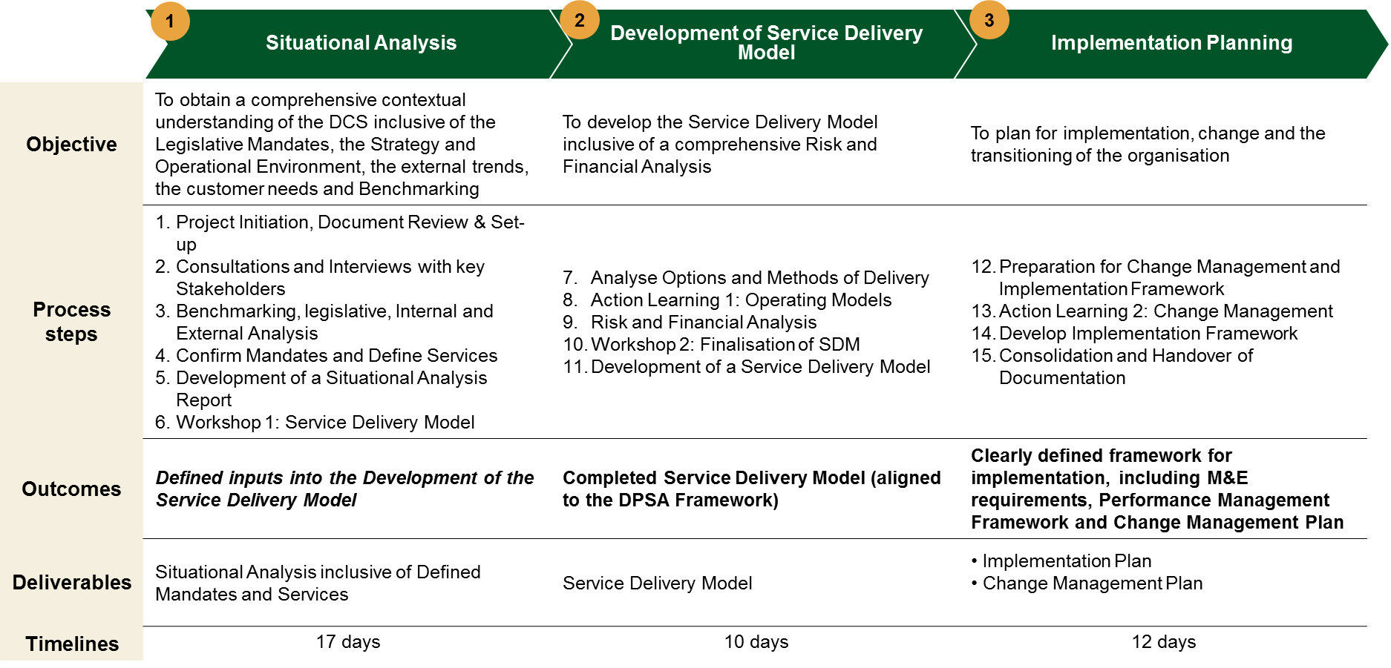
Through a rigorous process, the current value chain was vetted in consideration of current challenges & key strategic shifts…

Slide 5
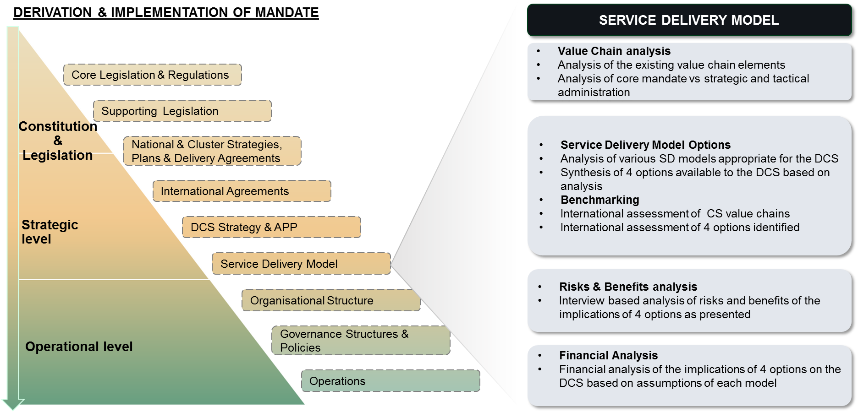
…to drive towards a robust service delivery model – clear in mandate and execution

Slide 6
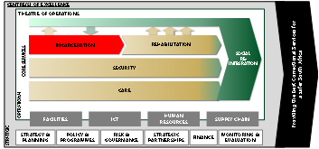
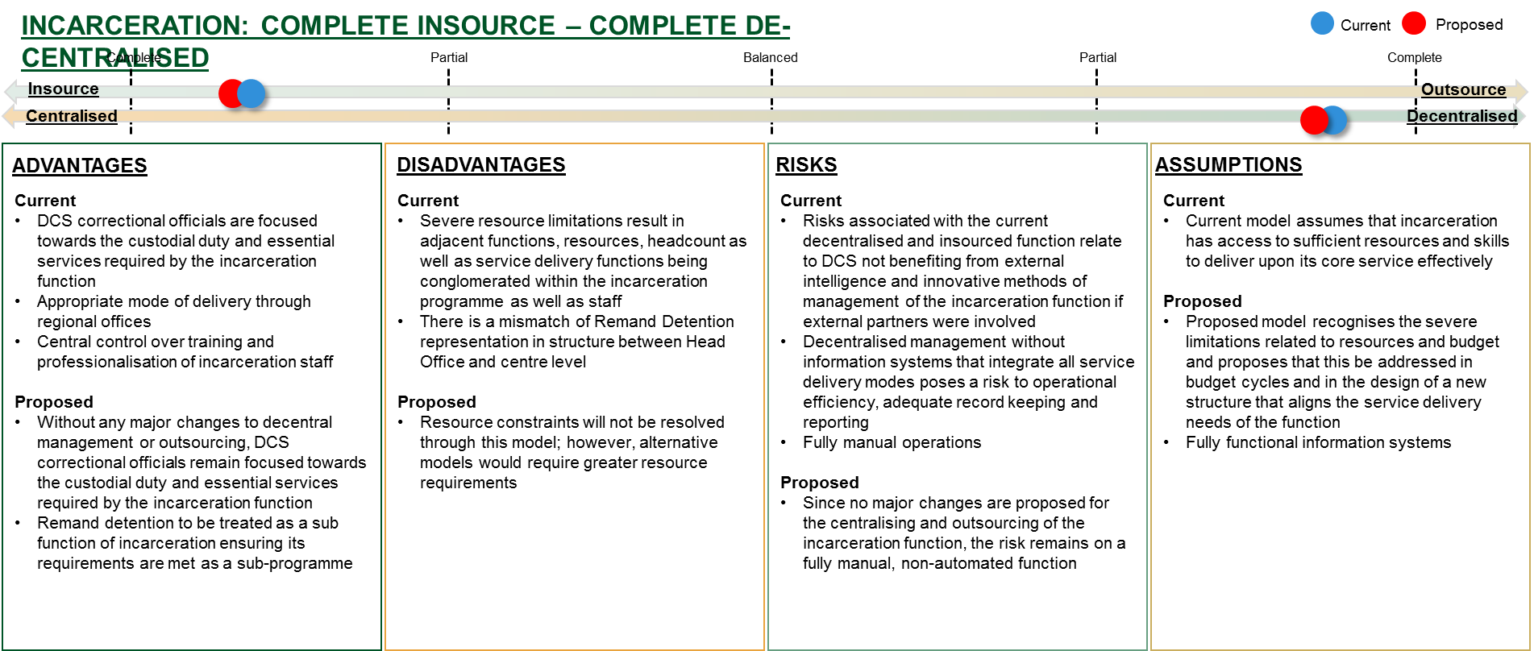
The Incarceration function is decentralised and insourced and there is a strong rationale for it to remain as such…

Slide 7
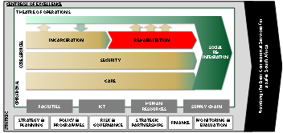
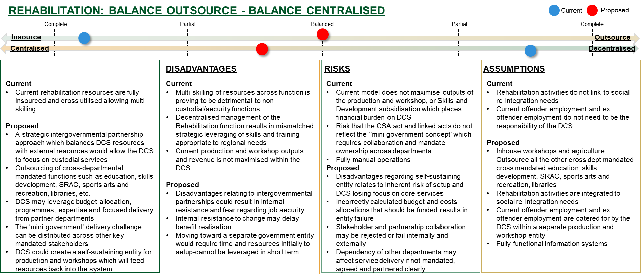
The Rehabilitation function should be balanced in terms of partnering and more centralised in management and setup…

Slide 8
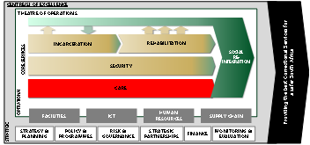
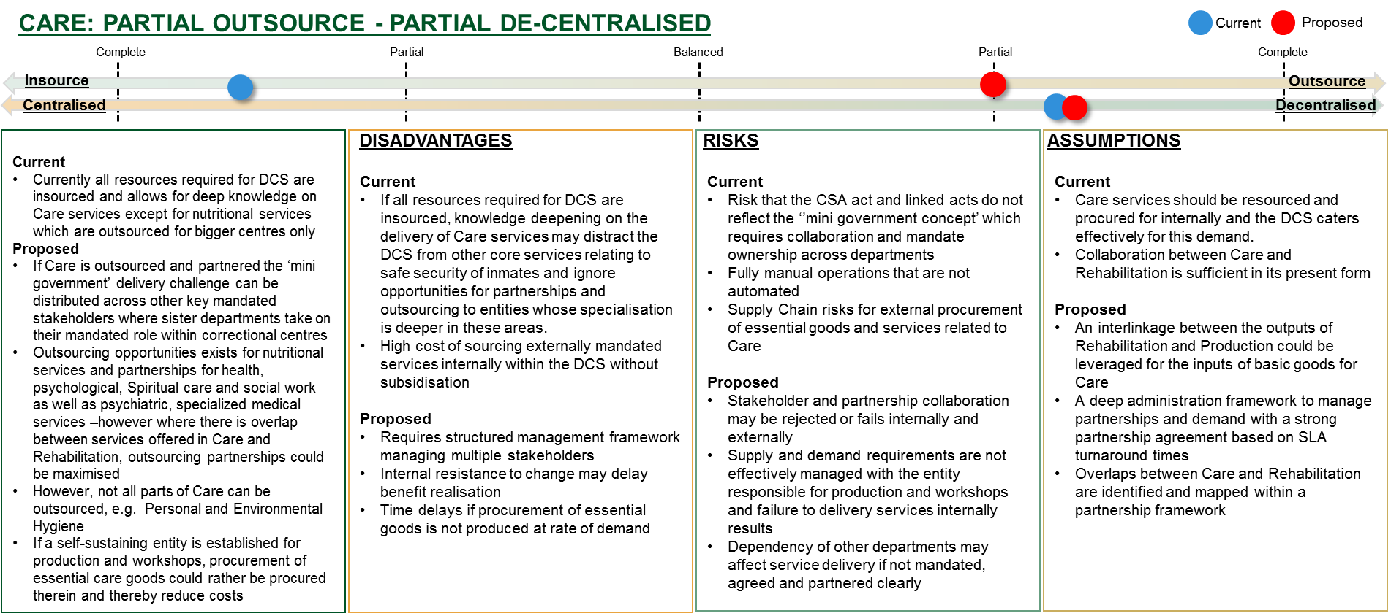
Care would require no change on its decentralised management, but would seek to partner more strategically

Slide 9
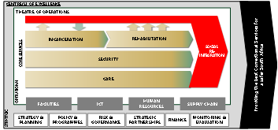
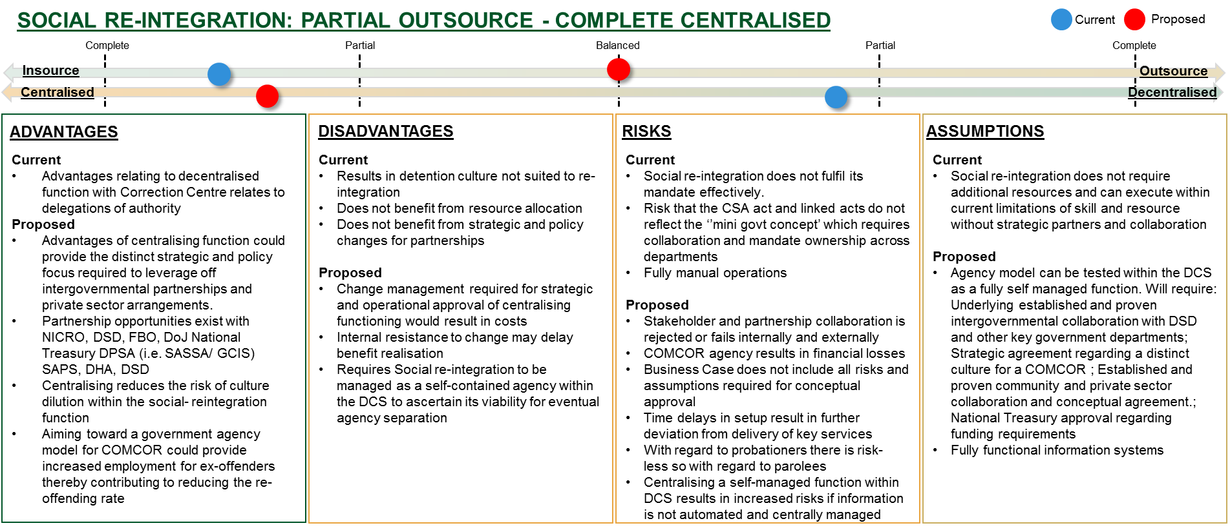
Social re-integration would balance its partnerships and seek to centralise its management – to strategically manage its delivery…

Slide 10
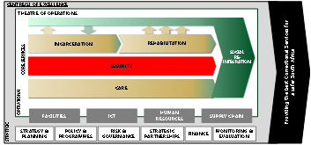
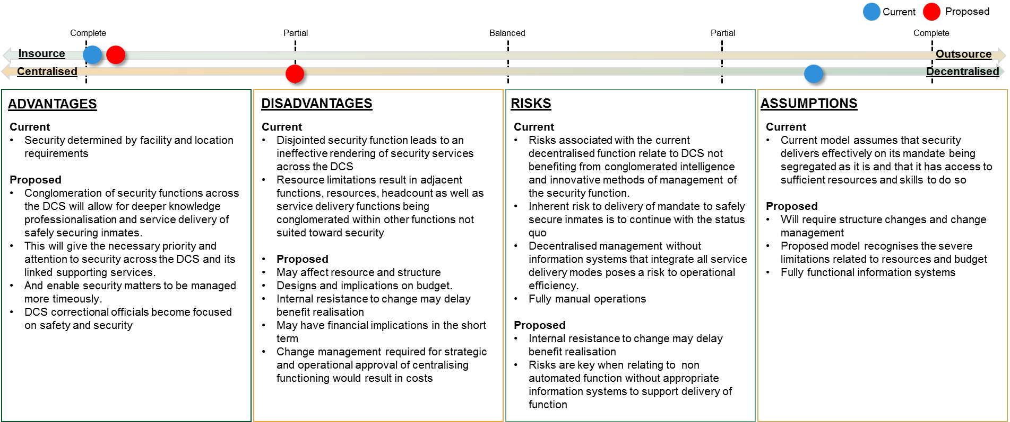
Security across the DCS should be centralised, conglomerated and fully insourced…

Slide 11
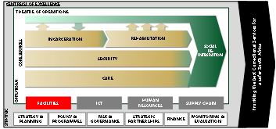
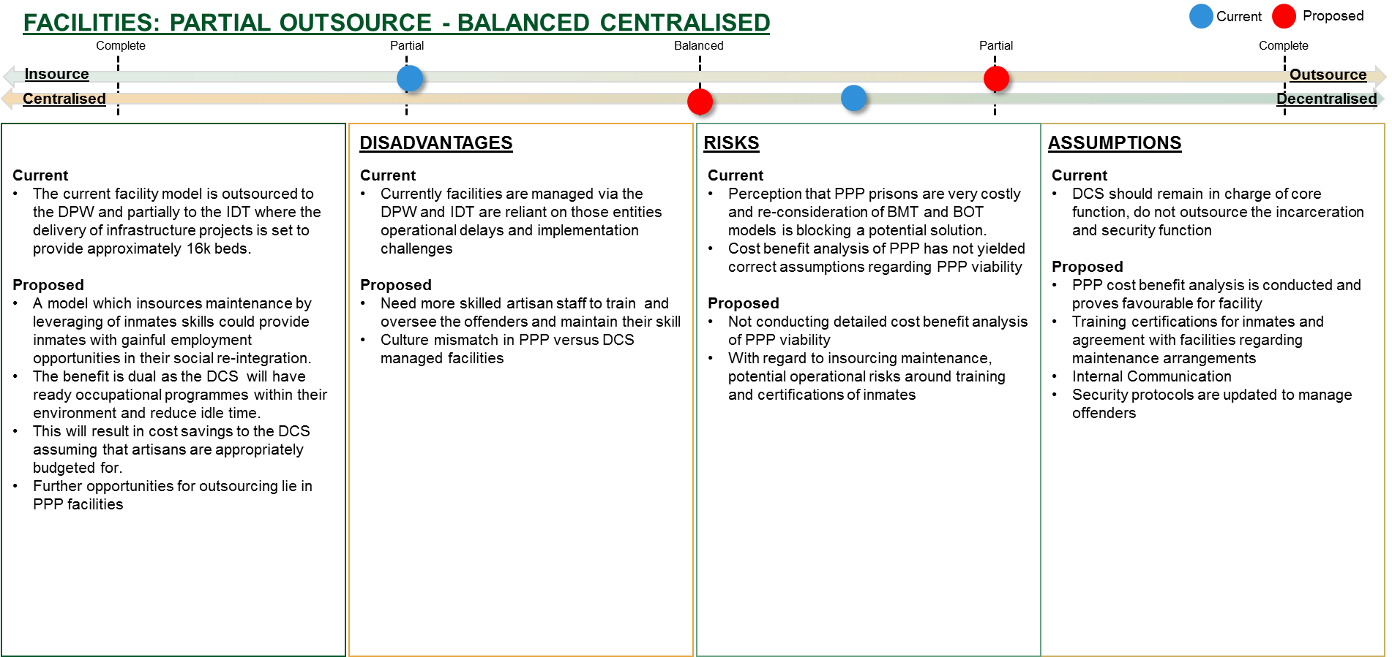
Facilities management must be centrally directed, leveraging off the regions for maintenance but outside partners for development…

Slide 12
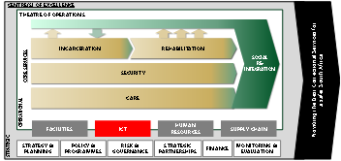
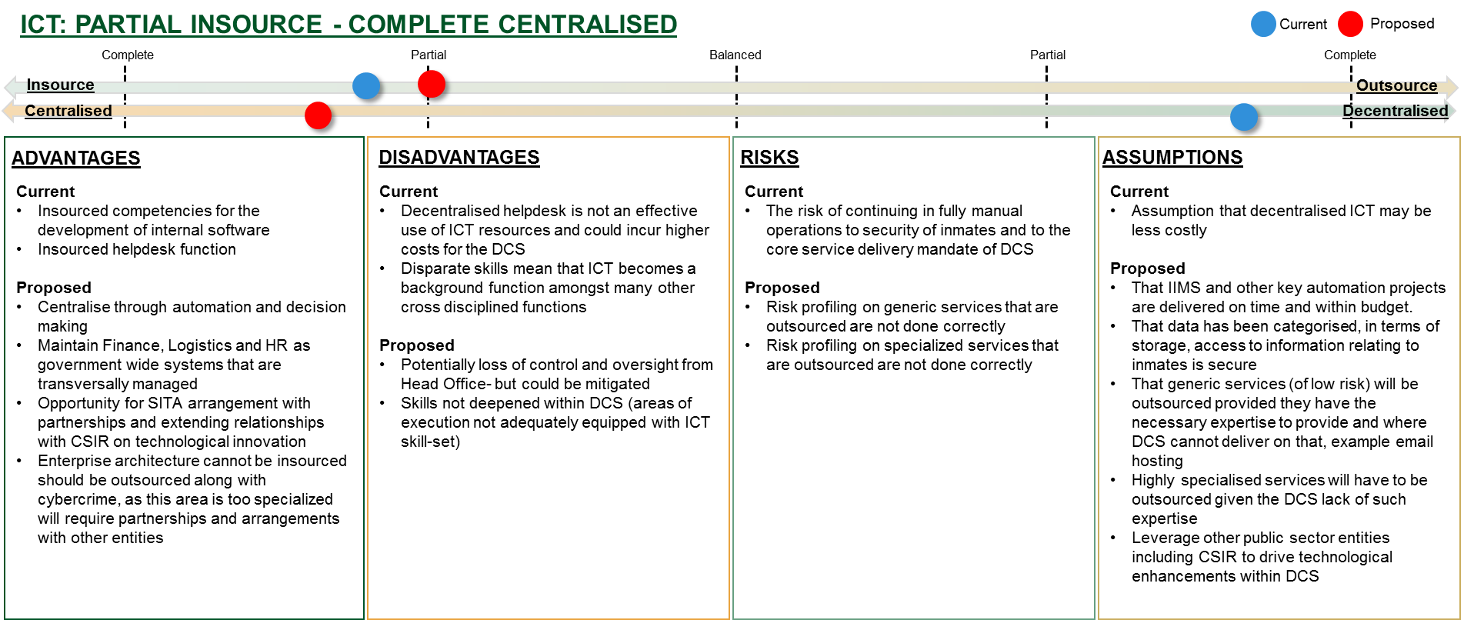
ICT should be fully centralised if key functions are automated, however more partnerships must be leveraged…

Slide 13
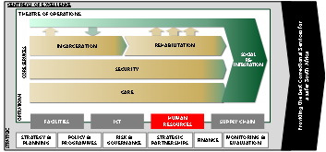
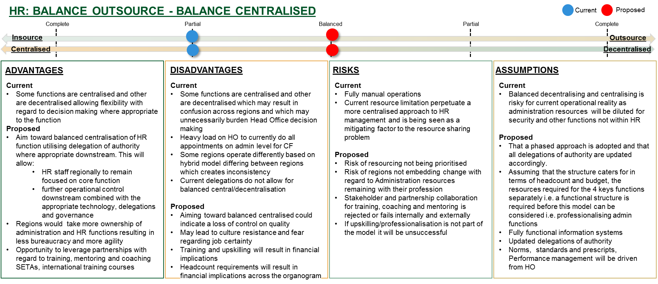
HR would require more balance of partnerships for training and skilling as well as decision making…

Slide 14
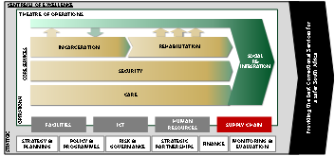
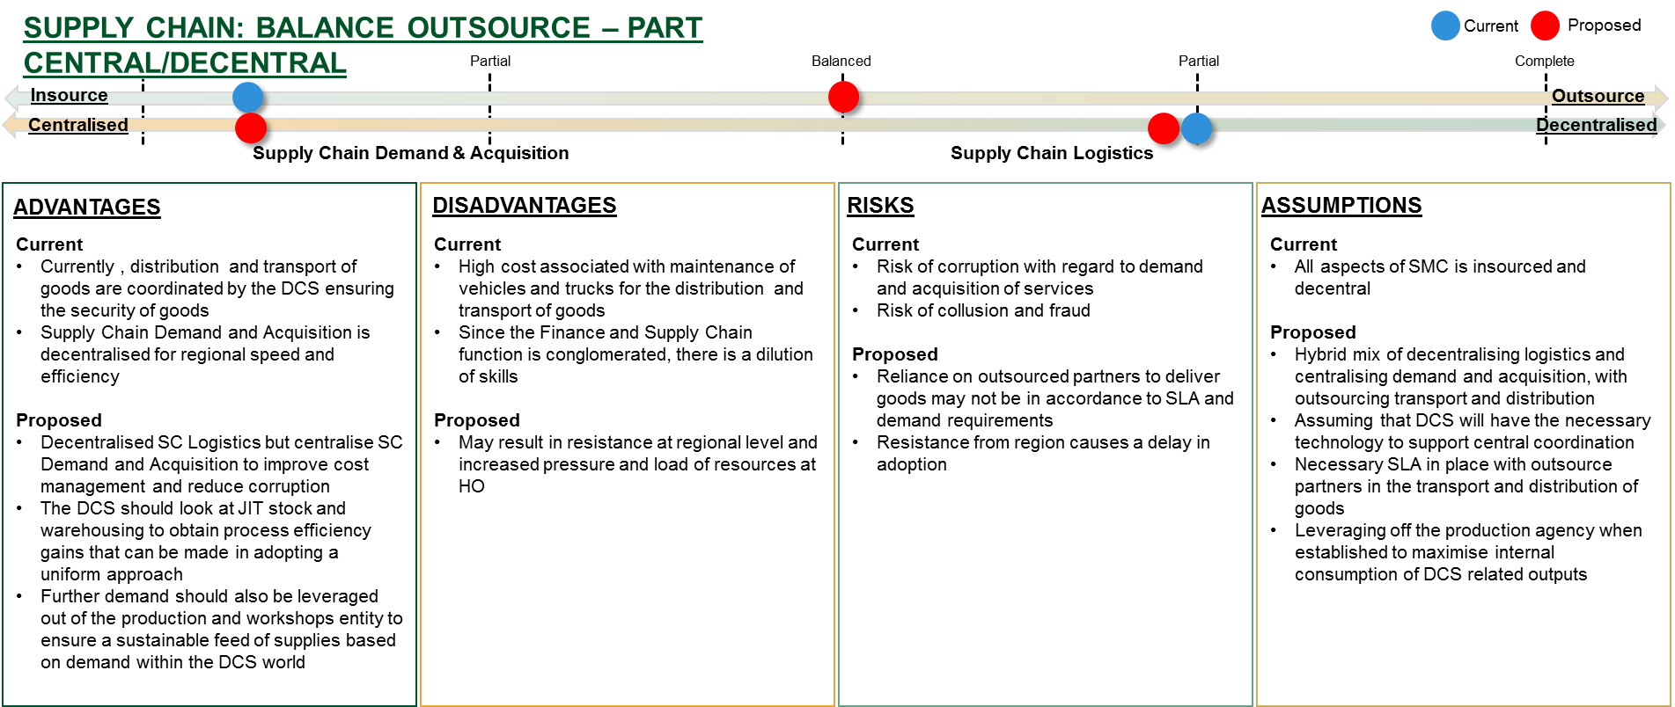
Supply Chain functions related to logistics are recommended to be outsourced and managed differently at regions…

Slide 15
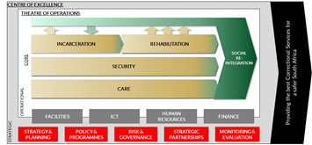
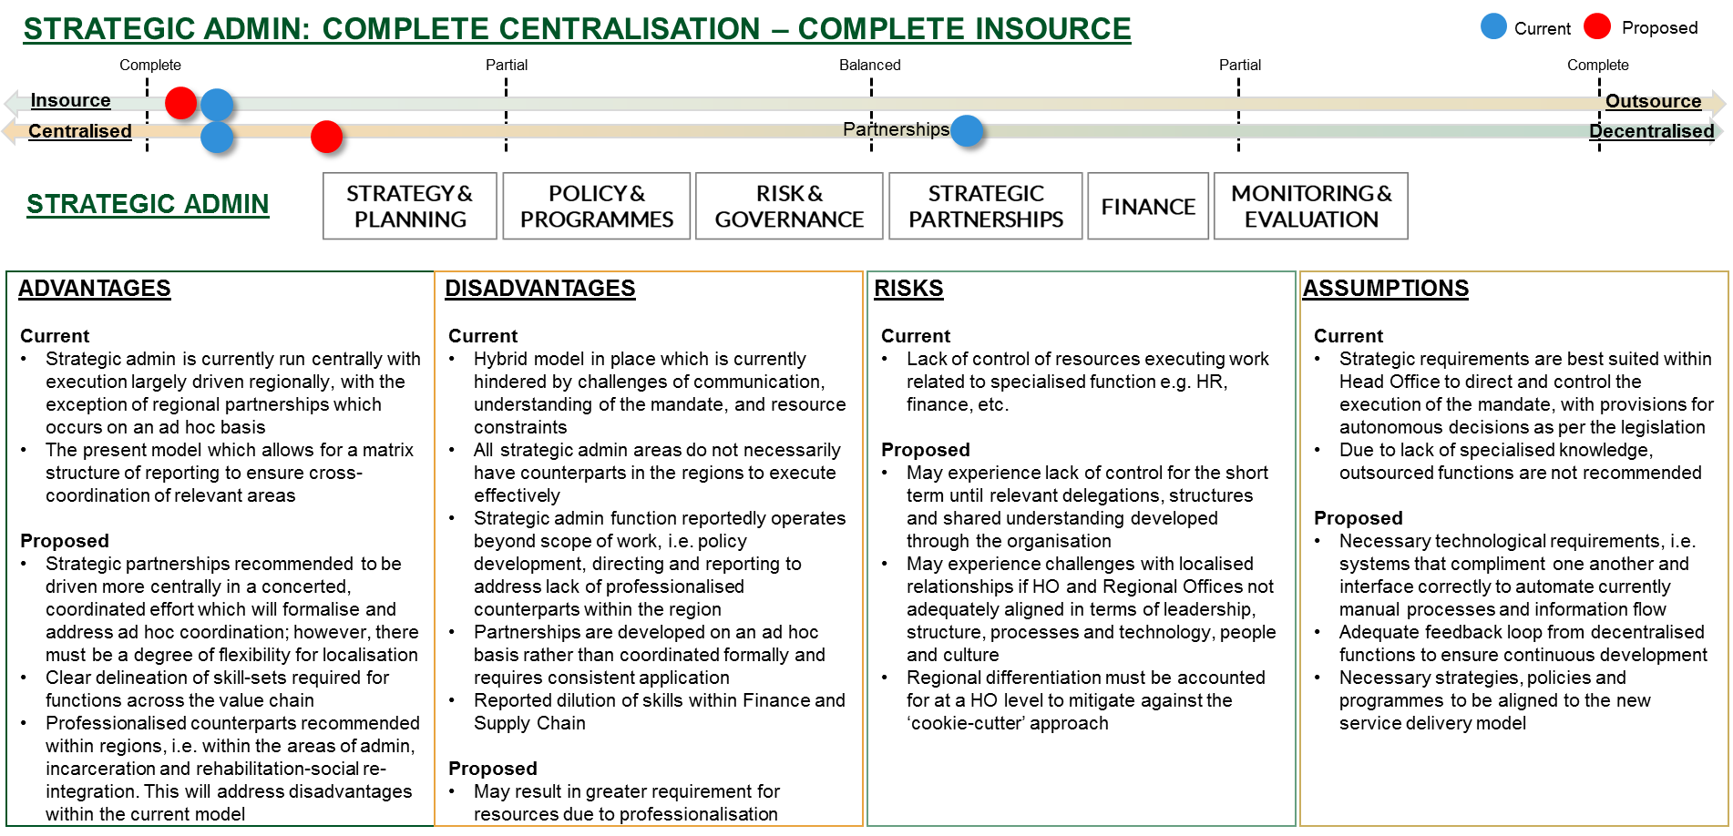
Strategic administration is recommended to elevate partnerships & M&E while remaining highly centralised and insourced, with some degree of flexibility for regional localisation…

Slide 16
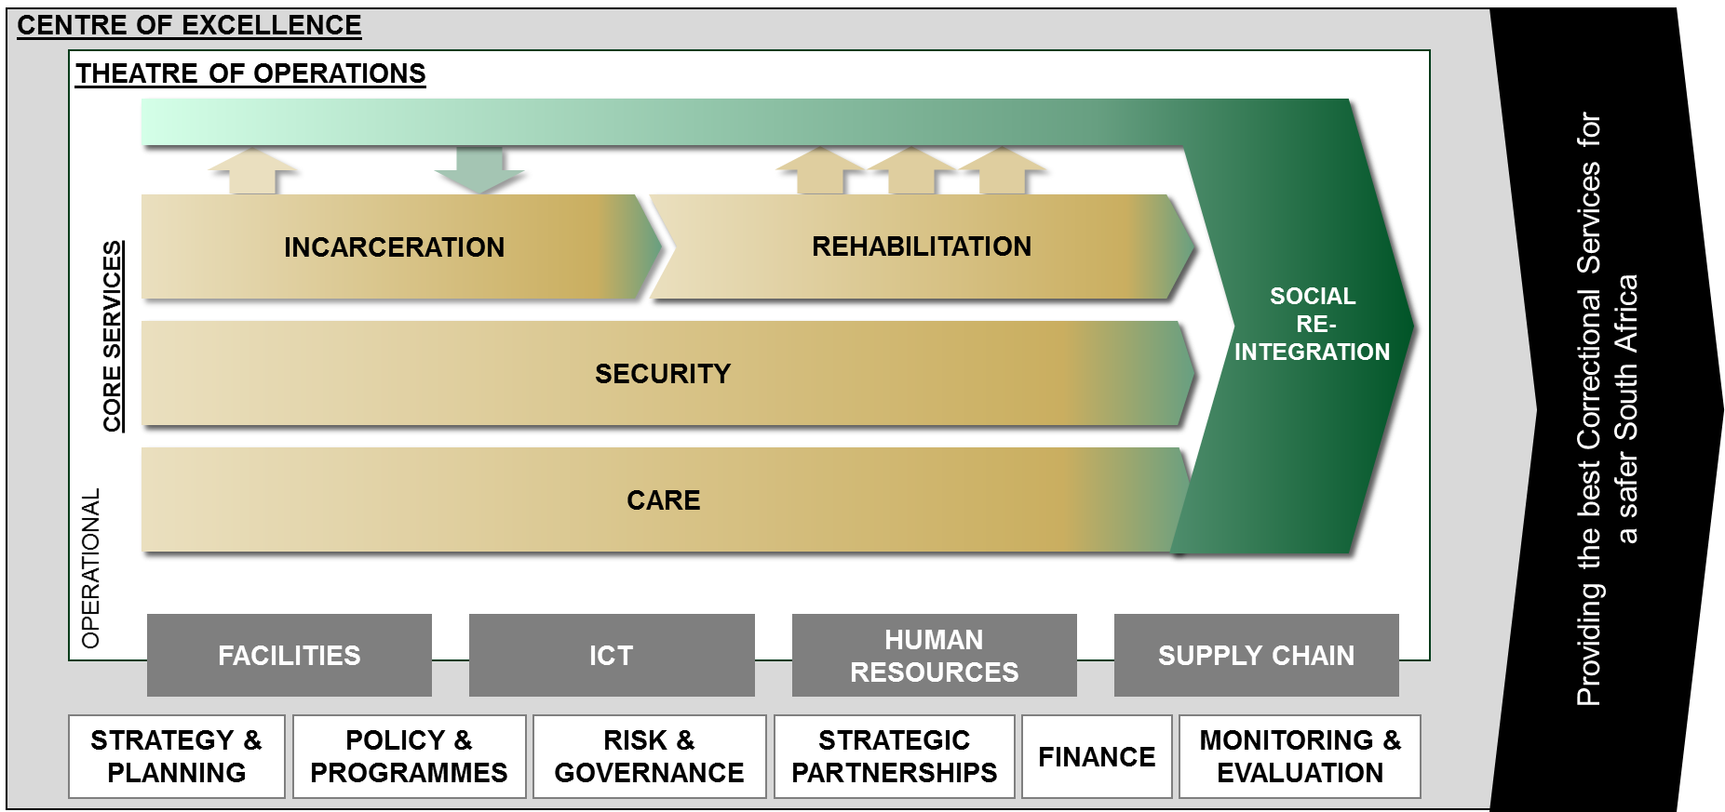
Insourcing, outsourcing, centralising and decentralising were then analysed within the value chain…
STRATEGIC

Slide 17
The Service Delivery Model was prepared in accordance with Public Service Regulations, Part 3, Section 36(a) and with the 2016 version of the Operations Management Framework (OMF).
A Task Team, consisting of SMS members from Head Office and Regions, was appointed in 2018/2019 to facilitate the development of the DCS Service Delivery model
The SDM was approved in June 2019.
Phase II (Operations Design) of the Operations Management Framework is currently in development by various work streams
A workshop held with Task Team Members at Leeuwkop Correctional Facility on 10 July 2019 to present the approved SDM (Phase I) and discuss the programme for of each work stream in Phase II.
In line with the resolutions of the Task Team meeting, Phase Two should be presented to the Regional Management Committees:
  Free State/ Northern Cape – 15 July 2019
  KwaZulu Natal – 29 July 2019
  Dates for the remaining four Regions still to be determined
The purpose of the engagement with Regional Management Committees is to inform the Regions of the approved SDM and obtain support for Phase II (which will be done at Centre Level)

Slide 18
Meetings held with work stream and sub work steam leaders:
  Work stream 2 leader (GITO) – 01 July 2019
  Change Management (Communications) – 08 July 2019
  Self Sufficiency (Finance, Rehabilitation) – April 2019
  Self Sufficiency Work stream leader and sub work stream leaders met on 01 August 2019
Work stream 2.1 BPM will be done at Gauteng and KZN and Work stream 2.2 BPM will be done at W Cape and LMN and Work stream 2.3 BPM will be done at E Cape and FS/NC.
Work stream 5 will be going to selected Agriculture and Production workshops

Slide 19
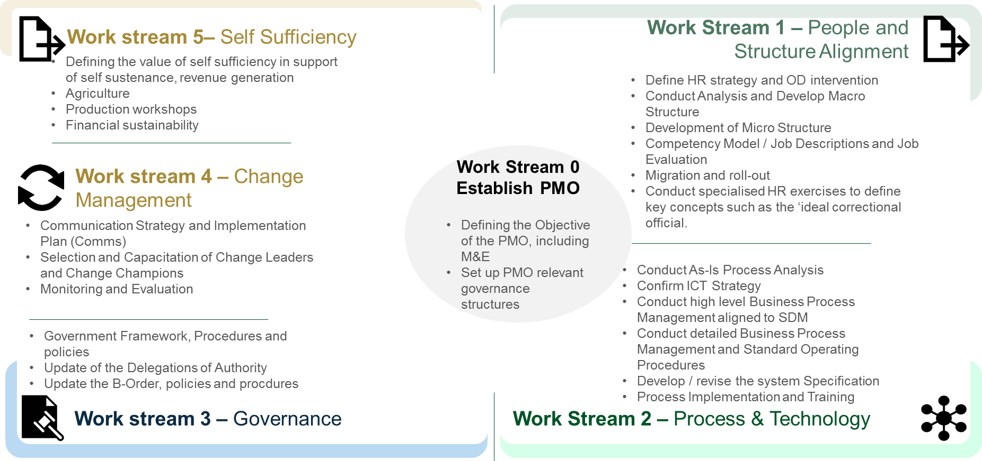
The following work streams were identified to drive the implementation of DCS SDM and Operations Management Framework Phase II (Operations Design)

Slide 20
PROJECT MANAGEMENT OFFICE
WORK-STREAM 0

Slide 21
On track
Risk of moderate delay
Risk of major delay/ risk of not delivering
Milestone Report – Deliverables (Establish PMO)
Work-Stream No 0 | Work-stream (0) Establish PMO
Work-Stream Leader | Dir: SDI: SKS Moukangwe
Project Manager | Dir: SKS Moukangwe
Project Leader | DC: A Naicker
Project Sponsor | CDC Strategy: J Katenga
Overall Status | 100%
Project duration | 24 months
Time lapsed | 0 months
Reporting period | Monthly update:
Prepared By | HPL Moruka
Milestone | Start Date | End Date | % Completed | Status | Corrective Actions
Define the objective of the PMO including M&E | 01/04/2019 | 15/04/2019 | 100% |  | N/A
Milestone | Start Date | End Date | % Completed | Status | Corrective Actions
Set up PMO relevant governance structures | 20/04/2019 | 30/09/2019 | 100% |  | N/A
Milestone | Start Date | End Date | % Completed | Status | Corrective Actions
Establish PMO | 01/04/2019 | 30/09/2019 | 100% |  | N/A
Milestone | Start Date | End Date | % Completed | Status | Corrective Actions
Project Governance | 20/04/2019 | 30/09/2019 | 100% |  | N/A
Deliverable
New DCS Value Chain mapped | 20/04/2019 | 30/09/2019 | 100% |  | N/A
Project chatter for Phase II approved | 20/04/2019 | 30/09/2019 | 100% |  | N/A
Project team appointed | 20/04/2019 | 30/09/2019 | 100% |  | N/A
Project reporting templates provided to Work stream and sub work stream leaders | 20/04/2019 | 30/09/2019 | 100% |  | N/A

Slide 22
WORK-STREAM 1
PEOPLE AND STRUCTURE

Slide 23
On track
Risk of moderate delay
Risk of major delay/ risk of not delivering
Milestone Report – Deliverables (People & Structure)
Work-Stream No 1 | Work-stream (1) People & Structure
Work-Stream Leader | DC HR: E Khoza
Project Manager | Dir: SKS Moukangwe
Project Leader | DC: A Naicker
Project Sponsor | CDC Strategy: J Katenga
Overall Status | On Track
Project duration | 24 months
Time lapsed | 0 months
Reporting period | Monthly update:
Prepared By | HPL Moruka
Milestone | Start Date | End Date | % Completed | Status | Corrective Actions
Define HR Strategy and OD intervention | 01/04/2019 | 30/09/2019 | 40%
Deliverable
Development of HR Strategy and OD interventions | 01/04/2019 | 30/09/2019 | 40%
Approved HR Strategy and OD Interventions | 01/07/2019 | 30/09/2019 | 40%
Milestone | Start Date | 30/09/2019 | % Completed | Status | Corrective Actions
Conduct analysis and develop macro structure | 01/04/2019 | 30/09/2019 | 60%
30/09/2019
Obtain inputs from Branches | 01/04/2019 | 30/09/2019 | 40%
Milestone | Start Date | End Date | % Completed | Status | Corrective Actions
Development of the Micro Structure | 01/10/2019 | 31/08/2020 | 60%
Deliverable
Development of draft Structures | 01/10/2019 | 30/06/2020 | 60%
Consultations of draft Structures | 01/01/2020 | 31/08/2020 | 50%
Submission of the Draft structures | 01/09/2019 | 31/08/2020 | 40%
Milestone | Start Date | 30/09/2019 | % Completed | Status | Corrective Actions
Competency Model | 01/10/2019 | 31/08/2020 | 20%
Deliverable
Identification of Competencies per Programme | 01/10/2019 | 31/08/2020 | 20%
Finalisation of the Competency Model | 01/06/2019 | 31/08/2020 | 20%

Slide 24
On track
Risk of moderate delay
Risk of major delay/ risk of not delivering
Milestone Report – Deliverables (People & Structure)
Milestone | Start Date | End Date | % Completed | Status | Corrective Actions
Job Descriptions | 01/10/2019 | 30/06/2020 | 30%
Deliverable
Obtain inputs from Branches | 01/10/2019 | 30/06/2020 | 30%
Finalisation of Job Descriptions | 01/10/2019 | 30/06/2020 | 30%
Milestone | Start Date | End Date | % Completed | Status | Corrective Actions
Job Evaluation | 01/10/2019 | 30/06/2020 | 30%
Deliverable
Identification of jobs to be evaluated | 01/10/2019 | 30/06/2020 | 30%
Appointment of Job Evaluation Committees | 01/10/2019 | 30/06/2020 | 30%
Conducting of Job evaluations | 01/10/2019 | 30/06/2020 | 30%
Pronouncement of job evaluation results | 01/10/2019 | 30/06/2020 | 30%
Milestone | Start Date | End Date | % Completed | Status | Corrective Actions
Migration and Roll-Out | 01/09/2020 | 30/11/2020 | 0%
Deliverable
Workshop conducted | 01/09/2020 | 30/09/2020 | 0%
Migration | 01/10/2020 | 31/10/2020 | 0%
Roll out | 01/11/2020 | 30/11/2020 | 0%

Slide 25
PEOPLE AND TECHNOLOGY
SUB-WORK-STREAM 2.0

Slide 26
On track
Risk of moderate delay
Risk of major delay/ risk of not delivering
Milestone Report – Deliverables (People & Technology)
Work-Stream No 2.0 | Sub Work-stream (2.0) People & Technology
Work-Stream Leader | DC: Application Management: Mr. J Mekgwe
Project Manager | Dir: SKS Moukangwe
Project Leader | DC: A Naicker
Project Sponsor | CDC Strategy: J Katenga
Overall Status | On Track
Project duration | 24 months
Time lapsed | 0 months
Reporting period | Monthly update:
Prepared By | HPL Moruka
Milestone | Start Date | End Date | % Completed | Status | Corrective Actions
Confirm ICT Strategy that support the implementation of Phase II | 01/04/2019 | 01/09/2019 | 0% |  | N/A
Milestone | Start Date | End Date | % Completed | Status | Corrective Actions
Conduct AS-IS System readiness in support of BPMN ( Business Process Modelling and Notation) in DCS environment. | 01/04/2019 | 01/09/2019 | 0%
Deliverable
Analysis applicable DCS business process mapping system | 01/04/2019 | 01/09/2019 | 0%
Select/ source identified system that support Business process mapping as Operations Management Framework (OMF)notations | 01/04/2019 | 01/09/2019 | 0%
Provide capacity for business process mapping in support of the new DCS Value chain and phase two of the OMF (Resourcing of people, systems and applicable tools of trade , training etc.) | 01/05/2019 | 01/09/2019 | 0%

Slide 27
PEOPLE AND TECHNOLOGY
SUB-WORK-STREAM 2.1

Slide 28
On track
Risk of moderate delay
Risk of major delay/ risk of not delivering
Milestone Report – Deliverables (People & Technology)
Work-Stream No 2.1 | Sub Work-stream (2.1) People & Technology
Work-Stream Leader | Acting DRC: LMN: Mr T Mashamba
Project Manager | Dir: SKS Moukangwe
Project Leader | DC: A Naicker
Project Sponsor | CDC Strategy: J Katenga
Overall Status | On Track
Project duration | 24 months
Time lapsed | 0 months
Reporting period | Monthly update:
Prepared By | HPL Moruka
Milestone | Start Date | End Date | % Completed | Status | Corrective Actions
Detailed Process Mapping: Incarceration | 01/09/2019 | 31/12/2019 | 0%
Deliverable
Admission of inmate | 01/09/2019 | 31/12/2019 | 0%
Risk profile/assessment | 01/09/2019 | 31/12/2019 | 0%
Security Classification | 01/09/2019 | 31/12/2019 | 0%
Allocation to housing unit | 01/09/2019 | 31/12/2019 | 0%
Visitation | 01/09/2019 | 31/12/2019 | 0%
Release | 01/09/2019 | 31/12/2019 | 0%
Milestone | Start Date | End Date | % Completed | Status | Corrective Actions
Detailed Process Mapping: Care | 01/09/2019 | 31/12/2019 | 0%
Deliverable
Medical screening | 01/09/2019 | 31/12/2019 | 0%
Medical complaints | 01/09/2019 | 31/12/2019 | 0%
Primary Health Care | 01/09/2019 | 31/12/2019 | 0%
Nutrition Services | 01/09/2019 | 31/12/2019 | 0%
Milestone | Start Date | End Date | % Completed | Status | Corrective Actions
Detailed Process Mapping: Rehabilitation | 01/09/2019 | 31/12/2019 | 0%
Deliverable
Develop Correctional Sentence Plan | 01/09/2019 | 31/12/2019 | 0%
Implementation and Review of CSP | 01/09/2019 | 31/12/2019 | 0%
Mapping of Correctional and Rehabilitation Programmes | 01/09/2019 | 31/12/2019 | 0%

Slide 29
PEOPLE AND TECHNOLOGY
SUB-WORK-STREAM 2.2

Slide 30
On track
Risk of moderate delay
Risk of major delay/ risk of not delivering
Milestone Report – Deliverables (People & Technology)
Work-Stream No 2.2 | Sub Work-stream (2.2) People & Technology
Work-Stream Leader | Act DRC: Gauteng Region: Mr. Thokolo
Project Manager | Dir: SKS Moukangwe
Project Leader | DC: A Naicker
Project Sponsor | CDC Strategy: J Katenga
Overall Status | On Track
Project duration | 24 months
Time lapsed | 0 months
Reporting period | Monthly update:
Prepared By | HPL Moruka
Milestone | Start Date | End Date | % Completed | Status | Corrective Actions
Detailed Process Mapping: Security (Internal Security) | 01/09/2019 | 31/12/2019 | 0%
Deliverable
Admission | 01/09/2019 | 31/12/2019 | 0%
Lock-Up and Unlock-Up | 01/09/2019 | 31/12/2019 | 0%
Gates Duties | 01/09/2019 | 31/12/2019 | 0%
Searching | 01/09/2019 | 31/12/2019 | 0%
Exercise | 01/09/2019 | 31/12/2019 | 0%
Serving of Meals | 01/09/2019 | 31/12/2019 | 0%
Escorting | 01/09/2019 | 31/12/2019 | 0%
Release | 01/09/2019 | 31/12/2019 | 0%
Milestone | Start Date | End Date | % Completed | Status | Corrective Actions
Detailed Process Mapping: Security (External Security) | 01/09/2019 | 31/12/2019 | 0%
Deliverable
Access Control Gates | 01/09/2019 | 31/12/2019 | 0%
Guard Duties | 01/09/2019 | 31/12/2019 | 0%
Span Duties | 01/09/2019 | 31/12/2019 | 0%
Escort Duties | 01/09/2019 | 31/12/2019 | 0%

Slide 31
On track
Risk of moderate delay
Risk of major delay/ risk of not delivering
Milestone Report – Deliverables (People & Technology)
Milestone | Start Date | End Date | % Completed | Status | Corrective Actions
Detailed Process Mapping: facilities | 01/09/2019 | 31/12/2019 | 0%
Deliverable
Proactive Maintenance | 01/09/2019 | 31/12/2019 | 0%
Reactive Maintenance | 01/09/2019 | 31/12/2019 | 0%
Milestone | Start Date | End Date | % Completed | Status | Corrective Actions
Detailed Process Mapping: Social Reintegration | 01/09/2019 | 31/12/2019 | 0%
Deliverable
Admission | 01/09/2019 | 31/12/2019 | 0%
Office consultations | 01/09/2019 | 31/12/2019 | 0%
Suitability Reports | 01/09/2019 | 31/12/2019 | 0%
Community and Stakeholder Liaison | 01/09/2019 | 31/12/2019 | 0%
Reintegration Programmes | 01/09/2019 | 31/12/2019 | 0%
Monitoring | 01/09/2019 | 31/12/2019 | 0%
Address Confirmation | 01/09/2019 | 31/12/2019 | 0%
Community Service | 01/09/2019 | 31/12/2019 | 0%
Absconder Tracing | 01/09/2019 | 31/12/2019 | 0%
Security | 01/09/2019 | 31/12/2019 | 0%
Release | 01/09/2019 | 31/12/2019 | 0%

Slide 32
PEOPLE AND TECHNOLOGY
SUB-WORK-STREAM 2.3

Slide 33
On track
Risk of moderate delay
Risk of major delay/ risk of not delivering
Milestone Report – Deliverables (People & Technology)
Work-Stream No 2.3 | Sub Work-stream (2.3) People & Technology
Work-Stream Leader | DC: Supply Chain Management: Mr. Marumule
Project Manager | Dir: SKS Moukangwe
Project Leader | DC: A Naicker
Project Sponsor | CDC Strategy: J Katenga
Overall Status | On Track
Project duration | 24 months
Time lapsed | 0 months
Reporting period | Monthly update:
Prepared By | HPL Moruka
Milestone | Start Date | End Date | % Completed | Status | Corrective Actions
Detailed Process Mapping of all Support Functions | 01/09/2019 | 31/12/2019 | 0%
Deliverable
Conduct detailed Process Mapping: ICT | 01/09/2019 | 31/12/2019 | 0%
Conduct detailed Process Mapping: Finance | 01/09/2019 | 31/12/2019 | 0%
Conduct detailed Process Mapping: Supply Chain | 01/09/2019 | 31/12/2019 | 0%
Conduct detailed Process Mapping: Strategic Management | 01/09/2019 | 31/12/2019 | 0%
Conduct detailed Process Mapping: Legal Services | 01/09/2019 | 31/12/2019 | 0%
Conduct detailed Process Mapping: Internal Audit and Compliance | 01/09/2019 | 31/12/2019 | 0%
Conduct detailed Process Mapping: Communication | 01/09/2019 | 31/12/2019 | 0%

Slide 34
WORK-STREAM 3
GOVERNANCE FRAMEWORKS AND POLICIES

Slide 35
On track
Risk of moderate delay
Risk of major delay/ risk of not delivering
Milestone Report – Deliverables (Governance Framework & Policies)
Work-Stream No 3 | Work-stream (3) Governance
Work-Stream Leader | DC Internal Control & Compliance: R Motaung
Project Manager | Dir: SKS Moukangwe
Project Leader | DC: A Naicker
Project Sponsor | CDC Strategy: J Katenga
Overall Status | On Track
Project duration | 24 months
Time lapsed | 0 months
Reporting period | Monthly update:
Prepared By | HPL Moruka
Milestone | Start Date | End Date | % Completed | Status | Corrective Actions
Governance Framework and Policies | 01/04/2019 | 31/12/2019 | 77.3%
Deliverable
Define Governance goals and objectives | 01/04/2019 | 31/05/2019 | 100%
Document governance structures and processes | 01/04/2019 | 31/05/2019 | 100%
Draft Governance Framework and Policies | 01/04/2019 | 31/12/2019 | 90%
Engage stakeholders and management for inputs | 01/04/2019 | 31/12/2019 | 90%
Consolidate stakeholders and management inputs | 01/04/2019 | 31/12/2019 | 80%
Validate Framework and Policies | 01/04/2019 | 31/05/2020 | 0%
Adopt Governance Framework and Policies | 01/04/2019 | 31/05/2020 | 0%
Update delegations | 01/04/2019 | 31/05/2020 | 0%
Review goals and objectives for delegations review | 01/04/2019 | 31/05/2020 | 100%
Research Legal Framework and Other Regulatory Environment | 01/04/2019 | 31/05/2020 | 100%
Clarify Roles and Responsibilities | 01/04/2019 | 31/05/2020 | 100%
Review and Update process and templates | 01/04/2019 | 31/05/2020 | 100%
Engage management for inputs | 01/04/2019 | 31/05/2020 | 100%
Consolidate inputs from management | 01/04/2019 | 31/05/2020 | 100%
Approve updated delegations | 01/04/2019 | 31/05/2020 | 100%

Slide 36
WORK-STREAM 4
CHANGE MANAGEMENT

Slide 37
On track
Risk of moderate delay
Risk of major delay/ risk of not delivering
Milestone Report – Deliverables (Change Management)
Work-Stream No 4 | Work-stream (4) Change Management
Work-Stream Leader | DC Communication: L Maistry
Project Manager | Dir: SKS Moukangwe
Project Leader | DC: A Naicker
Project Sponsor | CDC Strategy: J Katenga
Overall Status | On Track
Project duration | 24 months
Time lapsed | 0 months
Reporting period | Monthly update:
Prepared By | HPL Moruka
Milestone | Start Date | End Date | % Completed | Status | Corrective Actions
Communication Strategy for OMF Phase two: | 01/09/2019 | 30/09/2019 | 0%
Deliverable
Formulate the DCS communication strategy for OMF Phase two. | 01/09/2019 | 30/09/2019 | 0%
Milestone | Start Date | End Date | % Completed | Status | Corrective Actions
Formulate the DCS communication strategy for OMF Phase two. | 01/09/2019 | 30/09/2019 | 0%
Deliverable
Formulate the DCS Communication Plan OMF Phase two. | 01/09/2019 | 30/09/2019 | 0%
Appointment of dedicated Change Management Champions and Communication Team. | 01/09/2019 | 30/09/2019 | 0%
Implementation of the OMF Change Management Plan | 01/09/2019 | 30/09/2020 | 0%
Continuous engagement, monitoring and evaluation of OMF Change Management Plan | 01/09/2019 | 30/09/2020 | 0%

Slide 38
SELF SUFFICIENCY
WORK-STREAM 5.0

Slide 39
PREAMBLE
Given the prevailing budgetary constraints and the shrinking fiscus, DCS needs to assess and enhance the current state of self-sufficiency in line with the need for economic stimulus and growth
This ties in with the mandate of Production Workshops and Agriculture, viz:
  Section 3(2)(b) of the Correctional Services Act (Act No. 111 of 1998) as amended, states that “the department must as far as practicable be self-sufficient and operate according to business principles”.
  Section 40, of the Correctional Services Act (Act No. 111 of 1998) as amended, Labour of sentenced offenders.—(1) (a) “Sufficient work must as far as is practicable be provided to keep sentenced offenders active for a normal working day and a sentenced offender may be compelled to do such work”. (b) “Such work must as far as is practicable be aimed at providing such offenders with skills in order to be gainfully employed in society on release”.
In actualising this mandate and generating economic stimulus and growth, the Department has to increase levels of collaboration with communities, which includes victims.

Slide 40
UNPACKING WORK STREAM 5
Mandate of the workstream: To define the value of Self-Sufficiency in support of self-sustainance and revenue generation with regards to:
Agriculture,
Production Workshops and
Financial Sustainability.

Slide 41
Composition of Work Streams – SW5.1 – Agriculture
WORK STREAM LEADER | SUB –WORK STREAM LEADER | TEAM MEMBERS
RC: FS/NC | Sub work stream 5.1: Agriculture: Ms Lepule | Dir Procurement Administration | Dir Logistics
 |  | Acting DC Facilities Planning and Property Management Acting DC Legal Services | Regional Heads Finance and SCM (KZN and EC) Regional Heads Dev and Care (FS/NC and WC)
 |  | Section Head Agriculture (GP-Baviaanspoort) AC Finance–Kirkwood and Goedemoed | Regional Coordinators: Production Workshops and Agriculture (KZN and WC)

Slide 42
Composition of Work Streams – SW5.2 – Production Workshops
WORK STREAM LEADER | SUB –WORK STREAM LEADER | TEAM MEMBERS
RC: FS/NC | Sub work stream 5.2: Production Workshops Mr Bron | Acting DC Facilities Planning and Property Management | Dir Logistics
 |  | Acting DC Legal Services | Regional Heads Finance and SCM (GP and WC) Regional Heads Dev and Care (KZN and LMN)
 |  | Dir Procurement Administration | Regional Coordinators: Production Workshops and Agriculture (Gauteng)
 |  |  | AC Finance –Witbank and KMII
 |  |  | Manager Production Workshops ( Zonderwater GP, Bizzah Makhate FS/NC, Drakenstein WC)

Slide 43
Composition of Work Streams – 5.3 Financial sustainability
WORK STREAM LEADER | SUB –WORK STREAM LEADER | TEAM MEMBERS
RC: FS/NC | Sub work stream 5.3: Financial Sustainability Ms N Mabusela | Acting DC Legal Services | Dir Logistics
 |  | Dir Procurement Administration | Regional Heads Finance and SCM (LMN and FS/NC)
 |  | AC Finance | Regional Head Dev and Care (GP and EC)

Slide 44
5 Year Strategic Plan - Results Chain
*Economic stimulus and growth
*Job creation and poverty alleviation
*Revenue generation
*Self sufficient on identified items
*Integrated planning and delivery of service across government departments and stakeholders
*Skills development
*Empowerment of youth, women and the disabled including victims
*Modernised facilities and operations
Impact (Impact Statement)
Outcome (5 year target)
Primary Outputs (KPI’S)
Secondary Outputs (AOP)
Research/benchmarking with identified stakeholders
Collaboration and integration with stakeholders / local communities in delivery of service
Land audits
Audits of production workshops, farms, small vegetable gardens, machinery, equipment, HR capacity and infrastructure
Feasibility studies
Development of funding model
Development of a self sufficiency strategy
Development of business cases for new opportunities/expansions (e.g. Greening, drones, solar)
Implementation of pilot projects
Monitoring and evaluation
Roll-out
Notes:
A new dynamic outlook to reposition the Department

Slide 45
Summary of the 2018 Strategic Planning Session
5 Year Plan
* Audit on resources (infrastructure, human, land, machinery and equipment, as well as offender labour
*Self sufficient on identified items
*Establish a co-operative framework
*Increase in offender labour
*Enhanced levels of collaboration with communities
*Revenue generation
* Collaboration and integration with stakeholders in delivery of service
*Develop Business Case for a Trading Entity
*Review of regulatory framework
10 Year Plan
*Established Trading Entity
*Increased revenue generation
*Reviewed regulatory framework
50 Year Plan
*Fully self sustaining corrections beyond Agriculture and Production Workshops
*Alignment of DCS planning to the 4th Industrial Revolution by modernising corrections and operations for self-sufficiency

Slide 46
SUB WORK-STREAM 5.1
SELF SUFFICIENCY
(Production Workshops)

Slide 47
Milestone Report – Deliverables (Self Sufficiency)
On track
Risk of moderate delay
Risk of major delay/ risk of not delivering
Work-Stream No 5.1 | Sub Work-stream (5.1) Production Workshops
Work-Stream Leader | Ms Moodley S
Sub work stream leader | Mr Bron M
Project Manager | Dir: SKS Moukangwe
Project Leader | DC: A Naicker
Project Sponsor | CDC Strategy: J Katenga
Overall Status | On Track
Project duration
Time lapsed | 0 months
Reporting period | Monthly update:
Prepared By | HPL Moruka
Milestone | Start Date | End Date | % Completed | Status | Corrective Actions/progress
Conduct a detailed (as-is) analysis on the current Department’s Production Workshops | 01/09/2019 | 31/12/2019 | 0%
Deliverable
Conduct mandate analysis of Production Workshops (Textile/ wood/ Steel/ Bakeries). | 01/09/2019 | 31/12/2019 | 40% |  | .
Conduct a detail Audit of number of workshops, machinery & equipment, HR Capacity and Funding Model of identified Production Workshops (Textile/ wood/ Steel/ Bakeries) | 01/09/2019 | 31/12/2019 | 10% |  | Commenced with textile audit, i.e. On the 5th and 6th February 2019: Workshop planning and administration Processing of job orders Stock and store management Enhancement of offender participation Compliance with Legislation, Workshop Procedure Manual and OHS Act, Act no 85 of 1993 Witbank: Address vacant post at Textile Section Head and production post. Witbank : Address the broken compressors. Address vacant production staff post at Boksburg.

Slide 48
On track
Risk of moderate delay
Risk of major delay/ risk of not delivering
Milestone | Start Date | End Date | % Completed | Status | Corrective Actions/progress
Conduct a detailed (as-is) analysis on the current Department’s Production Workshops | 01/09/2019 | 31/12/2019 | 0%
Deliverable
Audit current performance and optimum utilisation of number of workshops, machinery & equipment, HR Capacity of the identified workshops (Textile/ wood/ Steel/ Bakeries) | 01/09/2019 | 31/12/2019 | 0%
Analyse the Demand and supply of goods and services produced by the workshops (Textile/ wood/ Steel/ Bakeries). | 01/09/2019 | 31/12/2019 | 10% |  | Internal Clients-The clients 'needs are identified and analyzed through: The Master Scheduling, i.e. for wood and steel. IT to assist with the development of textile scheduling system. External clients: The clients 'needs are identified and analyzed as per the quotation requests (Code 3).
Provide a detailed report on the findings of the as-is analysis | 01/09/2019 | 31/12/2019 | 0%
Determine expansion opportunities and optimum utilization of production workshops to enhance self-sufficiency. | 01/01/2020 | 31/03/2020 | 0%
Develop a short, medium and long-term self-sustainable /sufficiency strategy, | 01/01/2020 | 31/03/2020 | 0%
Milestone | Start Date | End Date | % Completed | Status | Corrective Actions
Determine feasibility of Self manufacturing of goods for internal consumption. | 01/09/2019 | 31/12/2019 | 0%
Deliverable
Identification of pilot goods item (s) ( Toilet paper and soap). | 01/09/2019 | 31/12/2019 | 5% |  | Developed a feasibility test panel for Pollsmoor Management Area. Develop a business case., upon approval, commence implementation.

Slide 49
On track
Risk of moderate delay
Risk of major delay/ risk of not delivering
Milestone | Start Date | End Date | % Completed | Status | Corrective Actions/progress
Conduct a detailed (as-is) analysis on the current Department’s Production Workshops | 01/09/2019 | 31/12/2019 | 0%
Deliverable
Conduct Feasibility Study of the identified item (s). | 01/09/2019 | 31/12/2019 | 0%
Develop Business Case of the identified item (s). | 01/09/2019 | 31/12/2019 | 0%
Implementation of the pilot project on the manufacturing of identified item (s). | 03/01/2020 | 31/03/2020 | 0%
Continues Monitoring , Evaluation and Controlling of the pilot Project | 03/01/2020 | 31/03/2020 | 0%
Project roll out and operationalisation | 01/04/2020 | 30/06/2020 | 0%

Slide 50
SUB WORK-STREAM 5.2
SELF SUFFICIENCY
(Agriculture)

Slide 51
On track
Risk of moderate delay
Risk of major delay/ risk of not delivering
Milestone Report – Deliverables (Self Sufficiency)
Work-Stream No 5.2 | Sub Work-stream (5.2) Agriculture
Work-Stream Leader | Ms Moodley S
Sub work stream leader | Ms Lepule E
Project Manager | Dir: SKS Moukangwe
Project Leader | DC: A Naicker
Project Sponsor | CDC Strategy: J Katenga
Overall Status
Project duration
Time lapsed | 0 months
Reporting period | Monthly update:
Prepared By | HPL Moruka
Milestone | Start Date | End Date | % Completed | Status | Corrective Actions
Conduct a detailed (as-is) analysis on the current state of Departmental Agriculture | 01/09/2019 | 31/12/2019 | 0%
Deliverable
Conduct Land Audit. | 01/09/2019 | 31/03/2020 | 5% |  | In process, inputs received from GT, EC, KZN and WC To consider using expertise from key stakeholders.
Conduct mandate analysis of Agriculture. | 01/09/2019 | 31/12/2019 | 40%
Conduct detail Audit of number and types of DCS Farms. | 01/09/2019 | 31/12/2019 | 90% |  | Data available as at end July 2019.
Audit current agriculture production performance and projects that require improvement for optimum utilisation. | 01/09/2019 | 31/12/2019 | 50% |  | Data on current production performance is available. To audit projects that require improvement for optimum utilization.

Slide 52
On track
Risk of moderate delay
Risk of major delay/ risk of not delivering
Milestone Report – Deliverables (Self Sufficiency)
Milestone | Start Date | End Date | % Completed | Status | Corrective Actions
Conduct a detailed (as-is) analysis on the current state of Departmental Agriculture | 01/09/2019 | 31/12/2019 | 0%
Deliverable
Audit current utilisation of offender labour in Agriculture . | 01/09/2019 | 31/12/2019 | 50% |  | Data available as at end July 2019. The HCC to assist in enhancing the allocation of offenders to agriculture and working hours.
Audit current DCS HR capacity in Agriculture. | 01/09/2019 | 31/12/2019 | 40% |  | Current HR capacity is available as per Persal Report Need to determine farms with inadequate post establishment and variance/inconsistency in placement of agric technicians. Work study to be conducted by HR, i.e.to enhance HR capacity of agriculture.

Slide 53
On track
Risk of moderate delay
Risk of major delay/ risk of not delivering
Milestone Report – Deliverables (Self Sufficiency)
Milestone | Start Date | End Date | % Completed | Status | Corrective Actions
Conduct a detailed (as-is) analysis on the current state of Departmental Agriculture | 01/09/2019 | 31/12/2019 | 0%
Deliverable
Analyse the Demand and supply of Agricultural produce by DCS Farms. | 01/09/2019 | 31/12/2019 | 30% |  | Respective farm plans provide for the need and potential supply of the farms. Market analysis also display the consumption/need and self-sufficiency. Data reported , i.e. on needs/consumption to be quality controlled.

Slide 54
On track
Risk of moderate delay
Risk of major delay/ risk of not delivering
Milestone Report – Deliverables (Self Sufficiency)
Milestone | Start Date | End Date | % Completed | Status | Corrective Actions
Conduct a detailed (as-is) analysis on the current state of Departmental Agriculture | 01/09/2019 | 31/12/2019 | 0%
Deliverable
Provide a detailed report on the findings of the as-is analysis. | 01/09/2019 | 31/12/2019 | 5% |  | To develop a detailed report on technical and production performance. To develop a detailed report on resource needs (machinery, equipment, infrastructure development, personnel, labour, budget, training and development, marketing, expansion opportunities as well as support services from internal and external stakeholders)

Slide 55
SUB WORK-STREAM 5.3
SELF SUFFICIENCY
(Financial Sustainability)

Slide 56
On track
Risk of moderate delay
Risk of major delay/ risk of not delivering
Milestone Report – Deliverables (Self Sufficiency)
Work-Stream No 5.3 | Sub Work-stream (5.3) Financial Sustainability
Work-Stream Leader | Ms Moodley S
Sub work stream leader | Ms. N Mabusela
Project Manager | Dir: SKS Moukangwe
Project Leader | DC: A Naicker
Project Sponsor | CDC Strategy: J Katenga
Overall Status
Project duration
Time lapsed | 0 months
Reporting period | Monthly update:
Prepared By | HPL Moruka
Milestone | Start Date | End Date | % Completed | Status | Corrective Actions
Conduct a detailed (as-is) analysis on the current state of Departmental resources | 01/04/2019 | 31/12/2019 | 0%
Deliverable
Financial allocations and spending plans in relation to the resourcing of Capital equipment and infrastructure; | 01/04/2019 | 31/12/2019 | 0%
Analysis of historic allocations vs actual spend to identify bottlenecks (under/over spending) | 01/04/2019 | 31/12/2019 | 0%
Analysis of costing models applied on internally produced commodities | 01/04/2019 | 31/12/2019 | 0%
Milestone | Start Date | End Date | % Completed | Status | Corrective Actions
Development of Departmental Self-Sufficiency Strategy, with realistic targets at Year 1; Year 5; Year 20 and ultimately Year 50 | 01/04/2019 | 31/12/2019 | 0%
Deliverable
Standardising operating models from income generating operations for Year 1; Year 5; Year 20 and ultimately Year 50 | 01/04/2019 | 31/12/2019 | 0%
Business case on establishing a Departmental Trading Entity or Trading Account Year 1; Year 5; Year 20 and ultimately Year 50 | 01/04/2019 | 31/12/2019 | 0%

Slide 57
PROJECT RISK ANALYSIS
PROJECT RISKS

Slide 58
On track
Risk of moderate delay
Risk of major delay/ risk of not delivering
Key Project Risks
Risk Descriptor | Risk Description | Cause | Consequence | Inherent risk |  |  |  | Inherent Risk exposure
 |  |  |  | Impact |  | Likelihood
Funding | Limited Funding | Constrained fiscus | Major Project delays | High | 5 | High | 5 | 25
Information Technology | IT Constraints | Lack of Business Process Mapping IT Tools | Major Project delays | High | 5 | High | 5 | 25
Human Resources | Inadequate internal business process capacity | Limited number of Business process Management skills | Major Project delays | High | 5 | High | 5 | 25
Conflicting Priorities by Project Team Members | Unavailability and lack of commitment to the Project | Current operational commitment | Major Project delays | High | 5 | High | 5 | 25

Slide 59
Implementation Plan with Timelines

Slide 60

Thank You
THANK YOU
STRIVING FOR A SOUTH AFRICA IN WHICH PEOPLE ARE AND FEEL SAFE

