Slide 1
Strategic Focus Areas for the next 5 to 10 and the 50 Years Intent

Slide 2
8 Strategic Focus Areas for the next 5 to 10 Years
A professional and ideal correctional environment
Appropriate facilities that meet basic quality standards, secured and cost effective
Value added activities through effective use of production workshops, agriculture and offender labour
Enhance rehabilitation of offenders
Improve social reintegration through partnerships
Integrate technology to optimize security in our centres
Ensure humane incarceration
Provide security integrated classification of facilities and offenders

Slide 3
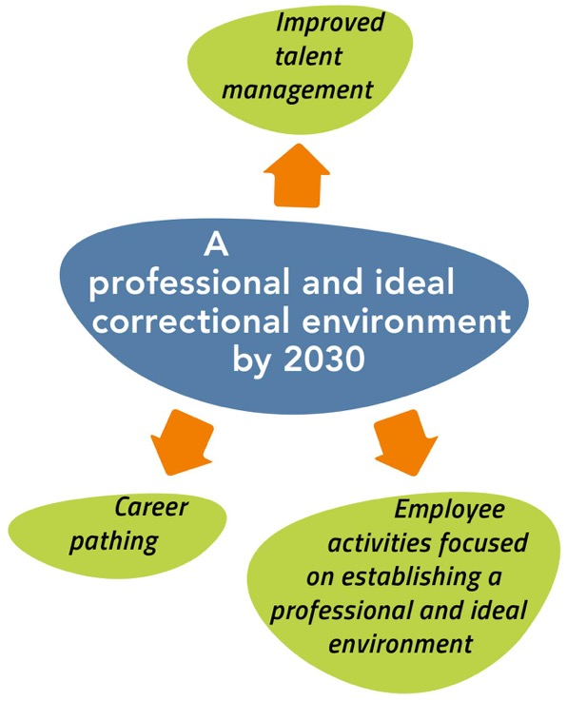

Slide 4
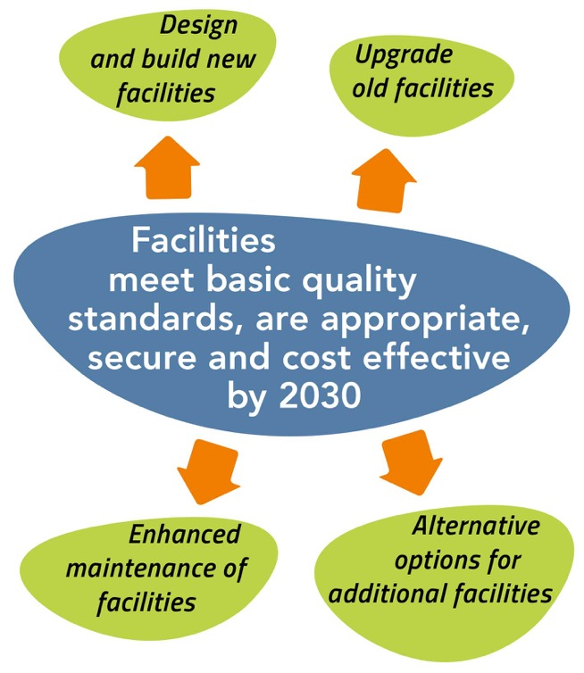

Slide 5
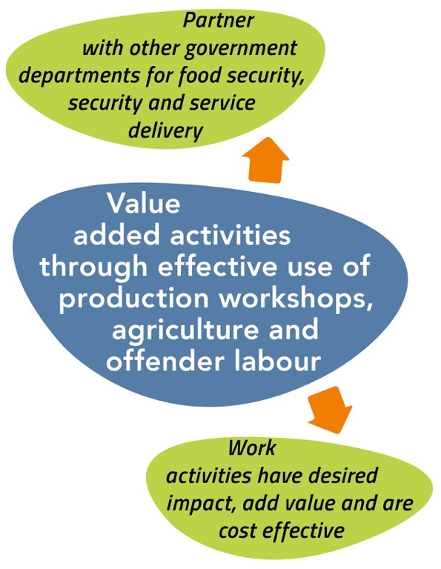

Slide 6
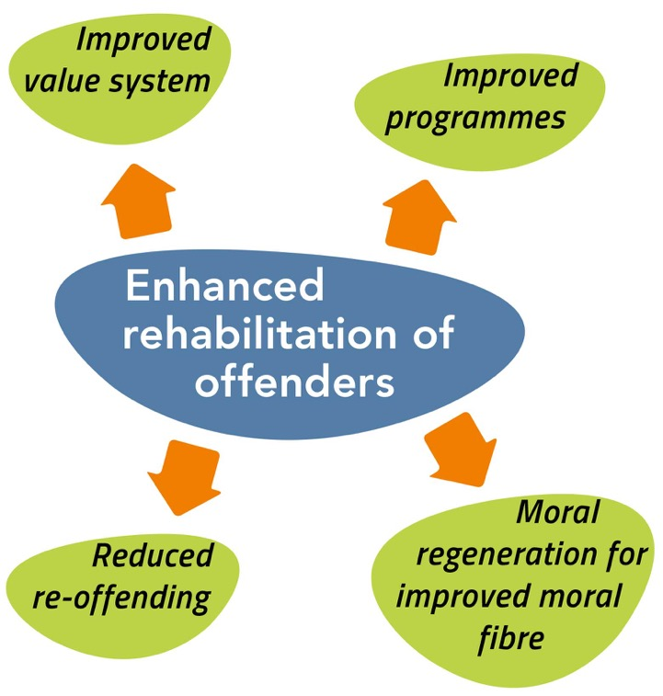

Slide 7
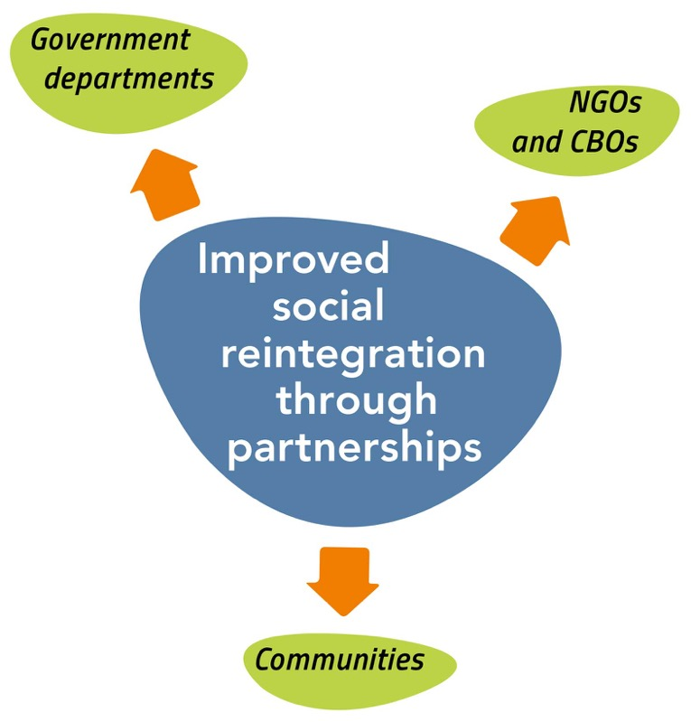

Slide 8
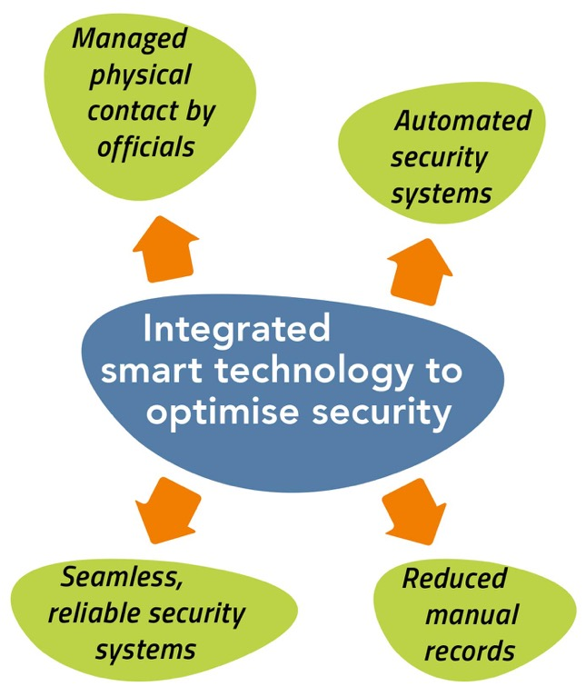

Slide 9
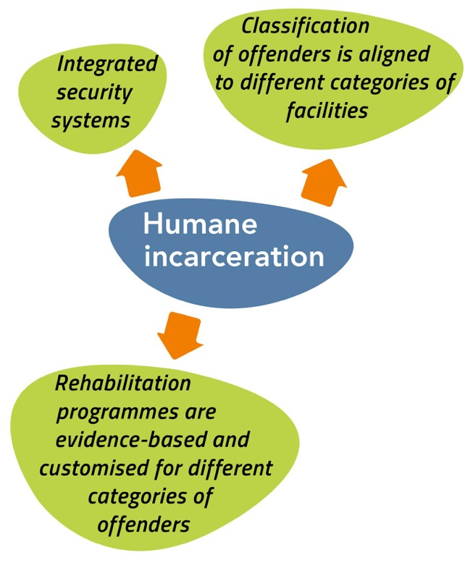

Slide 10
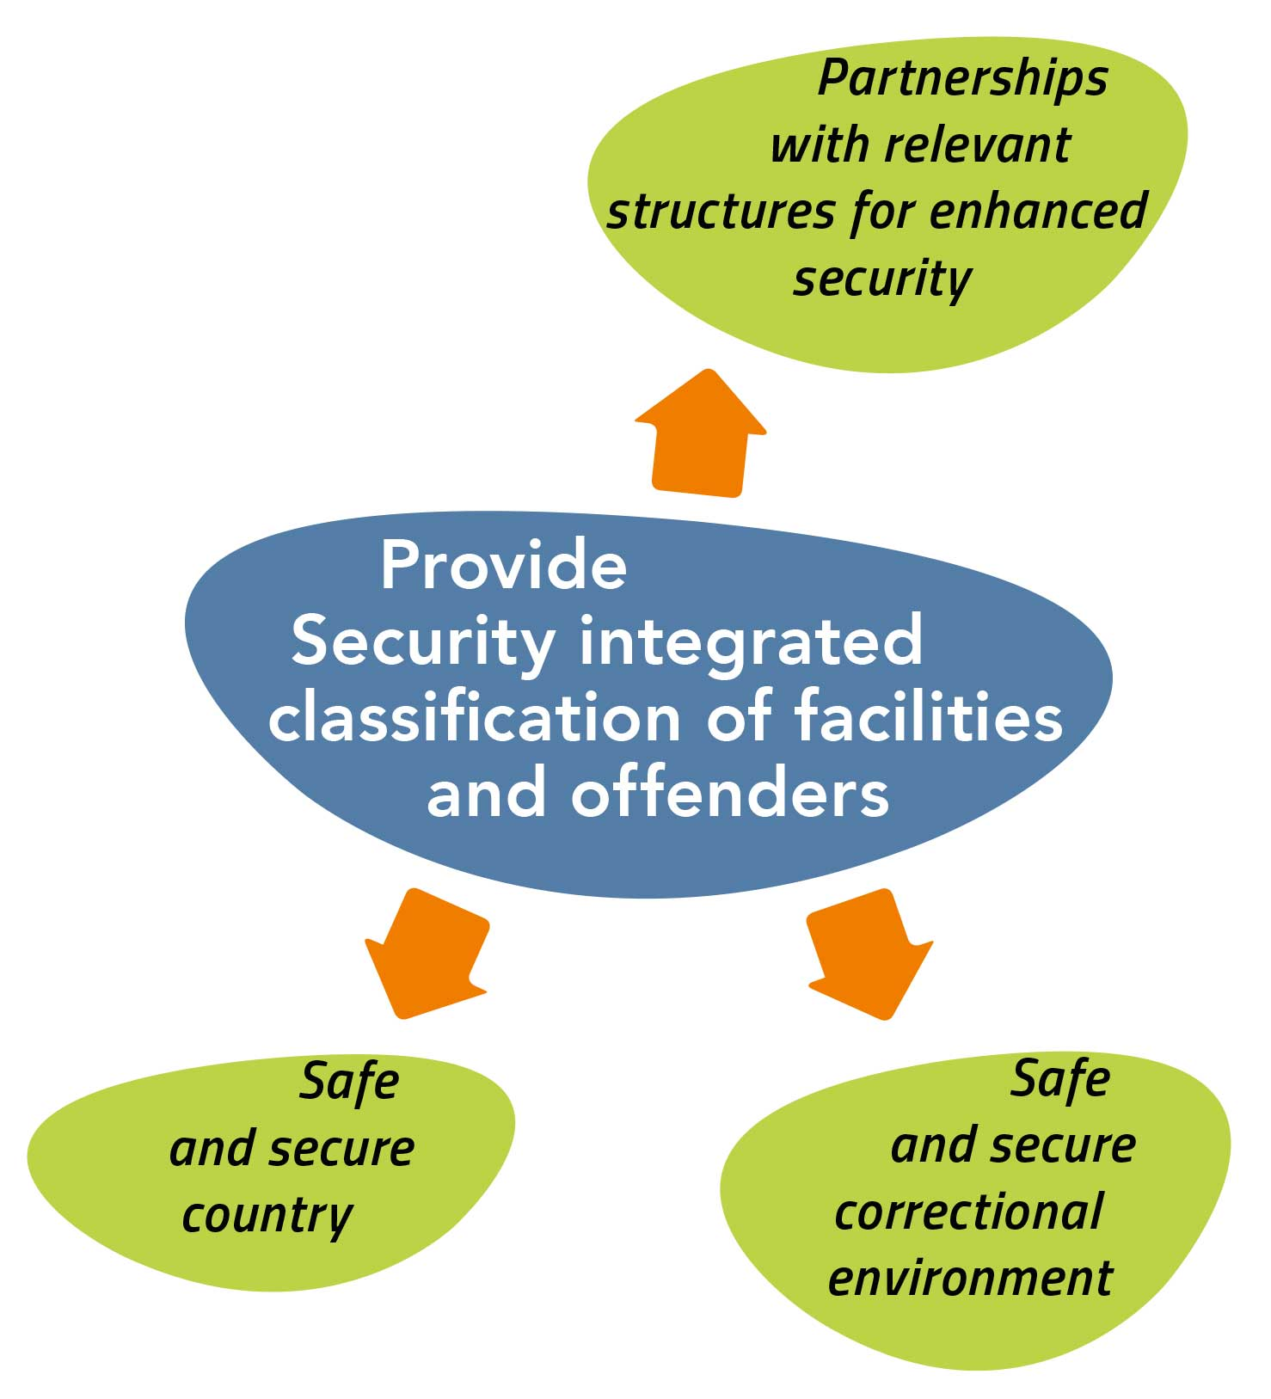
10

Slide 11
Our Vision for 2068

Slide 12
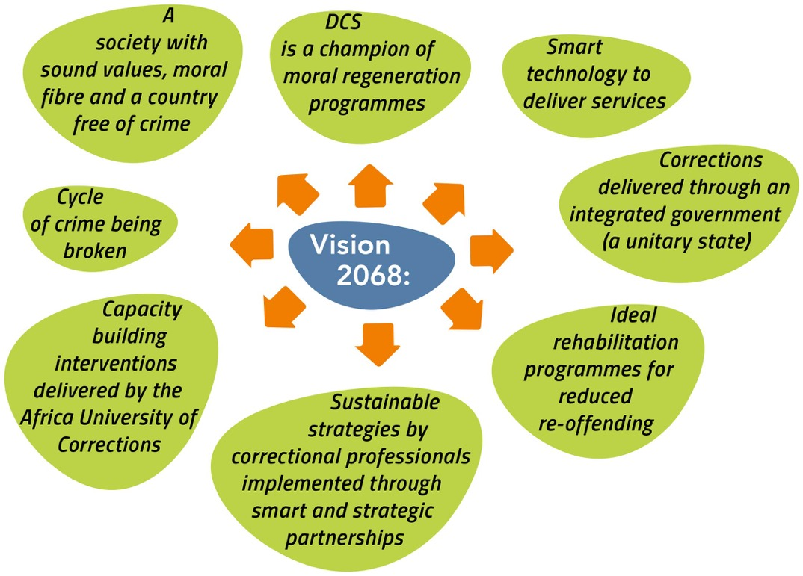

Slide 13
Walking the Journey towards 2068
What we intend to do

Slide 14
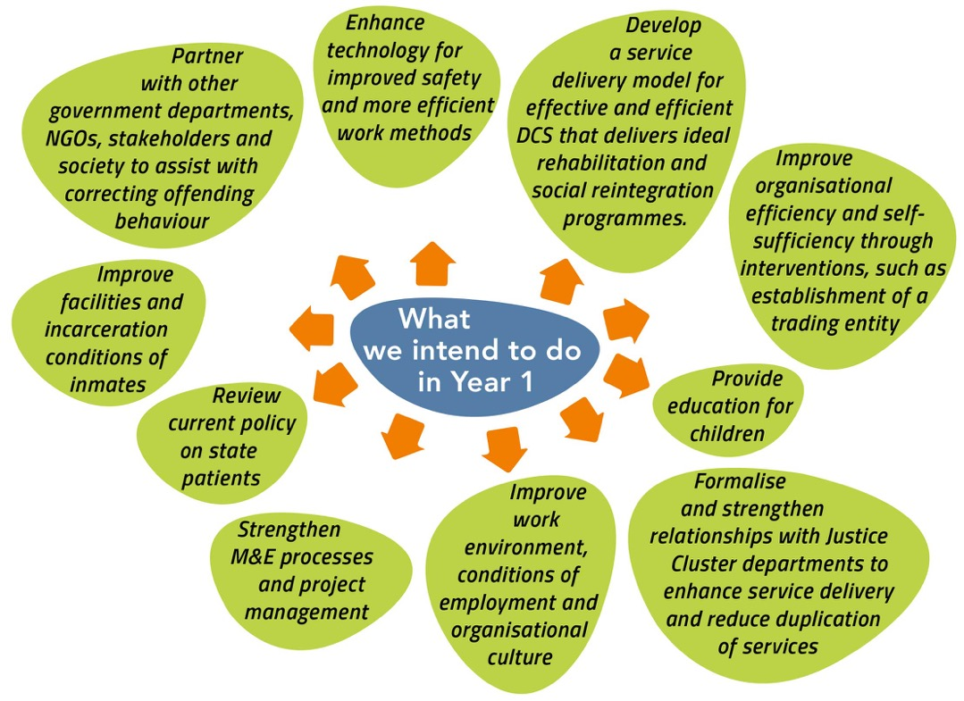

Slide 15
“Those who would judge us merely by the heights we have achieved, would do well to remember the depths from which we started”
Dr Kwame Nkrumah

Slide 16
Thank You

