Slide 1
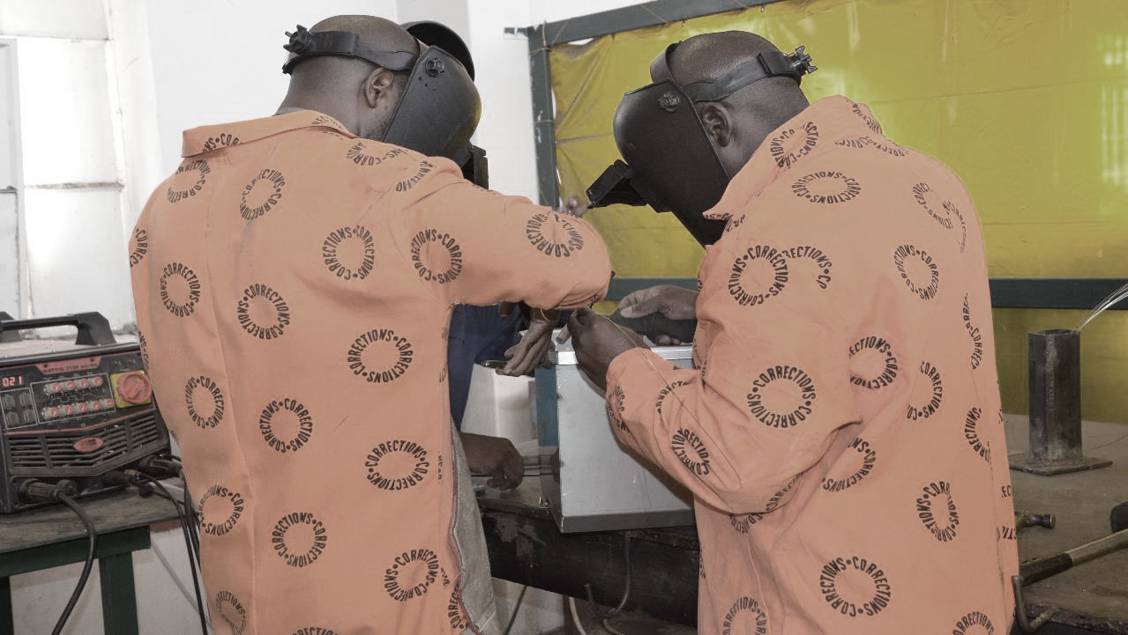

2020 ANNUAL STRATEGIC PLANNING SESSION
Outcome 4: Successful reintegration of all those under the care of the Department
Notes:
Photo by Rebrand Cities on Pexels

Slide 2
1 | Purpose
2 | The futures triangle
3 | Contextual issues
4 | Vision 2068
5 | MTSF Priorities
6 | Problem and Solution Trees
7 | Results Chain
8 | Alternative modes of delivery
9 | Strategic Risks
10 | Critical success factors
Presentation outline

Slide 3
Purpose
Outcome 4: Successful reintegration of all those under the care of the Department
The purpose of the presentation is to:
Reflect on the current realities that we are facing as a Department to identify new challenges and opportunities in this context.
Reflect on the 50 Year Plan for the Department, assess where we are and what we need to do.
Reflect on the 2020-25 Revised Strategic Plan (SP) and the 2020/21 Revised Annual Performance Plan (APP). What have achieved in this regard over the past six months (Q2 performance).
Review the Problem/ Solution Trees to determine if there are any gaps that need to be closed (new problems/ root causes) taking into consideration the current operating environment. Are there any pathways that are blocked on the Solution Tree, can we follow a new or different pathway to get to the same result. Has COVID-19 open/ closed some challenges or are they still relevant.
Are there any outputs that we have missed in the 2020/21 APP that must be included to achieve the Outcomes in the Revised Strategic Plan?
How do we deliver on the strategic intent set out in the Revised SP and APP? What are the things that we need to deliver on in the Strategic Operational Plans for 2021/22 (strategic levers)?
Notes:
Not for presentation purposes
This is important background information that will guide managers on what the content is focusing on

Slide 4
The futures triangle
Outcome 4: Successful reintegration of all those under the care of the Department
Pull of the future
A country free of crime
1.
Improved safety and security
6.
High performing ethical organisation
2. Improved case management
3.
Increased needs based rehabilitation
5.
Healthy incarcerated population
Weight of the past
Push of the present
4.
Successful reintegration
Social and economic inequalities
Punitive philosophy of corrections
MTEF budget cuts
COVID-19
MTSF
Notes:
Brainstorming technique:
Push: Driving forces in the present that affect the future
Weights: barriers to change that keep us in the past

Slide 5
Contextual issues for 2021 MTEF
Outcome 4: Successful reintegration of all those under the care of the Department
Contextual Issues (examples)
Proposed budget cuts by NT
Implications of Covid-19 on the operating environment (demand for health care services)
Low economic growth (GDP contract by 7.3% in 2020)
Crime trends (upward trend of serious crimes)
Capacity constrains (officials in isolation, quarantine and rotation)
Culture change (increasing use of technology)
Other resource constrains
Overcrowding (slow CJS)
Current 2020/21 actual performance
Opportunities (examples)
Self sufficiency
Partnerships
Promote the option of community corrections as alternative sentencing
Automation
Alternative modes of delivery
Remote working
Staff motivation
Notes:
Examples provided by Strategic Management – Outcome Leaders need to develop their own please

Slide 6
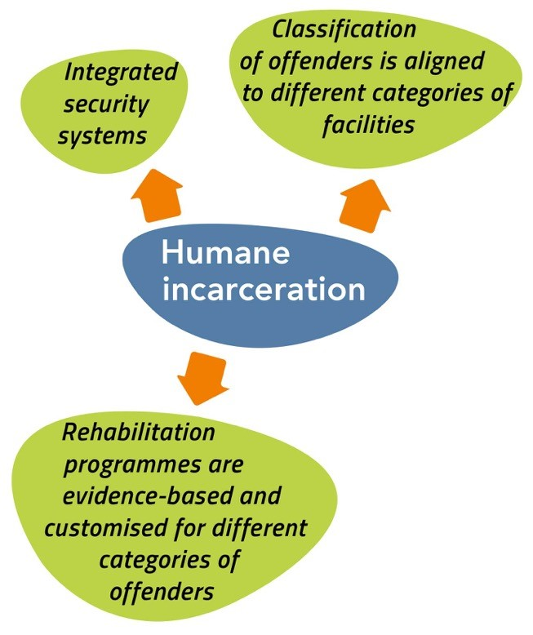
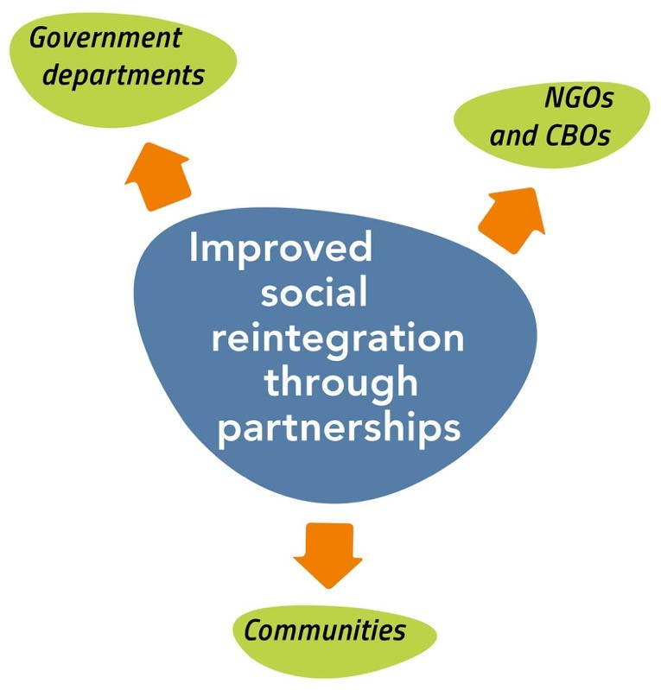
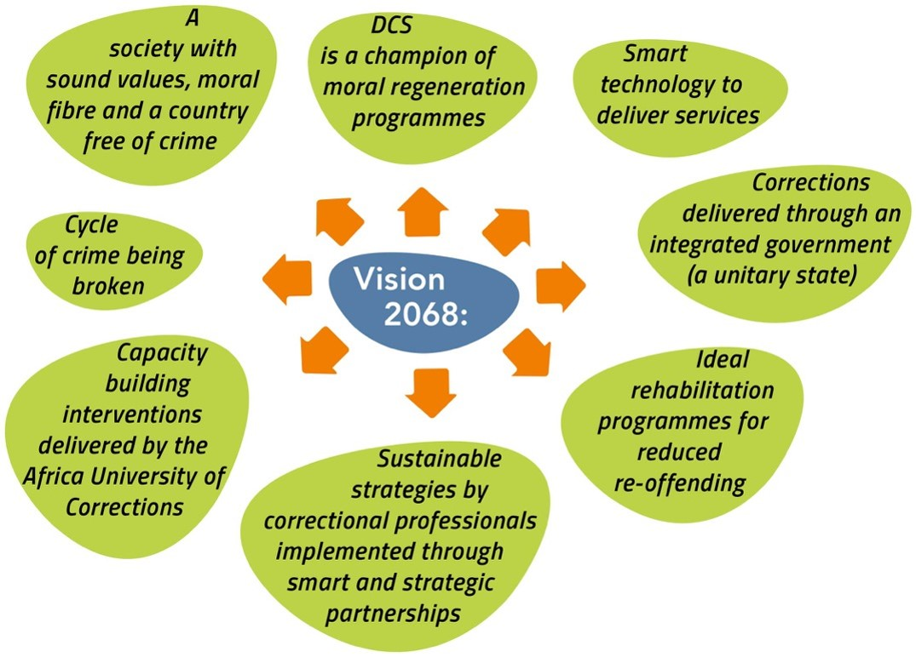
Vision 2068
Outcome 4: Successful reintegration of all those under the care of the Department
Vision 2068 (Objectives for Social reintegration)
What have we achieved thus far
What do we still need to do to get there
xxxx
xxxx
What is the new thought process
Key levers to be considered

Slide 7
2019 MTSF Priorities
Outcome 4: Successful reintegration of all those under the care of the Department
7.
1.
PRIORITY 1:
Building a capable, ethical and developmental state
PRIORITY 7: A better Africa and world
PRIORITY 6:
Social
cohesion
and safe
communities
2.
PRIORITY 2:
Economic transformation and job creation
PRIORITY 5:
Spatial integration, human settlements and local government
5.
3.
PRIORITY 3:
Education, skills and health
PRIORITY 4: Consolidating the social wage through reliable and quality basic services
4.
Notes:
This slide is for information only – remind managers what the seven priority areas are – not for presentation purposes

Slide 8
2019 MTSF contributions
Outcome 4: Successful reintegration of all those under the care of the Department
MTSF Priority Area |  | MTSF Indicator |  | Target |  | Current performance |  | Interventions to achieve the set targets
Priority 6: Social cohesion and safe communities |  | Percentage of probationers without violations
 |  | Percentage of parolees without violations
 |  | Percentage increase in victims participating in Restorative Justice Programmes
Outcome 4: Successful reintegration of all those under the care of the Department
Notes:
This slide is for information only – remind managers what the seven priority areas are – not for presentation purposes

Slide 9
Problem Tree - Social Reintegration….
Outcome 4: Successful reintegration of all those under the care of the Department
Reoffending
Unemployment
Dysfunctional families
Behaviour relapse
Effects
Problem Statement Social Reintegration:
Unsuccessful reintegration of offenders into communities
Direct cause:
Inability to live a productive life
Hindrances of criminal record to employment
Direct Cause:
Failure to comply with parole correctional supervision conditions
Insufficient family support
Inadequate participation and unwillingness of offenders in restorative justice programmes
Stigmatization and attitudes of communities towards offenders
Direct cause:
Rejection of offenders by families and/or communities
General fear of crime by communities
Inadequate marketing of Corrections agenda
Inappropriate ratio of official to offender
Inadequate specialised training
Non-provision of tools of trade
Lack of financial aid
Limited work or job opportunities for parolees
Inadequate collaboration among relevant stakeholders (departments, business sector, entities)
Offenders are released into the same environment that prevailed prior to their incarceration
Lack of ICT support systems for monitoring (remote monitoring, computers, wifi, mobile devices, etc.)
Inadequate collaboration among relevant stakeholders (departments, business sector, entities)
Insufficient and no suitable vehicles for monitoring
Lack of mobile offices
Direct cause:
Inadequate organisational structure
Core problem

Slide 10
Solution Tree - Social Reintegration….
Outcome 4: Successful reintegration of all those under the care of the Department
Solution Statement Social Reintegration:
Reconcile offenders, parolees and probationers with their communities
Intervention:
Improve public education on the mandate of correctional services
Intervention:
Collaboration among the relevant stakeholders
Enhance Partnerships (e.g. NHTL, National House of Traditional Leaders)
Intervention:
Support offenders to become law abiding and productive citizens
Strengthen strategic partnerships to provide after care support (e.g. SASSA)
Partnerships with Community Safety Forums
Revise business model for Halfway Houses
Improve collaboration with JCPS Cluster partners
Victim support
Participation in structures supporting social cohesion (DevCom, FOSAD, MinMec etc.)
Mobilise the business communities and create employment opportunities
Strengthen internal collaboration to ensure effective implementation of sentence plans
Encourage offenders to form co-operatives
Intervention:
ICT modernization for supervision
Mobility (laptops, smartphones, tablets, etc.)
Modernize supervision (e.g. Electronic monitoring, smart vehicles, drones, biometrics)
Intervention:
Provisioning of appropriate structure
Specialized training for social re-integration

Slide 11
Results chain
Outcome 4: Successful reintegration of all those under the care of the Department
Level of Result | Indicator | Baseline 2020/21 | Target 2021/22 | Assumption/Enablers
Impact (Strategic Plan) Safe and empowered communities through sustainable economic development | N/A | N/A | N/A | N/A
Outcome (Strategic Plan) Successful reintegration of all those under the care of the Department | Percentage increase in offenders under the system of Community Corrections | 0.78% (557) increase in parolees, probationers and ATPs under the system of community corrections | 4.1% increase in offenders under the system of community corrections (Parolees, probationers and ATPs) | Offenders are accepted into the family and/or communities Offenders are economically independent after release
Output (current) Compliance by Probationers and Parolees | Percentage of parolees without violations | 97% | 97%
 | Percentage of probationers without violations | 97% | 97%
Victim Offender Dialogue | Percentage increase of victims participating in Restorative Justice Programme | 7% | 7%

Slide 12
Results chain
Outcome 4: Successful reintegration of all those under the care of the Department
Level of Result | Indicator | Baseline 2020/21 | Target 2021/22 | Assumption/Enablers
Output (current) Victim Offender Dialogue | Percentage increase of offenders, parolees and probationers participating in Restorative Justice Programme | 3% | 3%
Job creation | Number of economic opportunities facilitated for offenders, parolees and probationers | 36 | 42
 | Number of parolees and probationers participating in community initiatives | 6 200 | 6 400
Output (new)
Strategic Operational Outputs (how do we deliver the outcomes) | Number of Parolees and probationers reintegrated back into communities through Halfway House |  | 96
 | Number of parolees and probationers involved in community projects |  | 7 200
 | Number of Imbizo coordinated |  | 76
 | Number of VOD Forum coordinated |  | 42
 | Number of Service Points established |  | 72
Notes:
There will be no further consultation on APP KPI, whatever is added her will be taken as the final

Slide 13
Social Reintegration progresses toward an outsourced and centralised function
Outcome 4: Successful reintegration of all those under the care of the Department
Complete
Partial
Balanced
Partial
Complete
SOCIAL RE-INTEGRATION: PARTIAL OUTSOURCE - COMPLETE CENTRALISED
OUTSOURCE
The criteria to test the success of an agency model would be tested via an inhouse ‘agency’ type operation Assessment regarding what is the best entity to establish would be more effective if piloted inhouse. The vehicle chosen for the long term would require plug and play in the long term
Once the function is centralised, other operational streamlining can take place allowing strategic and policy focus required to leverage off intergovernmental partnerships and private sector arrangements. Policy decisions regarding hiring ex offenders via a production workshop should be established here
CONTROL
Complete
Partial
Balanced
Partial
Complete
The Social Re-integration function would require strategic partnerships be established in the short term. Streamlining all existing partnerships and maximising future partnership principles would need to be bedded down. Moving structure toward central decision making
SI (To-Be) (LT)
SI (To-Be) (MT)
SI (To-Be) (ST)
INSOURCE
SI As-Is
CENTRALISE
CO-ORDINATION
DECENTRALISE
Current
ST
MT
LT
Change Management Focus

Slide 14
Modes of service delivery Social Reintegration
Outcome 4: Successful reintegration of all those under the care of the Department
Proposed
Addressing resource and structure limitations as decentralized function
Social Re-integration requires distinct training suited to interpersonal, relationship building, community facilitation, corrections training in order to effectively fulfil its mandate.
With a current ratio of 1:42 correctional officials: offenders and 1:400 social workers, where SW occupy 6% of current headcount, allocation to be addressed. Consider case growth against resource growth
Ensure that Social re-integration participates earlier on in the process journey of Rehabilitation and have sight of the monitoring of the case plan
Consider reducing requirements regarding extent of time of ex-offender case management based on good behaviour.
Transport related requirements are currently not catered for correctional officials to fulfil the monitoring duties and should be addressed.
Look at a panel of monitoring officials in remote areas for Social Re-integration to leverage off to reduce transport costs for informal settlements
What needs to be done to fast-track
SOCIAL RE-INT.
Social re-integration requires dedicated professionalised resources within its sub culture and the appropriate technology and facilities to deliver on its mandate if it is to prove successful as an agency
Notes:
Provide:
The alternative modes of delivery to improve performance
Reflect on the current modes of delivery and SDM proposed
Steps taken to resolve the challenges

Slide 15
Strategic Risks
Outcome 4: Successful reintegration of all those under the care of the Department
Outcome | Strategic Risk | Risk Mitigation
Successful reintegration of all those under the care of the Department | Unsuccessful reintegration of offenders into communities. | Reconcile offenders, parolees and probationers with their families /communities through enhancement of partnerships with community safety forums, National House of Traditional Leaders and Councillors.
 |  | Support offenders to become law abiding and productive citizens by encouraging offenders to form cooperatives.
 |  | Strengthen internal collaboration to ensure effective implementation of the sentence plans.
Notes:
provide:
Updated risks
Plans to mitigate

Slide 16
Strategic Risks cont….
Outcome 4: Successful reintegration of all those under the care of the Department
Outcome | Strategic Risk | Risk Mitigation
 |  | Enhance specialized training for social re-integration.
 |  | Strength strategic partnerships to provide after care support and participation in structures supporting social cohesion
 |  | Improve public education on the mandate of correctional services.
Notes:
provide:
Updated risks
Plans to mitigate

Slide 17
Critical success factors and management of dependencies
Outcome 4: Successful reintegration of all those under the care of the Department
xxx
Notes:
provide:
Updated risks
Plans to mitigate

Slide 18
Conclusion
Outcome 4: Successful reintegration of all those under the care of the Department
Notes:
provide:
Updated risks
Plans to mitigate

Slide 19
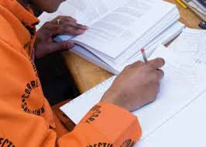
THANK
YOU
Notes:
Photo by fauxels
on Pexels

