Slide 1


2020 ANNUAL STRATEGIC PLANNING SESSION
Outcome 5: Healthy incarcerated population
Notes:
Photo by Rebrand Cities on Pexels

Slide 2
1 | Purpose
2 | The futures triangle
3 | Contextual issues
4 | Vision 2068
5 | MTSF Priorities
6 | Problem and Solution Trees
7 | Results Chain
8 | Alternative modes of delivery
9 | Strategic Risks
10 | Critical success factors
Presentation outline

Slide 3
Purpose
Outcome 5: Healthy incarcerated population
The purpose of the presentation is to:
Reflect on the current realities that we are facing as a Department to identify new challenges and opportunities in this context.
Reflect on the 50 Year Plan for the Department, assess where we are and what we need to do.
Reflect on the 2020-25 Revised Strategic Plan (SP) and the 2020/21 Revised Annual Performance Plan (APP). What have achieved in this regard over the past six months (Q2 performance).
Review the Problem/ Solution Trees to determine if there are any gaps that need to be closed (new problems/ root causes) taking into consideration the current operating environment. Are there any pathways that are blocked on the Solution Tree, can we follow a new or different pathway to get to the same result. Has COVID-19 open/ closed some challenges or are they still relevant.
Are there any outputs that we have missed in the 2020/21 APP that must be included to achieve the Outcomes in the Revised Strategic Plan?
How do we deliver on the strategic intent set out in the Revised SP and APP? What are the things that we need to deliver on in the Strategic Operational Plans for 2021/22 (strategic levers)?
Notes:
Not for presentation purposes
This is important background information that will guide managers on what the content is focusing on

Slide 4
The futures triangle
Outcome 5: Healthy incarcerated population
Pull of the future
A country free of crime
1.
Improved safety and security
6.
High performing ethical organisation
2. Improved case management
3.
Increased needs based rehabilitation
5.
Healthy
incarcerated population
Weight of the past
Push of the present
4.
Successful reintegration
Social and economic inequalities
Punitive philosophy of corrections
MTEF budget cuts
COVID-19
MTSF
Notes:
Brainstorming technique:
Push: Driving forces in the present that affect the future
Weights: barriers to change that keep us in the past

Slide 5
Contextual issues for 2021 MTEF
Outcome 5: Healthy incarcerated population
Contextual Issues (examples)
Proposed budget cuts by NT
Implications of Covid-19 on the operating environment (demand for health care services)
Low economic growth (GDP contract by 7.3% in 2020)
Crime trends (upward trend of serious crimes)
Capacity constrains (officials in isolation, quarantine and rotation)
Culture change (increasing use of technology)
Other resource constrains
Overcrowding (slow CJS)
Current 2020/21 actual performance
Opportunities (examples)
Self sufficiency
Partnerships
Promote the option of community corrections as alternative sentencing
Automation
Alternative modes of delivery
Remote working
Staff motivation
Notes:
Examples provided by Strategic Management – Outcome Leaders need to develop their own please

Slide 6
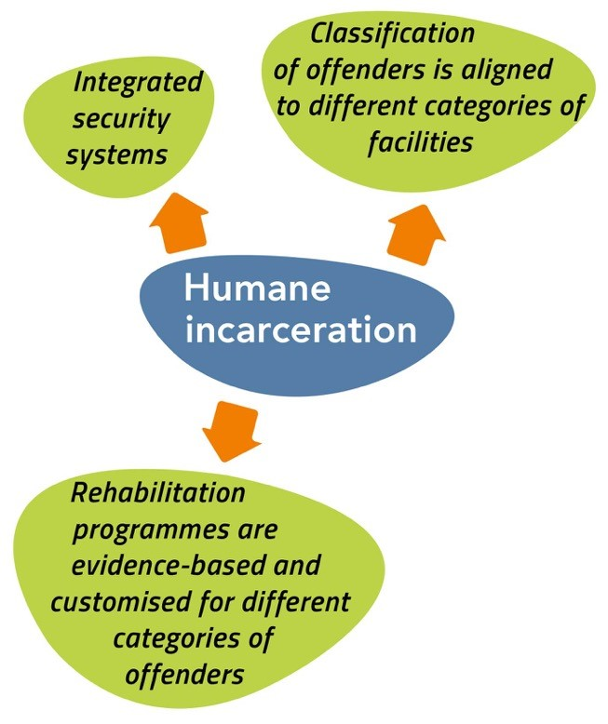
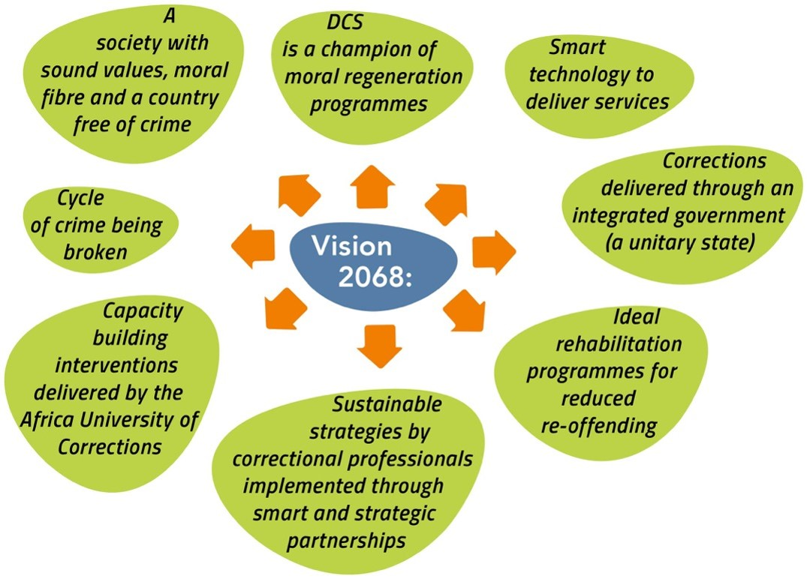
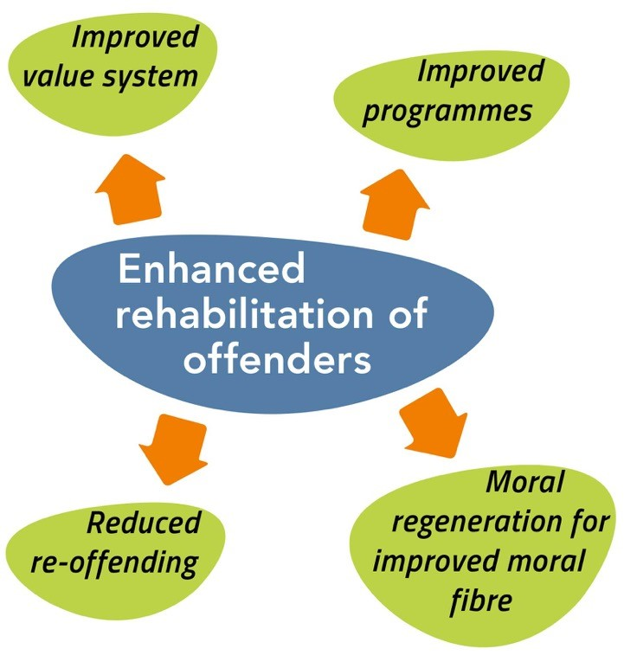
Vision 2068
Outcome 5: Healthy incarcerated population
Vision 2068 (Objectives for Care)
What have we achieved thus far
What do we still need to do to get there
xxxx
xxxx
What is the new thought process
Key levers to be considered

Slide 7
2019 MTSF Priorities
Outcome 5: Healthy incarcerated population
7.
1.
PRIORITY 1:
Building a capable, ethical and developmental state
PRIORITY 7: A better Africa and world
PRIORITY 6:
Social
cohesion
and safe
communities
2.
PRIORITY 2:
Economic transformation and job creation
PRIORITY 5:
Spatial integration, human settlements and local government
5.
3.
PRIORITY 3:
Education, skills and health
PRIORITY 4: Consolidating the social wage through reliable and quality basic services
4.
Notes:
This slide is for information only – remind managers what the seven priority areas are – not for presentation purposes

Slide 8
2019 MTSF contributions
Outcome 5: Healthy incarcerated population
MTSF Priority Area |  | MTSF Indicator |  | Target |  | Current performance |  | Interventions to achieve the set targets
Outcome 4: Successful reintegration of all those under the care of the Department
Notes:
None for Care

Slide 9
Problem tree
Outcome 5: Healthy incarcerated population
Inadequate prevention, health promotion and management of inmates medical conditions
Spread of communicable diseases
Medical complications and mortality resulting in possible litigations
Effects
Core problem
Problem Statement:
Inadequate provision of a comprehensive package of health care services to inmates
Direct cause
Inadequate compliance to legislative health prescripts and minimum health standards
Lack of support infrastructure (dishwashers etc.) to promote maintenance of hygiene
Outdated departmental nutritional ration scale
Limited number of pharmacies to increase availability and accessibility of medicines and other supplies
Direct cause Unavailability of electronic health information system
Outdated health care structure
Inadequate prevention, nutritional services not provided as prescribed by nutritional minimum standards
Environmental health services not provided as prescribed in the scope for environmental health by the Health Professionals Council for South Africa (HPCSA)
Manual systems that do not provide accurate information for decision making
Direct cause Non specific staffing norms for Health Care Professionals / Providers
Delays on processing of pharmaceutical orders resulting in stock shortages
Lack of resources to distribute medicines and supplies from pharmacies to clinics
Notes:
Review the Problem/ Solution Trees to determine if there are any gaps that need to be closed (new problems/ root causes) taking into consideration the current operating environment.

Slide 10
Solution tree
Outcome 5: Healthy incarcerated population
Solution Statement Care:
Provision of a comprehensive package of health care services to inmates
Intervention
Conduct work study to determine staffing requirements for Health Care Services
Development of DCS specific staffing norms for Health Care Professionals / Providers
Intervention
Review the ration scale to ensure compliance with food based dietary guidelines
Intervention Implementation of TB/HIV Integrated System (THIS) and development and implementation of integrated health information system
Review, align and fund the health care structure providing for Health Care Professionals, Food Service Managers, Dieticians, qualified Environmental Managers, Pharmacist, public health specialist based on the model / level of health care delivery.
Availability of an integrated electronic health information system
Intervention
Install required equipment in all food service units
Budget allocation and establishment of task team
Intervention
Improve access and supply of medicines and supplies
Establishment of pharmacies in Management Areas that do not have
Establish a Central Procurement Unit for medicines and supplies
Contract Courier Services for distribution of medicines and supplies
Intervention
Development of Develop DCS specific staffing norms for all cadres of Health Care Professionals
Notes:
Are there any pathways that are blocked, can we follow a new or different pathway to get to the same result. Has COVID-19 open/ closed some challenges or are they still relevant.

Slide 11
Results chain
Outcome 5: Healthy incarcerated population
Level of Result | Indicator | Baseline 2020/21 | Target 2021/22 | Assumption/Enablers
Impact (Strategic Plan) Safe and empowered communities through sustainable economic development | N/A | N/A | N/A | N/A
Outcome (Strategic Plan) Healthy incarcerated population | Percentage of inmates accessing Primary Health Care Services on the basis of need | 70% of inmates of inmates accessing Primary Health Services on the basis of need at correctional facilities | 80% of inmates accessing Primary Health Services on the basis of needs at correctional facilities | Inmates in need of care must be willing to seek healthcare services Availability of primary healthcare resources
Output (current) Communicable diseases treatment | Offenders viral load suppression rate (at 12 months) | 91% | 91%
 | Offenders Tuberculosis (TB) new pulmonary cure rate | 91% | 91%
Non-Communicable diseases treatment | Percentage of inmates screened for diabetes | 90% | 90%

Slide 12
Results chain
Outcome 5: Healthy incarcerated population
Level of Result | Indicator | Baseline 2020/21 | Target 2021/22 | Assumption/Enablers
Output (current) Non-Communicable diseases treatment | Percentage of inmates screened for hypertension | 90% | 90%
 | Percentage of identified inmates tested for COVID-19 | 100% | 100%
 | Percentage of inmates who have recovered from Coronavirus Disease 2019 (COVID-19) | 85% | 85%
Nutritional diets provided | Percentage of therapeutic diets prescribed for inmates | 12% | 12%
Output (new)
Strategic Operational Outputs (how do we deliver the outcomes) | Number of Management Areas that have appointed officials in writing as environmental hygiene supervisors in all Correctional Centres and Remand Detention Facilities |  | 46
 | Number of Management Areas that have functional Pharmaceutical and Therapeutics Committees (PTCs) |  | 46
Notes:
There will be no further consultation on APP KPI, whatever is added her will be taken as the final

Slide 13
Care would progress toward an outsourced function with partial decentralisation to allow for strategic partnerships
Outcome 5: Healthy incarcerated population
Complete
Partial
Balanced
Partial
Complete
CARE: PARTIAL OUTSOURCE - PARTIAL DE-CENTRALISED
OUTSOURCE
If a self sustaining entity is established for production and workshops, procurement of essential care goods would be procured therein and reduce costs. An administration framework and SLA’s are in place like any other service provider
Care (To-Be) (LT)
Demand and supply needs are understood and sister departments take on their mandated role within correctional centres. Outputs of the production workshop begin to be inputs for the Care function
CONTROL
Complete
Partial
Balanced
Partial
Complete
Care (To-Be) (MT)
The Care function would require strategic partnerships be established in the short term. Streamlining all existing partnerships and maximising future partnership principles would need to be bedded down. Ensuring that overlaps between services offered in Care and Rehabilitation, begin to be centrally coordinated
Care (To-Be) (ST)
INSOURCE
Care As-Is
CENTRALISE
CO-ORDINATION
DECENTRALISE
Current
ST
MT
LT
Change Management Focus

Slide 14
Modes of service delivery for Care
Outcome 5: Healthy incarcerated population
Proposed
If Care is outsourced and partnered the ‘mini government’ delivery challenge can be distributed across other key mandated stakeholders where sister departments take on their mandated role within correctional centres
Outsourcing opportunities exists for nutritional services and partnerships for health, psychological, Spiritual care and social work as well as psychiatric, specialized medical services –however where there is overlap between services offered in Care and Rehabilitation, outsourcing partnerships could be maximised
However, not all parts of Care can be outsourced, e.g. Personal and Environmental Hygiene
If a self-sustaining entity is established for production and workshops, procurement of essential care goods could rather be procured therein and thereby reduce costs
What needs to be done to fast-track
CARE
Care would require no change on its decentralised management, but would seek to partner more strategically resulting in functional changes, including ensuring the correct skills and people mix is present
Notes:
Provide:
The alternative modes of delivery to improve performance
Reflect on the current modes of delivery and SDM proposed
Steps taken to resolve the challenges

Slide 15
Strategic Risks
Outcome 5: Healthy incarcerated population
Outcome | Strategic Risk | Risk Mitigation
Healthy incarcerated population | Inadequate provision of a comprehensive package of health care services to inmates | Increase in pharmacy facilities in all Management Areas to ensure accessibility of medicines and other medical supplies
 |  | Provision of health care services in line with applicable legislation and minimum health standards and integrate inmate system with Health Information system for inmates
 |  | Development of DCS specific staffing norms for all cadres of Health Care Professionals/ Service providers
 |  | Strengthen partnership with stakeholders (DoH)
Notes:
provide:
Updated risks
Plans to mitigate

Slide 16
Strategic Risks
Outcome 5: Healthy incarcerated population
Outcome | Strategic Risk | Risk Mitigation
 |  | Rolling out awareness on communicable diseases across the DCS centres.
Notes:
provide:
Updated risks
Plans to mitigate

Slide 17
Critical success factors and management of dependencies
Outcome 5: Healthy incarcerated population
Health care system
Notes:
provide:
Updated risks
Plans to mitigate

Slide 18
Conclusion
Outcome 5: Healthy incarcerated population
Notes:
provide:
Updated risks
Plans to mitigate

Slide 19

THANK
YOU
Notes:
Photo by fauxels
on Pexels

