Slide 1


2020 ANNUAL STRATEGIC PLANNING SESSION
Outcome 6: High performing ethical organisation
Notes:
Photo by Rebrand Cities on Pexels

Slide 2
1 | Purpose
2 | The futures triangle
3 | Contextual issues
4 | Vision 2068
5 | MTSF Priorities
6 | Problem and Solution Trees
7 | Results Chain
8 | Alternative modes of delivery
9 | Strategic Risks
10 | Critical success factors
Presentation outline

Slide 3
Purpose
Outcome 6: High performing ethical organisation
The purpose of the presentation is to:
Reflect on the current realities that we are facing as a Department to identify new challenges and opportunities in this context.
Reflect on the 50 Year Plan for the Department, assess where we are and what we need to do.
Reflect on the 2020-25 Revised Strategic Plan (SP) and the 2020/21 Revised Annual Performance Plan (APP). What have achieved in this regard over the past six months (Q2 performance).
Review the Problem/ Solution Trees to determine if there are any gaps that need to be closed (new problems/ root causes) taking into consideration the current operating environment. Are there any pathways that are blocked on the Solution Tree, can we follow a new or different pathway to get to the same result. Has COVID-19 open/ closed some challenges or are they still relevant.
Are there any outputs that we have missed in the 2020/21 APP that must be included to achieve the Outcomes in the Revised Strategic Plan?
How do we deliver on the strategic intent set out in the Revised SP and APP? What are the things that we need to deliver on in the Strategic Operational Plans for 2021/22 (strategic levers)?
Notes:
Not for presentation purposes
This is important background information that will guide managers on what the content is focusing on

Slide 4
The futures triangle
Outcome 6: High performing ethical organisation
Pull of the future
A country free of crime
1.
Improved safety and security
6.
High performing ethical organisation
2. Improved case management
3.
Increased needs based rehabilitation
5.
Healthy
incarcerated population
Weight of the past
Push of the present
4.
Successful reintegration
Social and economic inequalities
Punitive philosophy of corrections
MTEF budget cuts
COVID-19
MTSF
Notes:
Brainstorming technique:
Push: Driving forces in the present that affect the future
Weights: barriers to change that keep us in the past

Slide 5
Contextual issues for 2021 MTEF
Outcome 6: High performing ethical organisation
Contextual Issues (examples)
Proposed budget cuts by NT
Implications of Covid-19 on the operating environment (demand for health care services)
Low economic growth (GDP contract by 7.3% in 2020)
Crime trends (upward trend of serious crimes)
Capacity constrains (officials in isolation, quarantine and rotation)
Culture change (increasing use of technology)
Other resource constrains
Overcrowding (slow CJS)
Current 2020/21 actual performance
Opportunities (examples)
Self sufficiency
Partnerships
Promote the option of community corrections as alternative sentencing
Automation
Alternative modes of delivery
Remote working
Staff motivation
Notes:
Examples provided by Strategic Management – Outcome Leaders need to develop their own please

Slide 6
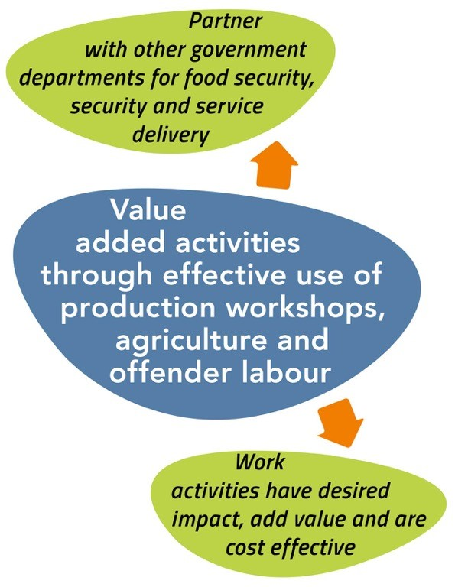
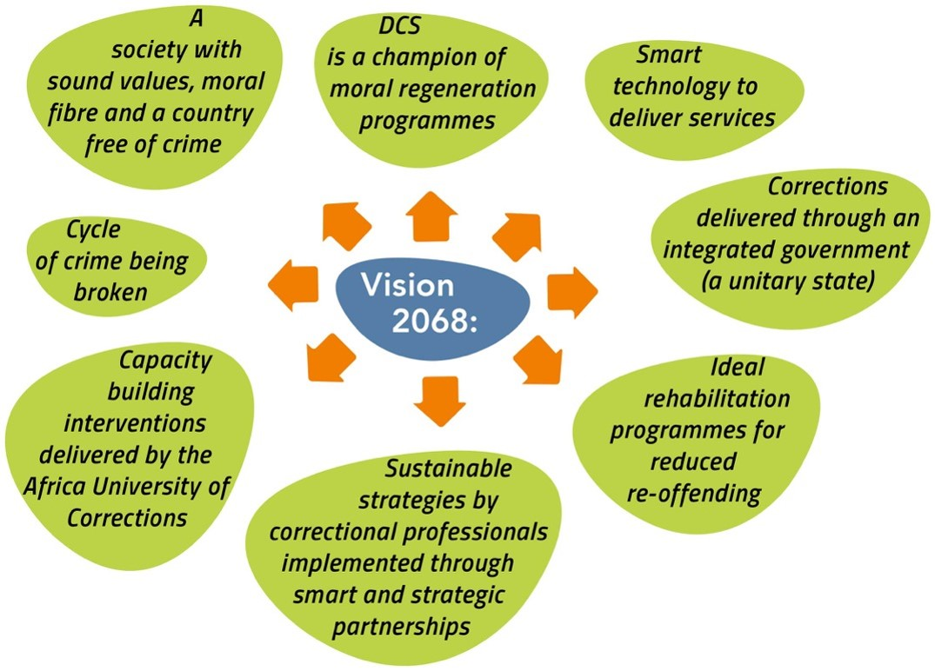
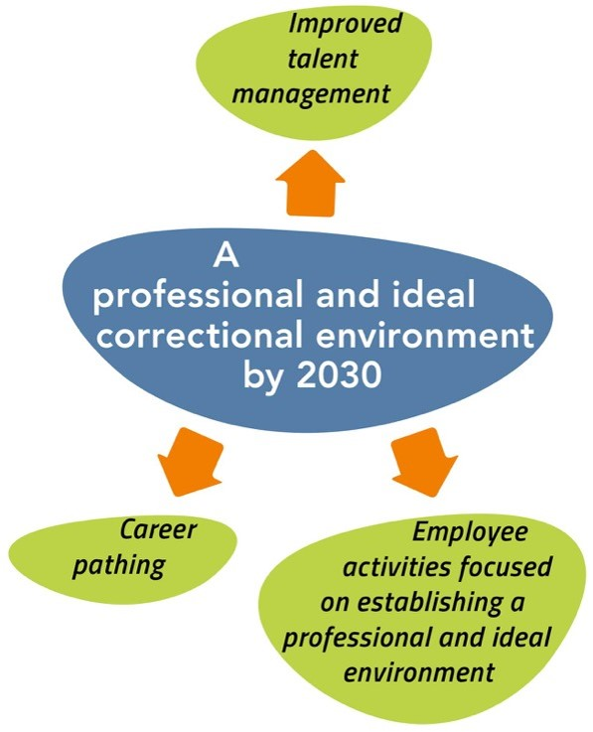
Vision 2068
Outcome 6: High performing ethical organisation
Vision 2068 (Objectives for Finance)
What have we achieved thus far
What do we still need to do to get there
xxxx
xxxx
What is the new thought process
Key levers to be considered

Slide 7
2019 MTSF Priorities
Outcome 6: High performing ethical organisation
7.
1.
PRIORITY 1:
Building a capable, ethical and developmental state
PRIORITY 7: A better Africa and world
PRIORITY 6:
Social
cohesion
and safe
communities
2.
PRIORITY 2:
Economic transformation and job creation
PRIORITY 5:
Spatial integration, human settlements and local government
5.
3.
PRIORITY 3:
Education, skills and health
PRIORITY 4: Consolidating the social wage through reliable and quality basic services
4.
Notes:
This slide is for information only – remind managers what the seven priority areas are – not for presentation purposes

Slide 8
2019 MTSF contributions
Outcome 6: High performing ethical organisation
MTSF Priority Area |  | MTSF Indicator |  | Target |  | Current performance |  | Interventions to achieve the set targets
Priority 2: Economic transformation and job creation |  | Percentage of tenders above R30 million awarded to designated groups
Outcome 4: Successful reintegration of all those under the care of the Department
Notes:
This slide is for information only – remind managers what the seven priority areas are – not for presentation purposes

Slide 9
Problem tree
Outcome 6: High performing ethical organisation
Effects
Demotivated workforce
Poor service delivery
Negative audit outcomes
Fraud and corruption
Problem Statement Strategic Support:
Lack of an enabling environment that supports service delivery excellence
Direct cause:
Lack of integrate business information for informed decision making
Direct cause:
Insufficient budget allocations for programmes and projects
Poor recruitment and retention strategy
Organisational structure not aligned to mandate
Non-compliance with employment equity targets and AA measures
Inadequate resourcing of the colleges
Inconsistent implementation of HR directives
Lack of uniform and appropriate shift system
Inadequate compliance monitoring coverage
Lack of segregation of duties and non-compliance to procurement prescripts
Direct cause:
Non compliance to key legislation, prescripts and policies
Weak economic growth outlook
Inadequate capital investment in production workshops and agriculture
Inadequate spending capacity in some expenditure line items
Data is maintained in multiple systems that are not integrated
Inadequate / Assurance gap on compliance
Delays in investigations, inadequate consequence management
Lack of contract management at Regional/ Management Area level
Poor planning (demand management)
Direct cause:
Inadequate organisational capacity
Direct cause:
Lowly skilled staff
Inadequate training and leadership development
Lack of talent management strategy
Unethical conduct
Manual systems that are prone to human error, high security risks
Inadequate ICT connectivity (bandwidth)
Old infrastructure that is obsolete
Lack of security technology standard to meet functional requirements
Dysfunctional and ineffective of Security Technology (no integration between Information Network and Security Technology)
Inadequate investment in integrated employee health and wellness
Inadequate Covid 19 awareness among officials
Core problem
Notes:
Review the Problem/ Solution Trees to determine if there are any gaps that need to be closed (new problems/ root causes) taking into consideration the current operating environment.

Slide 10
Solution tree
Outcome 1: Improved safety and security
Solution Statement Support:
High performing ethical organisation
Intervention:
Automation and integration of systems
Intervention:
Strategic Human Resource Management
Automation of business process for accurate, reliable, timeous and relevant information
Single view of offender (Integrated Inmate Management System)
Digitalise identity for offenders, officials, visitors, stakeholders
Integration of security technology and information network.
Upgrade and implement security technology
Develop Infrastructure assessment plan to ccontinuously maintain, support and upgrade the IT Infrastructure
Full decentralisation of HR functions
Consistent implementation of HR directives
Approval and implementation of functional, centre-centric organisational structure
Partnership with other departments, HEIs, SETAs, Disability Sector, NSG, professional bodies - MoUs; allowances for professionals, extension of Community service programme to include other professions;
Develop and Implement Talent Management Strategy
Capacitate the Management Areas and correctional centres
Consistently avail adequate budget for the colleges
Intervention:
Improve compliance
Review and automate compliance functions
Review the current supply chain management operating model and awarding of contracts
Review the line of sight between HO, Regions and Management Areas by clearly defining roles and responsibilities
Reorganize Assurance Services to maximize assurance value, optimize operational efficiency
Intervention:
Stringent budget management and enhancing self sufficiency
Timely budget reprioritisation and budget controls.
Continuous cost saving initiatives by way of bid negotiations and strategic procurement initiatives
Contribute towards growing small businesses and cooperatives and designated groups through 30% set aside to support SMME & Cooperatives (PPPFA)
Expansion of opportunities to increase self sufficiency
Approve the appropriate shift system after sufficient staffing has been provided
Implement integrated employee health and wellness programmes and training aligned to COVID 19 SOPs and protocols
Monitoring of compliance to legislation and prescripts
Consequence Management
Fraud awareness
Professionalise the Department
Notes:
Are there any pathways that are blocked, can we follow a new or different pathway to get to the same result. Has COVID-19 open/ closed some challenges or are they still relevant.

Slide 11
Results chain
Outcome 6: High performing ethical organisation
Level of Result | Indicator | Baseline 2020/21 | Target 2021/22 | Assumption/Enablers
Impact (Strategic Plan) Safe and empowered communities through sustainable economic development | N/A | N/A | N/A | N/A
Outcome (Strategic Plan) High performing ethical organisation | N/A | N/A | N/A | N/A
Output (current) Clean audit outcome | Audit outcome | Unqualified audit opinion with findings | Unqualified audit opinion with reduced findings
Accountable financial performance | Approved Integrated finance and supply chain management strategy | Approved Integrated finance and supply chain management strategy | Approved business case for revenue generation and retention
Preferential procurement | Percentage of tenders above R30 million awarded to designated groups | 30% | 30%

Slide 12
Results chain
Outcome 6: High performing ethical organisation
Level of Result | Indicator | Baseline 2020/21 | Target 2021/22 | Assumption/Enablers
Output (new)
Strategic Operational Outputs (how do we deliver the outcomes) | Contract management
Notes:
There will be no further consultation on APP KPI, whatever is added her will be taken as the final

Slide 13
Supply Chain Management centralises demand and acquisition and decentralises logistics…
Outcome 6: High performing ethical organisation
Complete
Partial
Balanced
Partial
Complete
SUPPLY CHAIN: BALANCE OUTSOURCE – PART CENTRAL/DECENTRAL
OUTSOURCE
In the MT SCM Demand and Acquisition would be fully centralised and further demand would also be leveraged out of the DCS production and workshops for goods. This function would be able to provide advisory input into other strategic demand requirements that could be scoped into the DCS workshop
SCM Logistics would remain decentralised but with established outsources functions for transport and arrangements, where necessary with a DCS production workshop function where supply and demand is leveraged
CONTROL
Complete
Partial
Balanced
Partial
Complete
SCM Demand & Acquisition (To-Be) (MT)
SCM Logistics
(To-Be) (MT)
SCM Logistics would remain a decentralised function managed by regions based on the supply of goods and services required by them. Partnerships should be identified for internal functions done by DCS outside of core mandate, e.g. transport
SCM Demand and Acquisition should be phased centralised allowing for regions to focus on core mandate and benefit from centralised sourcing. This would require change management but indicate cost savings due to the leverage of strategic negotiations.
SCM Demand & Acquisition
(To-Be) (ST)
SCM Logistics
(To-Be) (ST)
INSOURCE
Supply Chain As-Is
CENTRALISE
CO-ORDINATION
DECENTRALISE
Current
ST
MT
LT
Change Management Focus

Slide 14
Modes of service delivery for Supply Chain
Outcome 6: High performing ethical organisation
Proposed
Decentralised SC Logistics but centralise SC Demand and Acquisition to improve cost management and reduce corruption
The DCS should look at JIT stock and warehousing to obtain process efficiency gains that can be made in adopting a uniform approach
Further demand should also be leveraged out of the production and workshops entity to ensure a sustainable feed of supplies based on demand within the DCS world
What needs to be done to fast-track
SUPPLY CHAIN
Outsourcing only the distribution and transport of goods will result in a cost saving for the DCS, whilst maintaining a decentralised and insourced warehousing function. This could further leverage of the production agency once established
Notes:
Provide:
The alternative modes of delivery to improve performance
Reflect on the current modes of delivery and SDM proposed
Steps taken to resolve the challenges

Slide 15
Strategic Risks
Outcome 6: High performing ethical organisation
Outcome | Strategic Risk | Risk Mitigation
Notes:
provide:
Updated risks
Plans to mitigate

Slide 16
Critical success factors and management of dependencies
Outcome 6: High performing ethical organisation
xx
Notes:
provide:
Updated risks
Plans to mitigate

Slide 17
Conclusion
Outcome 6: High performing ethical organisation
Notes:
provide:
Updated risks
Plans to mitigate

Slide 18

THANK
YOU
Notes:
Photo by fauxels
on Pexels

