Slide 1


2020 ANNUAL STRATEGIC PLANNING SESSION
Outcome 2: Improved case management processes of inmates

Slide 2
1 | Purpose
2 | The futures triangle
3 | Contextual issues
4 | Vision 2068
5 | MTSF Priorities
6 | Problem and Solution Trees
7 | Results Chain
8 | Alternative modes of delivery
9 | Strategic Risks
10 | Critical success factors
Presentation outline

Slide 3
Purpose
Outcome 2: Improved case management
The purpose of the presentation is to:
Reflect on the current realities that we are facing as a Department to identify new challenges and opportunities in this context.
Reflect on the 50 Year Plan for the Department, assess where we are and what we need to do.
Reflect on the 2020-25 Revised Strategic Plan (SP) and the 2020/21 Revised Annual Performance Plan (APP). What have achieved in this regard over the past six months (Q2 performance).
Review the Problem/ Solution Trees to determine if there are any gaps that need to be closed (new problems/ root causes) taking into consideration the current operating environment. Are there any pathways that are blocked on the Solution Tree, can we follow a new or different pathway to get to the same result. Has COVID-19 open/ closed some challenges or are they still relevant.
Are there any outputs that we have missed in the 2020/21 APP that must be included to achieve the Outcomes in the Revised Strategic Plan?
How do we deliver on the strategic intent set out in the Revised SP and APP? What are the things that we need to deliver on in the Strategic Operational Plans for 2021/22 (strategic levers)?
Notes:
Not for presentation purposes
This is important background information that will guide managers on what the content is focusing on

Slide 4
The futures triangle
Outcome 2: Improved case management
Pull of the future
Safe and empowered communities
1.
Improved safety and security
6.
High performing ethical organisation
2. Improved case management
3.
Increased needs based rehabilitation
5.
Healthy incarcerated population
Weight of the past
Push of the present
4.
Successful reintegration
Social and economic inequalities
Punitive philosophy of corrections
MTEF budget cuts
COVID-19
MTSF
Notes:
Brainstorming technique:
Push: Driving forces in the present that affect the future
Weights: barriers to change that keep us in the past

Slide 5
Contextual issues for 2021 MTEF
Outcome 2: Improved case management
Contextual Issues (examples)
Proposed budget cuts by NT
Implications of Covid-19 on the operating environment (demand for health care services)
Low economic growth (GDP contract by 7.3% in 2020)
Crime trends (upward trend of serious crimes)
Capacity constrains (officials in isolation, quarantine and rotation)
Culture change (increasing use of technology)
Other resource constrains
Overcrowding (slow CJS)
Current 2020/21 actual performance
Opportunities (examples)
Self sufficiency
Partnerships
Promote the option of community corrections as alternative sentencing
Automation
Alternative modes of delivery
Remote working
Staff motivation
Notes:
Examples provided by Strategic Management – Outcome Leaders need to develop their own please

Slide 6
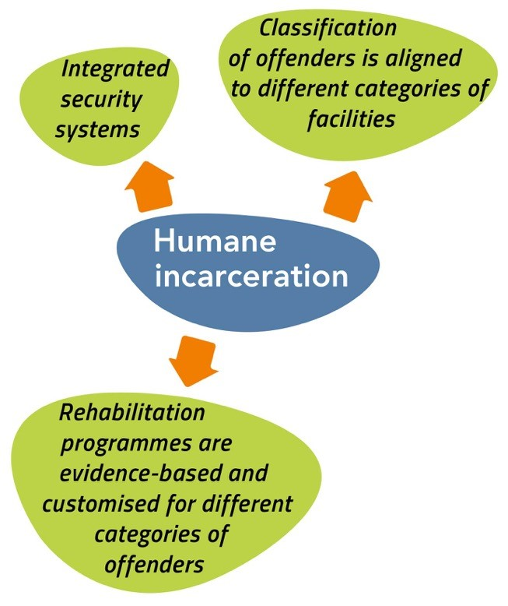
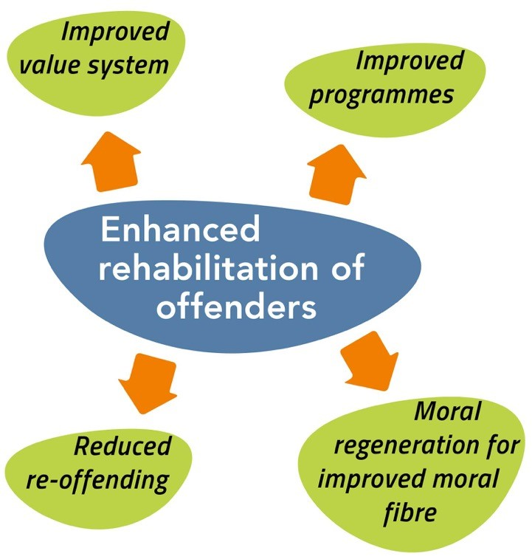
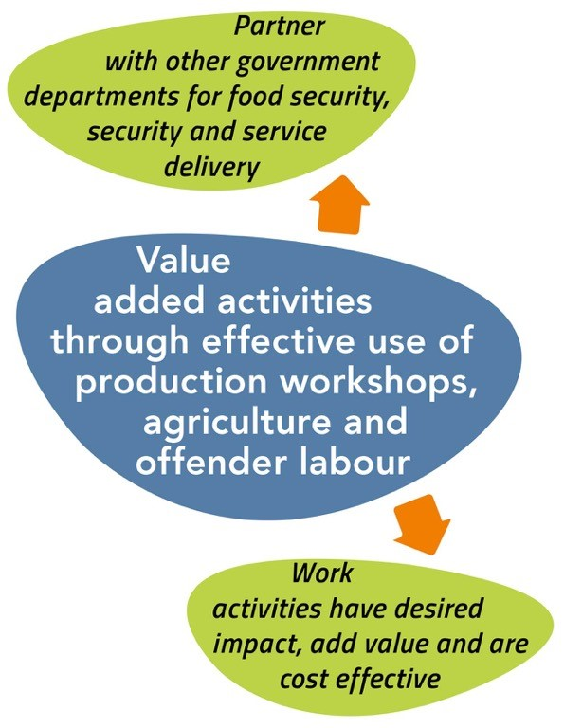
Vision 2068
Outcome 2: Improved case management
Vision 2068 (Objectives for Security and Facilities)
What have we achieved thus far
What do we still need to do to get there
xxxx
xxxx
What is the new thought process
Key levers to be considered

Slide 7
2019 MTSF Priorities
Outcome 2: Improved case management
7.
1.
PRIORITY 1:
Building a capable, ethical and developmental state
PRIORITY 7: A better Africa and world
PRIORITY 6:
Social
cohesion
and safe
communities
2.
PRIORITY 2:
Economic transformation and job creation
PRIORITY 5:
Spatial integration, human settlements and local government
5.
3.
PRIORITY 3:
Education, skills and health
PRIORITY 4: Consolidating the social wage through reliable and quality basic services
4.
Notes:
This slide is for information only – remind managers what the seven priority areas are – not for presentation purposes

Slide 8
2019 MTSF contributions
Outcome 2: Improved case management
MTSF Priority Area |  | MTSF Indicator |  | Target |  | Current performance |  | Interventions to achieve the set targets
Notes:
None for outcome 2

Slide 9
Problem tree
Outcome 2: Improved case management
Effects
Inadequate profile reports
Delayed consideration of offenders for parole placement
Inconsistencies in decision making by CSPBs
Problem Statement Incarceration:
Inefficient implementation of case management processes
Direct cause:
Inadequate case management system and processes
A&R system is outdated (manual)
Lack of integrated criminal justice information and management system (SAP62, SAP 69C & sentence remarks) – CMC, Parole Board & NCCS)
Lack of integrated planning within the JCPS Cluster
Direct cause:
Overcrowding
Occupancy levels exceed available bed space.
No control over the influx of both remand detainees and sentenced offenders
Inadequate implementation of the multi-pronged strategy
Limited functioning of courts during national lockdown, lack of electronic system for bail payment, limited functioning of AVR courts
Delay in the renewal of Parole Board contracts
High inmate population
Core problem
Notes:
Review the Problem/ Solution Trees to determine if there are any gaps that need to be closed (new problems/ root causes) taking into consideration the current operating environment.

Slide 10
Solution tree
Solution Statement Incarceration:
Improve implementation of case management processes of inmates (admission, detention, placement and release)
Intervention:
Review Case Management systems, optimise processes and tools
Intervention:
Integrated approach in the management of overcrowding with Cluster Departments
Induction, training & re-training of personnel in case management processes
Improved collaboration with JCPS Cluster partners
Review the current model of the parole system including the contracts
Implementation of electronic inmate management information system
Promote the use of diversion as sentence option for certain crimes
Review implementation of the current multi-prong strategy
Improve collaboration with JCPS Cluster partners (bail options, non custodial sentences, case related information)
Introduction of cashless and after hours bail payment, increase functionality of ARV courts, automation of CRA linked to SAPS system
Review of legislation in the Criminal Procedure Act and policies to address overcrowding of remand detainees (some reviews are on sentence provisions)
Outcome 2: Improved case management
Notes:
Are there any pathways that are blocked, can we follow a new or different pathway to get to the same result. Has COVID-19 open/ closed some challenges or are they still relevant.

Slide 11
Results chain
Outcome 2: Improved case management
Level of Result | Indicator | Baseline 2020/21 | Target 2021/22 | Assumption/Enablers
Impact (Strategic Plan) Safe and empowered communities through sustainable economic development | N/A | N/A | N/A | N/A
Outcome (Strategic Plan) Improved case management processes of inmates | Percentage increase in offenders profiles approved for placement or release | 53.9% (21 965/ 40 775) | 10% increase | Automation of case management processes Comprehensive risk profiling (assessment, profiling and sentence planning) of inmates Regular review of offenders’ progress by case review team Comprehensive offender profiles by CMCs
Output (APP current) Management of overcrowding Parole / correctional supervision | Percentage of overcrowding in correctional facilities in excess of approved bedspace capacity | 38% | 40%
 | Percentage of offenders’ profiles approved for placement by the Correctional Supervision and Parole Boards (CSPBs) | 53% | 55%

Slide 12
Results chain
Outcome 2: Improved case management
Level of Result | Indicator | Baseline 2020/21 | Target 2021/22 | Assumption/Enablers
Output (APP new)
Strategic Operational Outputs (how do we deliver the outcomes) | Review of the multi pronged strategy on inmate management | Draft strategy finalised | Multi pronged strategy on inmate management approved in Q2 | Stakeholder involvement DoJ, SAPS, etc.
Notes:
There will be no further consultation on APP KPI, whatever is added her will be taken as the final

Slide 13
Incarceration remains insourced and decentralised…
Outcome 2: Improved case management
Complete
Partial
Balanced
Partial
Complete
INCARCERATION: COMPLETE INSOURCE – COMPLETE DE-CENTRALISED
OUTSOURCE
CONTROL
Complete
Partial
Balanced
Partial
Complete
The Incarceration function should remain decentralised in decision making control and fully insourced in terms of staff and resources as this represents the core custodial services of the DCS
INSOURCE
Incarceration As-Is
Incarceration To-Be (ST)
CENTRALISE
CO-ORDINATION
DECENTRALISE
Current
ST
MT
LT
Change Management Focus

Slide 14
Modes of service delivery Incarceration
Outcome 2: Improved case management
Proposed
Without any major changes to decentral management or outsourcing, DCS correctional officials remain focused towards the custodial duty and essential services required by the incarceration function
Remand detention to be treated as a sub function of incarceration ensuring its requirements are met as a sub-programme
Proposed model recognises the severe limitations related to resources and budget and proposes that this be addressed in budget cycles and in the design of a new structure that aligns the service delivery needs of the function
Fully functional information systems
What needs to be done to fast-track
INCARCERATION
The incarceration function remains decentralised and insourced (with the exception of 2 PPP’s) and focuses on custodial services
Notes:
Provide:
The alternative modes of delivery to improve performance
Reflect on the current modes of delivery and SDM proposed
Steps taken to resolve the challenges

Slide 15
Strategic Risks
Outcome 2: Improved case management
Outcome | Strategic Risk | Risk Mitigation
Improved case management of inmates
Notes:
provide:
Updated risks
Plans to mitigate

Slide 16
Critical success factors and management of dependencies
Outcome 2: Improved case management
Fully automated systems with regard to the journey of an offender from the entry into the Department’s care.
Collaborate with DoJ on the review of the Criminal Procedure Act to promote the use of alternative sentencing
Notes:
Critical success factors
How will the success factors influence improvement
Identified key dependencies to engage in delivery of services
Measures taken to engage with such dependencies

Slide 17
Conclusion
Outcome 2: Improved case management

Slide 18

THANK
YOU
Notes:
Photo by fauxels
on Pexels

