Slide 1
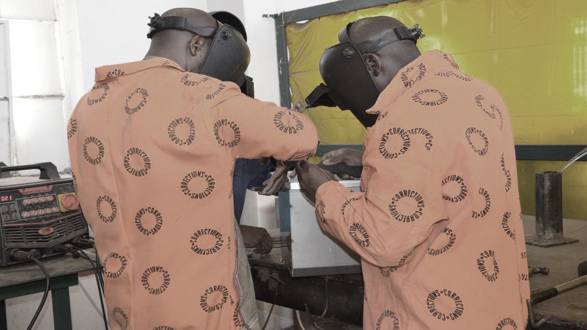

2020 ANNUAL STRATEGIC PLANNING SESSION
Outcome 3: Increased access to needs-based rehabilitation programmes

Slide 2
1 | Purpose
2 | The futures triangle
3 | Contextual issues
4 | Vision 2068
5 | MTSF Priorities
6 | Problem and Solution Trees
7 | Results Chain
8 | Alternative modes of delivery
9 | Strategic Risks
10 | Critical success factors
Presentation outline

Slide 3
Purpose
Outcome 3: Increased access to needs based rehabilitation programmes
The purpose of the presentation is to:
Reflect on the current realities that we are facing as a Department to identify new challenges and opportunities in this context.
Reflect on the 50 Year Plan for the Department, assess where we are and what we need to do.
Reflect on the 2020-25 Revised Strategic Plan (SP) and the 2020/21 Revised Annual Performance Plan (APP). What have achieved in this regard over the past six months (Q2 performance).
Review the Problem/ Solution Trees to determine if there are any gaps that need to be closed (new problems/ root causes) taking into consideration the current operating environment. Are there any pathways that are blocked on the Solution Tree, can we follow a new or different pathway to get to the same result. Has COVID-19 open/ closed some challenges or are they still relevant.
Are there any outputs that we have missed in the 2020/21 APP that must be included to achieve the Outcomes in the Revised Strategic Plan?
How do we deliver on the strategic intent set out in the Revised SP and APP? What are the things that we need to deliver on in the Strategic Operational Plans for 2021/22 (strategic levers)?
Notes:
Not for presentation purposes
This is important background information that will guide managers on what the content is focusing on

Slide 4
The futures triangle
Outcome 3: Increased access to needs based rehabilitation programmes
Pull of the future
Safe and empowered communities
1.
Improved safety and security
6.
High performing ethical organisation
2. Improved case management
3.
Increased needs based rehabilitation
5.
Healthy incarcerated population
Weight of the past
Push of the present
4.
Successful reintegration
Social and economic inequalities
Punitive philosophy of corrections
MTEF budget cuts
COVID-19
MTSF
Notes:
Brainstorming technique:
Push: Driving forces in the present that affect the future
Weights: barriers to change that keep us in the past

Slide 5
Contextual issues for 2021 MTEF
Contextual Issues (examples)
Proposed budget cuts by NT
Implications of Covid-19 on the operating environment (demand for health care services)
Low economic growth (GDP contract by 7.3% in 2020)
Crime trends (upward trend of serious crimes)
Capacity constrains (officials in isolation, quarantine and rotation)
Culture change (increasing use of technology)
Other resource constrains
Overcrowding (slow CJS)
Current 2020/21 actual performance
Opportunities (examples)
Self sufficiency
Partnerships
Promote the option of community corrections as alternative sentencing
Automation
Alternative modes of delivery
Remote working
Staff motivation
Notes:
Examples provided by Strategic Management – Outcome Leaders need to develop their own please

Slide 6
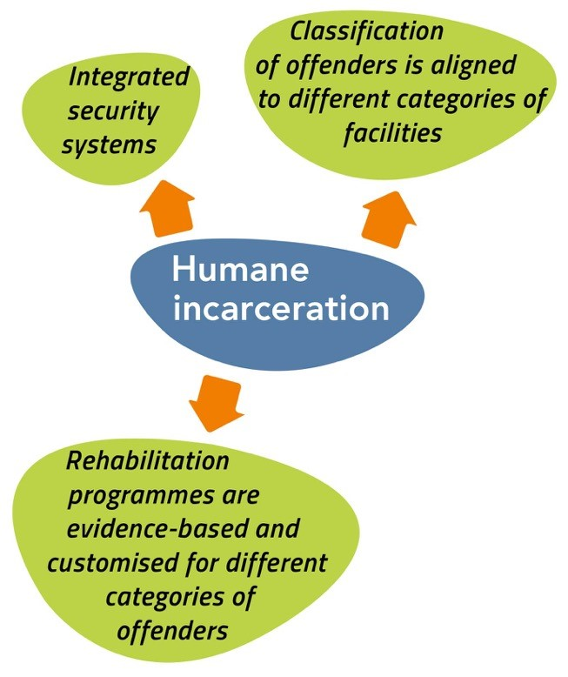
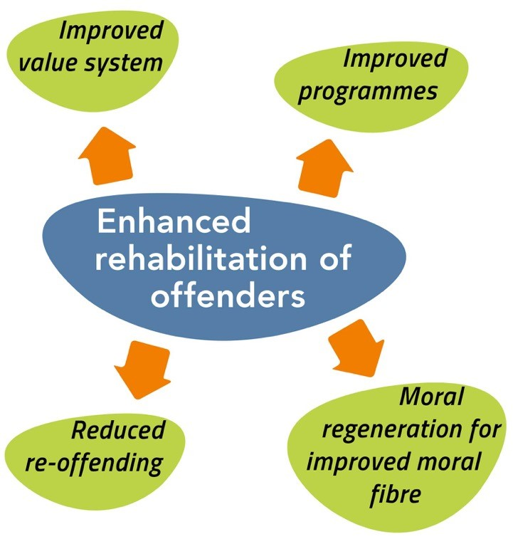
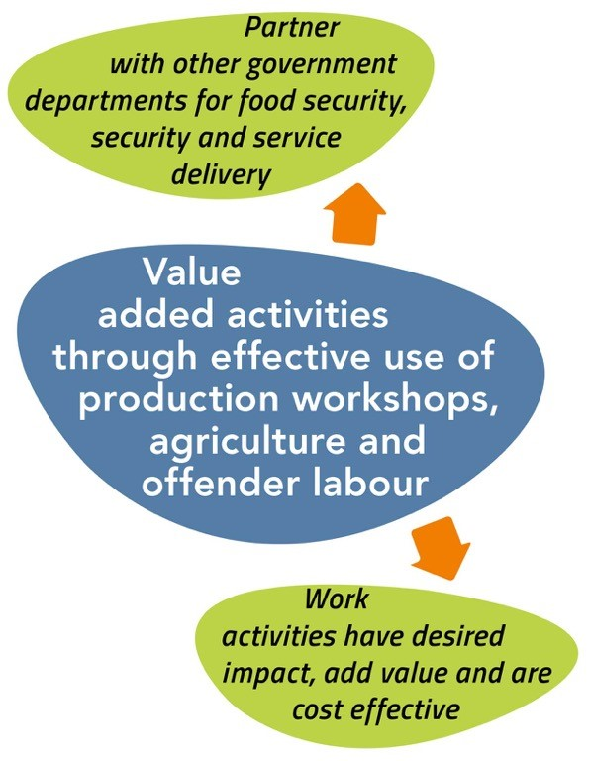
Vision 2068
Outcome 3: Increased access to needs based rehabilitation programmes
Vision 2068 (Objectives for Security and Facilities)
What have we achieved thus far
What do we still need to do to get there
xxxx
xxxx
What is the new thought process
Key levers to be considered

Slide 7
2019 MTSF Priorities
7.
1.
PRIORITY 1:
Building a capable, ethical and developmental state
PRIORITY 7: A better Africa and world
PRIORITY 6:
Social
cohesion
and safe
communities
2.
PRIORITY 2:
Economic transformation and job creation
PRIORITY 5:
Spatial integration, human settlements and local government
5.
3.
PRIORITY 3:
Education, skills and health
PRIORITY 4: Consolidating the social wage through reliable and quality basic services
4.
Notes:
This slide is for information only – remind managers what the seven priority areas are – not for presentation purposes

Slide 8
2019 MTSF contributions
MTSF Priority Area |  | MTSF Indicator |  | Target |  | Current performance |  | Interventions to achieve the set targets
Priority 3: Education, skills and health |  | Percentage of eligible offenders with CSPs who complete correctional programmes |  | 80% |  | 50%
 |  | Percentage of offenders participating in long skills programmes |  | 80% |  | 60%
 |  | Percentage of offenders participating in short skills programmes |  | 80% |  | 60%
Notes:
None for outcome 2

Slide 9
2019 MTSF contributions
MTSF Priority Area |  | MTSF Indicator |  | Target |  | Current performance |  | Interventions to achieve the set targets
Priority 3: Education, skills and health |  | Percentage of offenders participating in TVET College programmes |  | 80% |  | 50%
 |  | Percentage of offenders participating in GET per academic year |  | 80% |  | 60%
 |  | Percentage of offenders participating in GET per academic year |  | 80% |  | 60%
Notes:
None for outcome 2

Slide 10
Problem tree
Problem Statement Rehabilitation:
Inadequate access to rehabilitation programmes to prepare inmates for successful reintegration into society
Direct cause:
Environment not conducive for the implementation of rehabilitation programmes
Direct cause:
Correctional Sentence Plans are not completed and/or fully implemented
Limited number of DCS officials with the competency to provide rehabilitation programmes to offenders (e.g. educators, artisans, social workers)
Disproportionate ratio of offenders to professionals/ custodial members
Dependency on stakeholders to support DCS with rehabilitation programmes training interventions
Lack of integrated planning (internally and externally with stakeholders)
Inability to provide a formal structure for Spiritual and moral development coordinators and Correctional Intervention Officials
Officials performing multiple functions including the implementation of rehabilitation and development programmes
Outdated physical infrastructure, space limitations
Direct cause:
Daily structured programmes are not effectively implemented
Inadequate of personnel available to provide security during the rehabilitation and development programmes compounded by the shift patterns
Unavailability of ICT hardware, digital platforms, e-programmes and electronic monitoring of class attendance
Offenders not reintegrated into society
Reoffending, unemployment and poverty
Effects
Core problem
Notes:
Review the Problem/ Solution Trees to determine if there are any gaps that need to be closed (new problems/ root causes) taking into consideration the current operating environment.

Slide 11
Solution tree
Solution Statement Rehabilitation:
Improved access to rehabilitation programmes for inmates
Intervention:
Monitor implementation of the daily structured programmes.
Intervention:
Create an environment conducive for the implementation of rehabilitation programmes
Intervention:
Monitoring and evaluation of sentence plans to ensure proper completion and implementation
Appoint, identify, train and place officials to render rehabilitation programmes
Marketing and awareness of rehabilitation programmes to foster relationships with external partners
Align the organisational structure and skills to functions
Ensure compliance to internal and external policies/ prescripts
Utilisation of biometrics and other systems to monitor attendance and participation in rehabilitation programmes
Improve planning and collaboration with all stakeholders
Use ICT platforms to present rehabilitation programmes, make use of smart TVs, laptops and desktops for e-learning
Increase classrooms and other venues to be used for rehabilitation programmes
Notes:
Are there any pathways that are blocked, can we follow a new or different pathway to get to the same result. Has COVID-19 open/ closed some challenges or are they still relevant.

Slide 12
Results chain
Level of Result | Indicator | Baseline 2020/21 | Target 2021/22 | Assumption/Enablers
Impact (Strategic Plan) Safe and empowered communities through sustainable economic development | N/A | N/A | N/A | N/A
Outcome (Strategic Plan) Increased access to needs-based rehabilitation programmes to improve moral fibre | • Percentage increase in offenders enrolled in development programmes • Percentage increase of inmates participating in well-being programmes | • 10% (1 457) increase • 6.15% (8 064) | • 25% increase • 10% increase in inmates | Strategic partnerships with relevant stakeholders (e.g. government departments, SETAs, NSF, NPOs, NGOs, FBOs, and private sector) Discretionary Grant allocation Infrastructure that is suitable for rehabilitation purposes Subject specialists to support rehabilitation programmes, including, among others, Psychologists, Artisans, Social Workers, Spiritual Care Workers and Educators
Output (APP current) Offenders who completed correctional programmes | Percentage of sentenced offenders with CSPs who completed correctional programmes | 50% | 70%

Slide 13
Results chain
Level of Result | Indicator | Baseline 2020/21 | Target 2021/22 | Assumption/Enablers
Outputs (APP CURRENT) Occupational skills training | Percentage of offenders participating in Long Occupational Skills Programmes | 80% | 80%
 | Percentage of offenders participating in Short Occupational Skills Programmes | 80% | 80%
 | Percentage of offenders participating in TVET College Programmes | 80% | 80%
Outputs (APP CURRENT) Educational Programmes | Percentage of offenders participating in General Education and Training (GET) per academic year | 80% | 80%
 | Percentage of offenders participating in Further Education and Training (FET) per academic year | 80% | 80%
 | Grade 12 National Senior Certificate (NSC) pass rate obtained per academic year | 76% | 76%
Outputs (APP CURRENT) Enhanced self sufficiency | Percentage of cloth face masks manufactured for inmates | 80% | 100%
Notes:
There will be no further consultation on APP KPI, whatever is added her will be taken as the final

Slide 14
Results chain
Level of Result | Indicator | Baseline 2020/21 | Target 2021/22 | Assumption/Enablers
Outputs (APP CURRENT) Personal well being services | Percentage of offenders, parolees and probationers receiving social work services | 53% | 54%
 | Percentage of inmates receiving spiritual care services | 80% | 82%
 | Percentage of inmates receiving psychological care services | 20% | 21%
Outputs (APP NEW)
Notes:
There will be no further consultation on APP KPI, whatever is added her will be taken as the final

Slide 15
Results chain
Level of Result | Indicator | Baseline 2020/21 | Target 2021/22 | Assumption/Enablers
Strategic Operational Outputs (how do we deliver the outcomes) | Number of rehabilitation programmes reviewed in line with market related skills | 2 | 5
Notes:
There will be no further consultation on APP KPI, whatever is added her will be taken as the final

Slide 16
Rehabilitation progressing toward a balanced centralised and outsourced function
Complete
Partial
Balanced
Partial
Complete
REHABILITATION: BALANCE OUTSOURCE - BALANCE CENTRALISED
OUTSOURCE
Sufficient operational case study observations would inform the DCS of the most profitable entity in which to house a production workshop, allowing a plug and play model. Strategic partnerships already established and working effectively for skills development and rehabilitation
Entrenching these partnerships in the medium term would require more coordination from a centralised perspective. Establishing policies regarding an internal DCS Production workshop should be operationalised which allows for employment of ex-offenders and gratuity for current offenders
CONTROL
Complete
Partial
Balanced
Partial
Complete
The Rehabilitation function would require strategic partnerships be established in the short term. The early internal setup considerations for an operating production workshop should begin
Rehabilitation To-Be (LT)
Rehabilitation To-Be (MT)
INSOURCE
Rehabilitation As-Is
Rehabilitation To-Be (ST)
CENTRALISE
CO-ORDINATION
DECENTRALISE
Current
ST
MT
LT
Change Management Focus

Slide 17
Modes of service delivery Incarceration
Proposed
A strategic intergovernmental partnership approach which balances DCS resources with external resources would allow the DCS to focus on custodial services
Outsourcing of cross-departmental mandated functions such as education, skills development, SRAC, sports arts and recreation, libraries, etc.
DCS may leverage budget allocation, programmes, expertise and focused delivery from partner departments
The ‘mini government’ delivery challenge can be distributed across other key mandated stakeholders
DCS could create a self-sustaining entity for production and workshops which will feed resources back into the system
Fully functional information systems
What needs to be done to fast-track
REHABILITATION
Rehabilitation is proposed toward a balanced outsourced function, maximising the outputs of production and a more centralised function leveraging off strategic partnership arrangements regarding skills development
Notes:
Provide:
The alternative modes of delivery to improve performance
Reflect on the current modes of delivery and SDM proposed
Steps taken to resolve the challenges

Slide 18
Strategic Risks
Outcome | Strategic Risk | Risk Mitigation
Increased access to needs-based rehabilitation programmes to improve moral fibre | Inadequate access to rehabilitation, psychosocial services and developmental interventions to prepare inmates for successful reintegration into society | Formalised partnership with communities, traditional leaders, NGO's and other government departments.
Notes:
provide:
Updated risks
Plans to mitigate

Slide 19
Critical success factors and management of dependencies
Fully automated systems with regard to the journey of an offender from the entry into the Department’s care.
Create greater awareness of rehabilitation programmes to increase partnerships and resources
Notes:
Critical success factors
How will the success factors influence improvement
Identified key dependencies to engage in delivery of services
Measures taken to engage with such dependencies

Slide 20
Conclusion

Slide 21
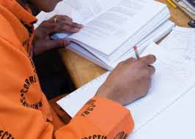
THANK
YOU
Notes:
Photo by fauxels
on Pexels

