Slide 1
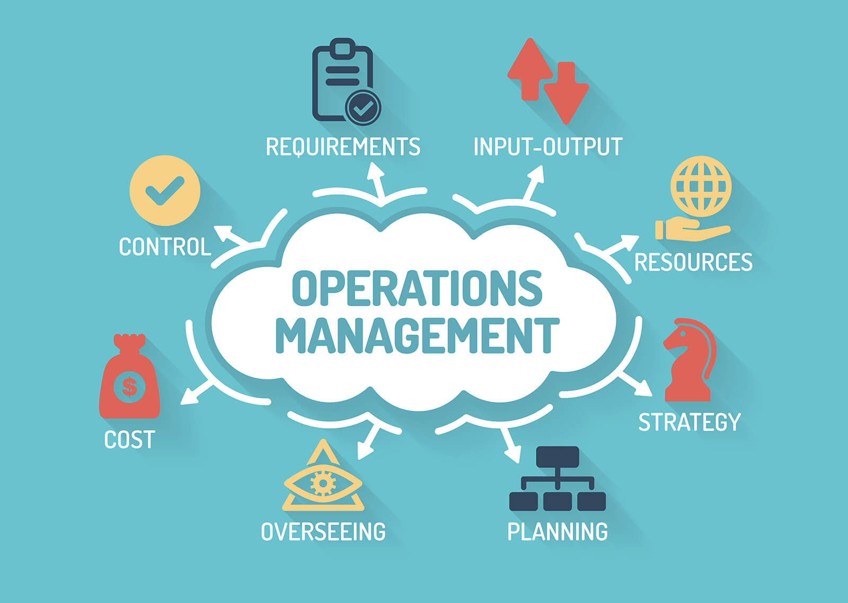


2020 ANNUAL STRATEGIC PLANNING SESSION
OMF PHASE II
WORKSTREAM 4

Slide 2
1 | Purpose
2 | Legislative framework
3 | Public Service Operations Management Framework
4 | DCS Value Chain
5 | Composition of Work Streams & sub - work streams
6 | Progress Workstream deliverables
7 | Planned deliverables and timeframes
8 | Conclusion
Presentation outline

Slide 3
Purpose
OMF Phase II (Workstream 4)
The purpose of the presentation is to:
Provide context to the DCS Operations Management Framework Phase II with a focus on the deliverables of Workstream 4: Change Management .
Provide a summary of the guiding prescripts, guidelines, policy mandates that inform the work to be delivered by Workstream 4: Change Management.
Indicate the core members of Workstream 4: Change Management that have been appointed to deliver on Phase II.
Provide progress of the work completed by Workstream 4: Change Management since the appointment of the workstream leaders and members in February 2019 (18 months).
Indicate the outstanding deliverables for Workstream 4: Change Management with timeframes against the OMF Phase II Charter.
Provide concluding remarks on the deliverables of Workstream 4: Change Management and the movement into the next phase.
Notes:
Not for presentation purposes
This is important background information that will guide managers on what the content is focusing on

Slide 4
Legislative framework - Workstream 4
OMF Phase II (Workstream 4)
Notes:
Not for presentation purposes
This is important background information that will guide managers on what the content is focusing on

Slide 5
DCS Operations Management Framework
OMF Phase II (Workstream 4)
DCS STRATEGY
National Development Plan | Medium-Term Strategic Framework | Strategic plan | Annual Operational Plan | Annual Performance Plan
OPERATIONS
4
Organisational Functionality Assessment
Productivity Measurement
Service Delivery Improvement Plan
Learning and Knowledge Management
1
Transformed Resources
Material
Information
Service Beneficiaries
Operations Strategy
Service Delivery Model (SM) - completed
Operations Analysis & Improvement
Batho Pele
3
Business Process Management - in progress
Standard Operating Procedure
Service Standards
Organisational Development
Operations Design
2
Operations Planning & Control
Transformed Resources
Facilities
Officials
Operational Forecasting
Operational Planning
Operational Control & Adjustments
Transformation
Output
Goods & Services
Notes:
Not for presentation purposes
This is important background information that will guide managers on what the content is focusing on

Slide 6
DCS Value Chain…..and structure
OMF Phase II (Workstream 4)
CENTRE OF EXCELLENCE
xx
Providing the best Correctional Services for
a safer South Africa
THEATRE OF OPERATIONS
INCARCERATION
REHABILITATION
SOCIAL
RE-INTEGRATION
CORE SERVICES
SECURITY
CARE
OPERATIONAL
FACILITIES
ICT
HUMAN RESOURCES
SUPPLY CHAIN
STRATEGY & PLANNING
POLICY & PROGRAMMES
RISK & GOVERNANCE
STRATEGIC PARTNERSHIPS
FINANCE
MONITORING & EVALUATION
Notes:
Not for presentation purposes
This is important background information that will guide managers on what the content is focusing on

Slide 7




Phase II Workstreams
OMF Phase II (Workstream 4)
Workstream 1: People and structure alignment
Workstream 2: Process and technology
Workstream 3: Governance
Workstream 4: Change Management
Workstream 5: Self sufficiency
.
Review the organisational structure
Conduct specialised HR exercises to define key concepts such as the ‘ideal correctional official’, the ideal culture, the competency sets required across the organisation for greater professionalisation
Deploy culture interventions
Mapping of business processes reflective of the Service Delivery Model
Incorporating workflows into standardised documentation
Input of workflows into system design and enhancement
Training for users on processes and technology
Facilitate centralisation of ICT
Update any affected policies
Update of the Delegations of Authority
Update the B-Order and ORP
Communication Strategy and Implementation Plan (Comms)
Selection and Capacitation of Change Leaders and Change Champions
Monitoring and Evaluation
Defining the value of self sufficiency in support of self sustenance and revenue generation
Production workshops
Financial sustainability
Notes:
Not for presentation purposes
This is important background information that will guide managers on what the content is focusing on

Slide 8
Composition of Workstream 4
OMF Phase II (Workstream 4)
Workstream Leader
DC Communications
Regional Comm
Coordinator KZN
Director Marketing and Promotions
Dir Internal Comm. and Media Production
Regional Comm
Coordinator WC
Workstream 4
Change Management
Dir Internal Comm. and Media Production
Regional Comm
Coordinator FS/NC
Dir Public Education, Stakeholder Relations and Media Services
Regional Comm
Coordinator LMN
Regional Comm
Coordinator GP

Slide 9
Overview of Workstream 4 progress
OMF Phase II (Workstream 4)
i.
ii.
iii.
Communication Strategy and Implementation Plan (Comms)
Selection and Capacitation of Change Leaders and Change Champions
Monitoring and Evaluation
35%
23%
17%
Notes:
Not for presentation purposes
This is important background information that will guide managers on what the content is focusing on

Slide 10
Detailed progress on Workstream 4
OMF Phase II (Workstream 4)
DELIVERABLES | PROGRESS TO DATE | COMMENTS
Communication Strategy and Implementation Plan (Comms)
Selection and Capacitation of Change Leaders and Change Champions
Monitoring and Evaluation
Notes:
Not for presentation purposes
This is important background information that will guide managers on what the content is focusing on

Slide 11
Remaining deliverables and timeframes
OMF Phase II (Workstream 4)
MONTH 1
MONTH 2
MONTH 3
Week 1
Week 2
Week 3
Week 4
Week 1
Week 2
Week 3
Week 4
Week 1
Week 2
Week 3
Week 4
Deliverable 1
START – FINISH DATE
Communication Strategy and Implementation Plan (Comms)
xxx
Deliverable 2
START – FINISH DATE
Selection and Capacitation of Change Leaders and Change Champions
xx
Deliverable3
START – FINISH DATE
Monitoring and Evaluation
xx
Deliverable 4
START – FINISH DATE
xx
xx
Deliverable 5
START – FINISH DATE
xx
xxx
Deliverable 6
START – FINISH DATE
xx
xxx
Notes:
Not for presentation purposes
This is important background information that will guide managers on what the content is focusing on

Slide 12
Risk Management
OMF Phase II (Workstream 4)
Deliverable | Strategic Risk | Risk Mitigation
Communication Strategy and Implementation Plan (Comms)
Notes:
Not for presentation purposes
This is important background information that will guide managers on what the content is focusing on

Slide 13
Conclusion
OMF Phase II (Workstream 4)
Notes:
Not for presentation purposes
This is important background information that will guide managers on what the content is focusing on

Slide 14

THANK YOU

