Slide 1
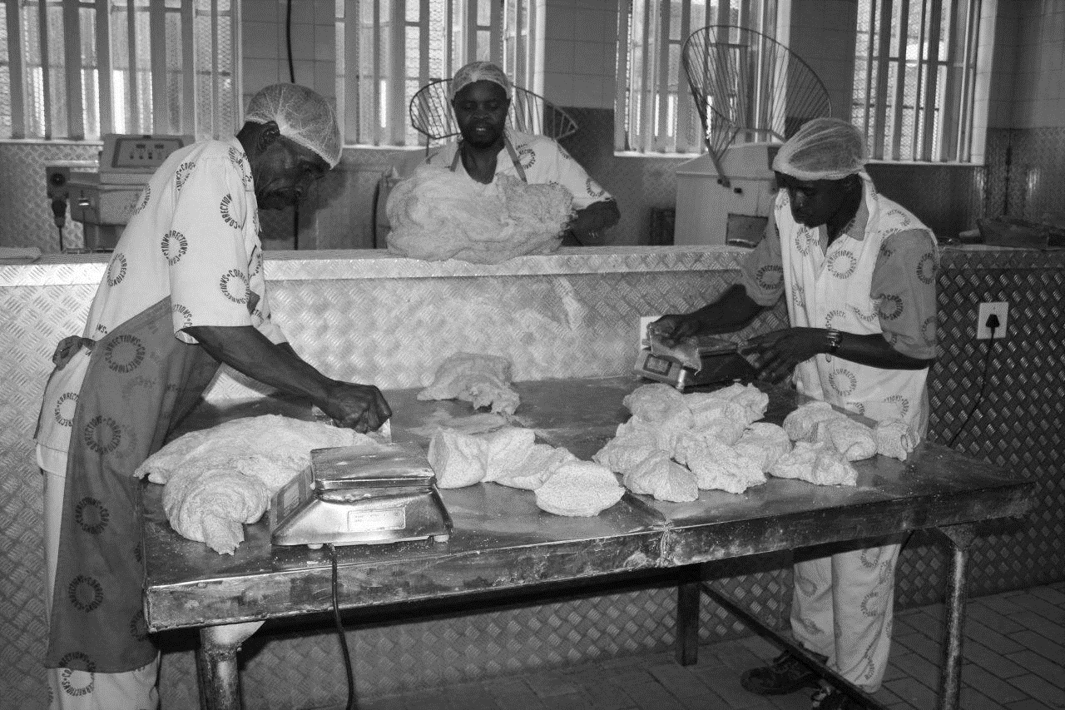
INTEGRATED HUMAN RESOURCE STRATEGY
Branch HR
Date:2020/11/12

Slide 2
EXECUTIVE SUMMARY
The Minister of Correctional Services and the National Commissioner have confirmed on an ongoing basis that the Department exists to give effect to the Constitution of South Africa, operates within statutes, laws and prescripts of the country and serves to achieve the aspirations of the country, namely PRIORITY 6: “Social cohesion and safe communities”
The Department has in the past focused its HR function on filling of vacant posts as one of the HR Performance Indicators, this has in many ways put the ability of the department to provide robust HR interventions such as upliftment of skills of employees and enabling a better working environment at the back . As a result, a number of issues ranging from low employee morale, poor capacity building of employees and low compliance levels with policies and procedures continue to plague the department into a situation often referred to as the “Leaking Bucket Conundrum”
The White Paper on Corrections state that the HR strategy must include human resource planning, entrenchment of an organisational culture that is appropriate to the delivery of core business, that transforms DCS into a recognized profession in South Africa with a commitment to education, training of personnel and career pathing among others.
In the future, the HR function in DCS shall reposition itself and expend its efforts ensuring that employees are engaged and participate fully in the activities of the department (employee engagement). It is envisaged that this approach shall move the department closer to working within the confines of the constitution and the law as well positively contributing to the strategic goals of DCS, the National Development Plan, Vision 2030. This means that HR will be measured on effective and efficient delivery of HR Initiatives as well as Employee Engagement.

Slide 3
INTRODUCTION
BACKGROUND INFORMATION
Human Resource is currently faced with a number of challenges, ranging from capacity, administration, capability of personnel and number of strategic issues such as lack of an integrated HR Strategy.
The white paper on Corrections in South Africa calls for the transformation of the department to a correctional service focused on rehabilitation. It introduces a concept ”ideal Correctional official”, and further outlines the characteristics of an ideal correctional official.
Moreover the HR processes are fragmented culminating to a situation that does not enhance the ideal correctional official in its totality. Additionally, the departmental environment is not conducive to promote the health and development of officials in line with the white paper.
Furthermore, the post establishment of the Department has been progressively reduced in the past years resulting in dire staff shortages which have had the most severe impact in the operations at the correctional centres. These staffing shortages have in turn affected the health and safety of officials resulting in low staff morale, security risks and compromised rehabilitation programmes.

Slide 4
INTRODUCTION…continue
The Department is in the process of reviewing the organisational structure to align it to the recently approved service delivery model. The intention over the strategic plan period is to finalise the process of reviewing the organisational structure and post establishment, development and implementation of the talent management strategy and professionalising corrections.
During 2019/2020 HR embarked on the business environment scanning where inputs from officials at the different session such as Security Indaba, CMC, Roadshows and HR Summits were gathered.
THE PURPOSE OF THE INTEGRATED HR STRATEGY
The purpose of this Integrated HR strategy is to facilitate and support the department to achieve its vision and mission
To this end, there is a need to develop an integrated human resource strategy underpinned by the following four pillars that will determine how the HR services will strive to assist the department to achieve its strategic objectives.
- Human Resource Management
- Human Resource Development
- Employee Relations & Gender and Employment Equity
- Integrated Employee Health and Wellness

Slide 5
INTRODUCTION…continue
PROBLEM STATEMENT
The development of an HR Strategy is a process in motion which cannot be stopped at any stage while the delivery of HR services are in demand. This means that the process of developing the HR strategy must run concurrently with the delivery of HR services. In the process, the delivery of HR services are being delayed due to the participation of key HR functionaries in the development of integrated HR strategy.

Slide 6
Perceptions and HR Challenges
HR is faced with a situation that can be likened to a “leaking bucket”:
Lack of an approved integrated HR Strategy which supports the attraction, development and retention of an ideal correctional officials.
Multiple constraints that limit HR to provide the required capacity to enable the Department to deliver on its strategic goals.
Inadequate capacity to provide relevant, accredited and quality training that is responsive to the needs of the Department.
Low staff morale. This is a serious impediment to excellence in service delivery.
Unhealthy work environment that is not conducive for enhanced service delivery and healthy work force. Environment not conducive to sound employee relations.

Slide 7
Perceptions and HR Challenges
Lack of a service delivery model which is necessary to inform HR essentials.
The entire HR value chain does not target the ideal correctional official.
Inadequate allocation of resources for implementation of policies and strategies that support the attraction, development and retention of an ideal correctional official/leader.
HR does not have full control over the management of the compensation of employees’ budget. Culture of poor performance.
Excellence is not recognised / encouraged in the reward systems currently in place.
The current human resource practices in the department are fragmented and not responsive to the requirements of the white paper.

Slide 8
Legislative Mandates
Correctional Services Act, 1998 (Act No. 111 of 1998, as amended)
Paper on Corrections in South Africa (2005)
PUBLIC SERVICE REGULATIONS, 2016
Public service Act
Labour Relations Act 66
The White Paper on Corrections in South Africa (2005)
Skills Development Act, 1998
Occupational Health and Safety Act 85 of 1993
Compensation for occupational injuries and diseases act of 1993
COVID-19 Direction on Health and Safety in the Workplace issued by the Minister in terms of Regulation 10(8) of the National Disaster Regulations
Promotion of equality and prevention of unfair discrimination act
Promotion of access to information act (no 2 of 2000)
Employment Equity Act

Slide 9
Legislative Requirements
Correctional Services Act, 1998 (Act No. 111 of 1998, as amended)
The Correctional services Act empowers the Commissioner to, subject to provisions of the Act, Public Service Regulations and Labour Relations Act and having regards to operational requirements of the Department, appoint, promote and transfer correctional officials, but
In terms of section 96 (3) (c) the assessment of persons shall be based on level of training, relevant skills, competence, and the need to redress the imbalances of the past in order to achieve a Department broadly representative of the South African
population, including representation according to race, gender and disability.
The White Paper on Corrections in South Africa (2005)
White Paper on Corrections in South Africa identifies corrections as being focused on rehabilitation, it puts the rehabilitation at the centre of all DCS business.
Chapter 8 of the White Paper on Corrections in South Africa, 2005, introduces a concept ”ideal Correctional official”, it further outlines the characteristics of an ideal correctional official. In order to succeed in the rehabilitation of offenders, all officials are expected to embody the characteristics espoused in the White Paper.
.

Slide 10
Legislative Requirements
PUBLIC SERVICE REGULATIONS, 2016
In terms of section 25(2) (a) of the PSR, an Executive Authority will determine the organisational structure of the department based on its support and core functions
Furthermore, section 35(a) requires the Executive Authority to establish operations management framework which will pave way for the development of the service delivery model and the Directive on the design of the organisational structure from the Department of Public Service and Administration requires that the structure should be based on such model.
Section 27 provides for the Executive Authority to develop and implement an employment equity plan as contemplated in section 20 of the Employment Equity Act.
According to section 28 (1) an Executive Authority is required to prepare and implement a human resource development plan of his/ her department taking into account the human resource plan.
Labour Relations Act
The purpose of this Act1 is to advance economic development, social justice, labour peace and the democratisation of the workplace by fulfilling the primary objects of this Act, which are, amongst others-
(c) to provide a framework within which employees and their trade unions, employers and employers' organisations can- (i) collectively bargain to determine wages, terms and conditions of employment and other matters of mutual interest; and (ii) formulate industrial policy; and (d) to promote- (i) orderly collective bargaining; (ii) collective bargaining at sectoral level; (iii) employee participation in decision-making in the workplace; and (iv) the effective resolution of labour disputes.

Slide 11
Legislative Requirements
The White Paper on Corrections in South Africa (2005)
The White Paper states: “A thorough analysis of the categories of personnel that are required to perform the range of functions in the Department’s administrative offices, correctional centres and community corrections offices, is necessary. The distinction between competencies required for line function staff responsible for interacting with offenders, those involved in policy development and administration, and those involved in management must inform the provisioning strategy.”
Skills Development Act, 1998
The Skills Development Act aims to expand the knowledge and competencies of the labour force in order to improve productivity and employment. The Main Aims of the Act are: To improve the quality of life of workers, their prospects of work and labour mobility, To improve productivity in the workplace and the competitiveness of employers, To improve the delivery of services
Occupational Health and Safety Act 85 of 1993
The main objective of the Act could be described as a pro-active attempt by government to prevent and avoid work related injuries and illness. The Act governs the health and safety for the diverse industry of South Africa. It regulates and control health and safety in all organisations, from a normal office environment to more hazardous environments

Slide 12
Legislative Requirements
COVID-19 Direction on Health and Safety in the Workplace issued by the Minister in terms of Regulation 10(8) of the National Disaster Regulations
The OHSA, read with its regulations and incorporated standards, requires the
employer to provide and maintain as far as is reasonably practicable a working environment that is safe and without risks to the health of workers and to take such steps as may be reasonably practicable to eliminate or mitigate the hazard or potential hazard
OHSA requires employers to review and update risk assessments on a regular basis. The objective of conducting or updating a risk assessment in respect of COVID-19 is to provide specific focus on COVID-19 and adapt the measures required by directives been issued to specific working environments taking into account the Risk Assessment Guides published by the National Department of Health.

Slide 13
STRATEGIC PLANNING PROCESS
PLANNING RESOURCING GOAL ATTAINMENT
2
0
2
4
FINANCES
HR/PEOPLE
TECHNOLOGY
2019
INFORMATION
MONITORING AND EVALUATION

Slide 14

HR PILLARS FOCUSED SUMMITS 2019/20
HRM
1stQ
ER
2st Q
HRD
3RD Q
EHW
4TH Q

Slide 15
OUTCOMES OF OUR INTERGRATED STRATEGIC HUMAN RESOURCE MANAGEMENT FRAMEWORK 2019/2020
1ST QUARTER HRM | 2ND QUARTER ER | 3RD QUARTER HRD | 4TH QUARTER EHW
RECRUITMENT STRATEGY | INTEGRATED EMPLOYEE RELATIONS STRATEGY | TRAINING & DEVELOPMENT STRATEGY | 4 PILLARS OF OHS
PERFORMANCE MANAGEMENT STRATEGY | DISCIPLINARY INVESTIGATIVE COMPONENT | PROFESSIONAL COUNCIL | OCCUPATIONAL HEALTH AND SAFETY STRATEGY
CAREER MANAGEMENT STRATEGY | GRIEVANCE SETTLEMENT COMMITTEE |  | INTEGRATED SOCIAL CLUBS AND RECREATIONAL FACILITIES FRAMEWORK
RETENTION STRATEGY
NATIONAL & REGIONAL HUMAN RESOURCE COMMITTEES | WORKPLACE FORUMS BARGAINING COUNCIL | NATIONAL AND REGIONAL LEARNING COMMITTEE | OCCUPATIONAL HEALTH AND SAFETY COMMITTEES

Slide 16
LEGISLATIVE MANDATES
Applicable mandates that give effect to HR Operations
  The Constitution of RSA
  Basic Condition of Employment Act
  Labour Relations Act
  Correctional Services Act 111 of 1998 as amended
  Public Service Act
  Public Financial Management Act
  Occupational Health and Safety Act
  Employment Equity Act
  Protection of Personal Information Act
  White Paper on Corrections;
  National development plan Vision 2030
  DCC Strategic Plan

Slide 17

WHERE ARE WE GOING?
OUR VISION
Providing the best correctional services for a safer South Africa.
OUR MISSION
Contributing to a just, peaceful and safer South Africa through effective and humane incarceration of inmates and the rehabilitation and social reintegration of offenders.
OUR VALUES
The core values that underpin the culture of the Department are the following:
Development.
Integrity
Accountability
Excellence
OUR MOTTO
HR is the Heartbeat of the Department.

Slide 18
HUMAN RESOURCE VALUE CHAIN
HR Management
Need Identified
Recruitment
Induction & Orientation
Placement & Transfers
Employee / Member
Life Cycle
Employee Termination
Employee Life Cycle
Performance Management
Career Path (Career Management)
Training & Development
Core Processes
Service Benefits
Employee Wellness
Social & Recreational Activities
Employee Relations
Availability of accessible facilities
Organisational Development (Org Structures, Job Profiling, etc)
Policies, Procedures & Standards Development & Management (QA)
Employment Equity & Gender Management
Enabling Processes
Persal Management

Slide 19
PILLARS / KEY FOCUS AREAS
Human Resources
Pillar 1:
HR
Management
Pillar 2:
HR
Development
Pillar 3:
Employee
Relations
Pillar 4:
Integrated
Employee
Health and
Wellness
Pillar1::
Purpose
Provide effective and efficient HR Transactional Capacity to enable the department to deliver on its mandate and employee engagement in line with relevant legislations.
Pillar2::
Purpose
To provide relevant, capacity building programmes and accredited and quality training responsive to the needs of DCS in line with the relevant legislations
Pillar3::
Purpose
To create and environment conducive to sound employee relations in line with the relevant legislations
Pillar4::
Purpose
To manage employee health and wellness programmes in line with the relevant legislations

Slide 20


INTEGRATED HUMAN RESOURCE STRATEGIC FRAMEWORK
Shift System implemented
HR Talent Management Strategy
Change management strategy
Improved management of disciplinary cases
Professionalization of corrections
Succession strategy
Sound Employee relations
DCS STRATEGIC INTENTS
INTENDED OUTCOMES
Organisational Structure aligned to Service Delivery Model
Approved Post Establishment (All Correctional facilities)
Recruitment and retention strategy
Youth development and empowerment programme
Compliance with Employment Equity plan
Integrated Health, safety and wellness strategy implemented
Need based training provided
Skills audit
Ideal Correctional Environment
Integrated HR policies / procedures
Career path framework
Automation of HR processes
Decentralised HR functions
Mentoring & coaching
Accreditation of training programmes
5Years
MISSION
Functional organisational structure
HR Talent Management
VISION
10 Years
Ideal correctional environment
Professionalization of corrections
50 Years
African University of Corrections
Explore capacitation of the ideal correctional official for universal and virtual corrections.
HUMAN RESOURCE PILLARS
HRM
HRD
ER
IEHW
HR Standards
HR Policies and Procedures
Legislative Mandates Standards

Slide 21
INTENDED OUTCOMES OF THE STRATEGY
5 Year Strategic Intent
Impact:
Outcome:
Build capacity to ensure value driven delivery of correctional services
Strategic intent:
Functional organisational structure developed
HR Talent Management Strategy developed and implemented
Integrated support and solutions for efficient and economical service delivery

Slide 22
INTENDED OUTCOMES OF THE STRATEGY
Strategic Intent | Strategic measure | 5 year target | Year 1 | Year 2 | Year 3 | Year 4 | Year5 | Responsible Pillar
Functional organisational structure developed by 2028 | Approved reviewed Organisational Micro Structure | Implementation of an approved functional Structure | Develop an Organisational Structure aligned to the Service Delivery Model | Develop an Organisational Structure aligned to the Service Delivery | Determine Post establishment for the draft organisational structure | Consultations with the key stakeholders | Approved functional structure and implementation of the structure | CDC HR
Expected results of the strategic intent: An organisational structure which is informed by the strategic plan of the Department and enables the provision of support and core functions. Established clear reporting lines anchored on the Service Delivery Model and District Development Model while emphasising on Centre Centric approach

Slide 23
INTENDED OUTCOMES OF THE STRATEGY
Strategic Intent | Strategic measure | 5 year target | Year 1 | Year 2 | Year 3 | Year 4 | Year5 | Responsible Pillar
HR Talent Management Strategy in place by 2023 | Strategy developed which encompasses a competency framework, recruitment policy, career pathing policy, retention policy and succession planning policy | HR Talent Management Strategy in place | Consultations on the development of Retention Strategy | Career Pathing aligned to the Occupational Specific Dispensation developed | Development of Competency framework | Implementation of the HR Talent Management Strategy | Monitoring of the implementation of HR Talent Management | DC HRM Directors in the Chief Directorate HRM Regional Heads Corporate Services
Expected results of the strategic intent: Attract and nurture the required talents into the organisation while continuing to invest in such talents with the intention of creating leadership for the future management of the organisation.

Slide 24
INTENDED OUTCOMES OF THE STRATEGY
Strategic Intent | Strategic measure | 5 year target | Year 1 | Year 2 | Year 3 | Year 4 | Year5 | Responsible Pillar
Consistent Implementation of the EE Plan | Attainment of equitable workforce representation in all occupational levels | Achievement of EE targets : SMS: 50/50% PWD: 2 % | SMS: 50/50 PWD: 2% | SMS: 50/50 PWD: 2% | SMS:50/50 PWD: 2% | SMS: 50/50 PWD: 2% | SMS: 50/50 PWD: 2% | CDC:HR
Expected results of the strategic intent: Achievement of disability and gender EE targets as required by Cabinet and Employment Equity Act. This can only be achieved if the transformational gender unit is correctly placed.

Slide 25
INTENDED OUTCOMES OF THE STRATEGY
Strategic Intent | Strategic measure | 5 year target | Year 1 2021/2022 | Year 2 2022/2023 | Year 3 2023/2024 | Year 4 2024/2025 | Year 5 2025/2026 | Responsible Pillar
Maintenance of sound labour relations environment | Attainment of labour peace, reduction of grievances /disciplinary cases and few litigations | Achievement of harmonious and peaceful working environment in term of ER agreed targets. | Finalisation of grievances and disciplinary cases within the prescribed time. | SMS: 50/50 PWD: 2% | SMS: 50/50 PWD: 2% | SMS: 50/50 PWD: 2% | SMS: 50/50 PWD: 2% | CDC:HR
Expected results of the strategic intent: Attainment of labour peace and harmonious environment, reduction of grievances /disciplinary cases and few litigations through effective monitoring and consequence management.

Slide 26
INTENDED OUTCOMES OF THE STRATEGY
Strategic Intent | Strategic measure | 5 year target | Year 1 (2019-2020) | Year 2 (2020-2021) | Year 3 (2021-2022) | Year 4 (2022-2023) | Year 5 (2023-2024) | Responsible Pillar
IEHW Program implemented at 48 Management Areas |  | 48 Management Areas | 12 | 12 | 12 | 12 | Review the effectiveness of the IEHW program | DC IEHW
Expected results of the strategic intent: Healthy and safe workforce which may improve work output Aims to create, promote and maintain an enabling environment for the integrated management of the health and wellness of DCS employees. In addition, the program aims to enhance health and safety in the workplace which may increase productivity and efficiency

Slide 27
INTENDED OUTCOMES OF THE STRATEGY
Strategic Intent | Strategic measure | 5 year target | Year 1 2021/2022 | Year 2 2022/2023 | Year 3 2023/24 | Year 4 2024/2025 | Year 5 2025/2026
Professionalization of corrections | Approved Professional council for Corrections | Interim structure for Professional Council implemented. | Draft Legislation for Professional Council consulted externally. | Interim structure for Professional Council implemented Draft Legislation submitted to Legal Services for coordinating process for passing the legislation. | Draft legislation to Parliament for approval | Bill submitted to state law advisors for certification | HRD DC: Legal Services
Expected results of the strategic intent: To professionalize the public service and improve the quality of service delivery. To produce competent correctional officials through effective registration and continuous professional development

Slide 28
INTENDED OUTCOMES OF THE STRATEGY
10 Year Strategic Intent
Impact:
Integrated support and solutions for efficient and economical service delivery
Outcome:
Build capacity to ensure value driven delivery of correctional services
Strategic intent:
Functional organisational structure implemented
Ensure ideal correctional environment
Professionalization of corrections

Slide 29
INTENDED OUTCOMES OF THE STRATEGY
Strategic Intent | Strategic measure | 10 year target | Year 2026/2027 | Year 2027/28 | Year 2028/29 | Year 2029/2030 | Year 2030/31 | Responsible Pillar
Functional organisational structure developed by 2028 | Organisational structure aligned to MTSF strategy | Revised organisational structure implemented | Revised organisational Structure approved. | Organisational structure implemented | Organisational structure implemented | Organisational structure implemented | Review of Organisational structure | CDC HR
Expected results of the strategic intent: Organisational structure aligned to MTSF strategy.

Slide 30
INTENDED OUTCOMES OF THE STRATEGY
Strategic Intent | Strategic measure | 10 year target | Year 2026/27 | Year 2027/28 | Year 2028/29 | Year 2029/2030 | Year 2030/31 | Responsible Pillar
Ensure ideal correctional environment by 2028 | Safe, healthy and conducive work environment | Idea correctional environment created | Conduct organisational culture survey | Identification and realignment of HR policies and procedures Implement findings and recommendations of culture survey | Implementation of realigned human resources policies and procedures. Monitor the implementation of culture survey findings and recommendation | Monitor the implementation of realigned HR policies and procedures Monitor the implementation of culture survey findings and recommendation | Monitor the implementation of realigned HR policies and procedures Monitor the implementation of culture survey findings and recommendation | CDC HR
Expected results of the strategic intent: Creation of a conducive environment in which the official are able to practice and support the goals of the correctional system.

Slide 31
INTENDED OUTCOMES OF THE STRATEGY
Strategic Intent | Strategic measure | 10 year target | Year 2026/2027 | Year 2027/28 | Year 2028/29 | Year 2029/2030 | Year 2030/31
Ensure ideal correctional environment | Trained officials in ethics and integrity framework | Officials trained on ethics and integrity framework(no budget) | Master trainers trained on ethics and integrity framework | Officials trained on ethics and integrity framework | Officials trained on ethics and integrity framework | Officials trained on ethics and integrity framework | HRD DIU
Expected results of the strategic intent: To comply with regulatory guidelines and influence employee behavior, To educe the risk of ethics and violations, both intentional and unintentional

Slide 32
INTENDED OUTCOMES OF THE STRATEGY
Strategic Intent | Strategic measure | 10 year target | Year 2026/2027 | Year 2027/28 | Year 2028/29 | Year 2029/2030 | Year 2030/31
Professionalization of corrections | Approved Professional council for Corrections | Interim structure for Professional Council implemented. | Draft legislation to Parliament for approval | Bill submitted to state law advisors for certification | Professional council established | Professional council established | HRD DC: Legal Services
Expected results of the strategic intent: To professionalize the public service and improve the quality of service delivery. To produce competent correctional officials through effective registration and continuous professional development

Slide 33
INTENDED OUTCOMES OF THE STRATEGY
50 Year Strategic Intent
Impact:
Integrated support and solutions for efficient and economical service delivery
Outcome:
Build capacity to ensure value driven delivery of correctional services
Strategic intent:
African University of Corrections
Explore capacitation of the ideal correctional official for universal and virtual corrections.

Slide 34
INTENDED OUTCOMES OF THE STRATEGY
Strategic Intent | Strategic measure | 50 year target | Year 20 | Year 10 | Responsible Pillar
African University of Corrections | African University established | Established university | Installation of the university(funding, partnerships etc) | Explore and identify the needs | HRM HRD
Expected results of the strategic intent: The idea would have been explored and needs identified within the member states Budget will be sourced and provided by member states and other relevant partners (AUC) be established and communication strategy implemented throughout the members states and relevant parners.

Slide 35
CONTEXTUAL ISSUES
The following are the guiding documents that inform HR:
National Development Plan - Chapter 13: Building a capable and developmental state
  Objective: Staff at all levels have the authority, experience, competence and support they need to do their jobs
All the national strategic documents related to HR emphasize building public sector capacity, developing skills to meet the demands of the current and emerging social and economic priorities and to overcome the related challenges of poverty and unemployment, especially among the youth.
  Objective: A public service immersed in the development agenda but insulated from political interference.
The emphasis is on making every workspace a training space with the state being at the forefront of driving work integrated learning and development initiatives.
Commitment to employ 2064 entry level correctional officials annually - this means that the Department will need to enrol this number of learners in the Correctional Services Learnership per annum to have a ready pool of competent entry level correctional officers to draw from.

Slide 36
CONTEXTUAL ISSUES
This is in line with Priority 1 of the MTSF which emphasizes the need for economic transformation and job creation, especially for the youth.
The wellbeing of youth will have to be prioritised and institutionalised in the wellness policies.
HR is expected to contribute to Priority 6: A capable, ethical and developmental state.
The CoE budget cuts will however have a negative impact on the alignment of the organisational structure and filling of posts which will also affect the National Development Plan (NDP) , Medium Term Strategic Framework (MTSF) and National Priorities in job creation and number of youth to be employed in DCS.

Slide 37
ENVIRONMENTAL ANALYSIS
Strengths | Weaknesses
Experienced HR subject matter experts | Lack of an appropriate organisational structure to attract and retain the skills required for an impactful approach to HR.
Good relationship with critical stakeholders including SASSETA, NSG, EAPA-SA, Organised Labour, National Treasury, DPSA, Tertiary Institutions and NGO’s. | Benefits of these relationships not optimised.
E-learning has been introduced and this mode of delivery saves costs while reaching large numbers | Lack of sufficiently developed systems and appropriate technology to capture and analyse HR information
Two DCS Colleges and training centres in most management areas | Not all infrastructure is OHS compliant and accessible and PWDs and OHS meetings not held consistently.
Capacitated EAP’s to manage referrals | Insufficient EAP’s
Large numbers that are taken in the learnership and internship programmes | The inability of available systems to cope with the large volumes of applications received for the learnership.
Availability of HR policies | There is poor, inconsistent implementation and monitoring
Draft HR Strategy | Lack of integrated HR strategy
Compensation of employees’ budget | Inadequate HR budget and capacity to fill posts

Slide 38
ENVIRONMENTAL ANALYSIS
Opportunities | Threats
High unemployment rate, which includes a large number of unemployed Corrections graduates whose skills can be tapped into for entry level positions | Shortage of professional skills in the country
 | Expectations of employment from communities in the recruitment processes.
 | Bogus recruitment agencies
 | High unemployment and levels of poverty which means large numbers of applications which are difficult to manage
4th industrial revolution - E-learning | CoE Budget cuts
Courses offered and funded by international organisations | Lack of collaborative efforts between the Government Departments
E-recruitment for developmental programmes and posts, e-bursary applications | Lack of adequate IT infrastructure
Automation of HR processes | High conviction rate
Enhanced employee engagement | Labour unrest, high litigation rate

Slide 39
CRITICAL SUCCESS FACTORS TO MEET TARGET
Requirements | Dependencies
Organisational Structure aligned to Service Delivery Model | Approved service delivery model
Approved Post Establishment (All Correctional facilities) | Approved organisational structure and job profiles
Recruitment and retention strategy developed and implemented (ideal correctional official) | Cooperation and buy-in from stakeholders
Compliance with Employment Equity plan | Compliance to EE Plan by delegated Authority. Functional Gender and equity desk
Integrated Health, safety and wellness strategy implemented | Availability of funds Need for additional dedicated HR capacity for wellness programmes, with urgent intervention required in terms of occupational health and safety, in particular.
Shift System implemented | Buy-in from labour unions, Signing of averaging agreement with labour unions / Overtime payments (availability of funds)
HR Talent Management Strategy developed and implemented | Availability of funds
Need based training provided | Availability of funds.

Slide 40
CRITICAL SUCCESS FACTORS TO MEET TARGET
Requirements | Dependencies
Ideal Correctional Environment | Sound HR practices, labour relations and compliance with policies Implementation of with Integrated Health, safety and wellness strategy implemented
Alignment of HR policies / procedures - to be responsive to national disasters e.g COVID-19 Development of Promotions policy | Policy reviews and approvals thereof , availability of funds, training Review of the OSD for Correctional Officials
Automation of HR processes | Assistance with the enhancement of ICT infrastructure and procurement of equipment for ICT training and e-learning.
Decentralised HR functions | Availability of policy procedures and review of delegations of authority. Training and continuous monitoring of HR activities
Improved management of disciplinary cases | Implementation of ER Policies and legislation, functional Labour Forums, monitoring and enforcement of collective agreements
Professionalization of the corrections profession | Buy-in from the stakeholders Capable and competent staff Availability of core business policies to inform training material

Slide 41
PROGRESS TO DATE ON THE STRATEGY DEVELOPMENT
HRM, HRD and ER summits held (with head office and regional representatives) in 2019/20 to lay the foundation for an Integrated HR Strategy
Draft master plans were developed from the inputs which inputs were based on a situational analysis, are aimed in the development of the integrated HR Strategy of the Department
The Integrated Employee Health and Wellness Summit was affected negatively by the Covid-19 pandemic that had an impact on all meetings and gatherings.
1st draft of the integrated Strategy HR strategy developed in consultation with the regional Heads of Corporate Services

Slide 42
RISK MANAGEMENT
Outcome | Risk | Probability (High/ Medium/ Low) | Impact (High/ Medium/ Low) | Mitigation Strategy
Professionalisation of Corrections | Interim structures not approved | High | High | Engagement of Ministry
Contribution to youth employment and empowerment through the Corrections Services Learnership while filling entry level vacancies | Correctional Training Colleges not adequately resourced | High | High | Budget planning for the learnership MOU with SANDF to provide facilities and facilitators
Provide a summary of the risks and mitigation factors related to the delivery and implementation of the Strategy

Slide 43
RISK MANAGEMENT
Outcome | Risk | Probability (High/ Medium/ Low) | Impact (High/ Medium/ Low) | Mitigation Strategy
Improve human resource capacity and management to enable the department to fulfil its mandate | Misalignment between organizational structure and operational needs. | high | high | Proper feasibility studies conducted and approval of the Structure accelerated
 | Staff shortage | high | high | Develop and accelerate the implementation of the three(3) pronged HR Recruitment Strategy
Provide a summary of the risks and mitigation factors related to the delivery and implementation of the Strategy

Slide 44
PROJECT PLAN TO FINALISE THE INTEGRATED HUMAN RESOURCE STRATEGY
Output | Action | Time Frame
Integrated HR Strategy approved by 31 March 2021 | Consultation on the 1st draft Strategy with internal stakeholders | Quarter 2 of 2020/21
 | Consultation with regions and branches | Quarter 3 of 2020/21
 | Approval of the draft IHR strategy | Quarter 4 of 2020/21
Integrated HR Strategy Implementation | Workshops in regions and HO | Quarter 1 and 2 of 2021/2022
 | Monitoring and Evaluation | Quarter 3 and 4 of 2021/20
Integrated HR Strategy Review | Assessing the efficacy of the strategy | Quarter 3 and 4 of 2023/24
 | Recommendations for possible review | Quarter 1 of 2024/25

Slide 45

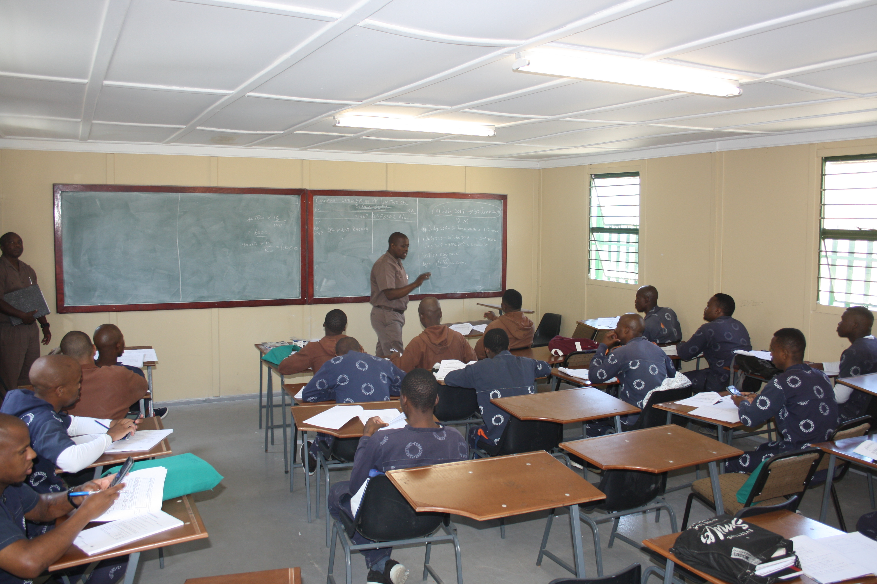

Department of Correctional Services (DCS)
Head Office: Correctional Services
124 WF Nkomo Street
WF Nkomo & Sophie De Bruyn Streets
Pretoria Central
Private Bag X136
Pretoria
0001
Website: http://www.dcs.gov.za

