Slide 1
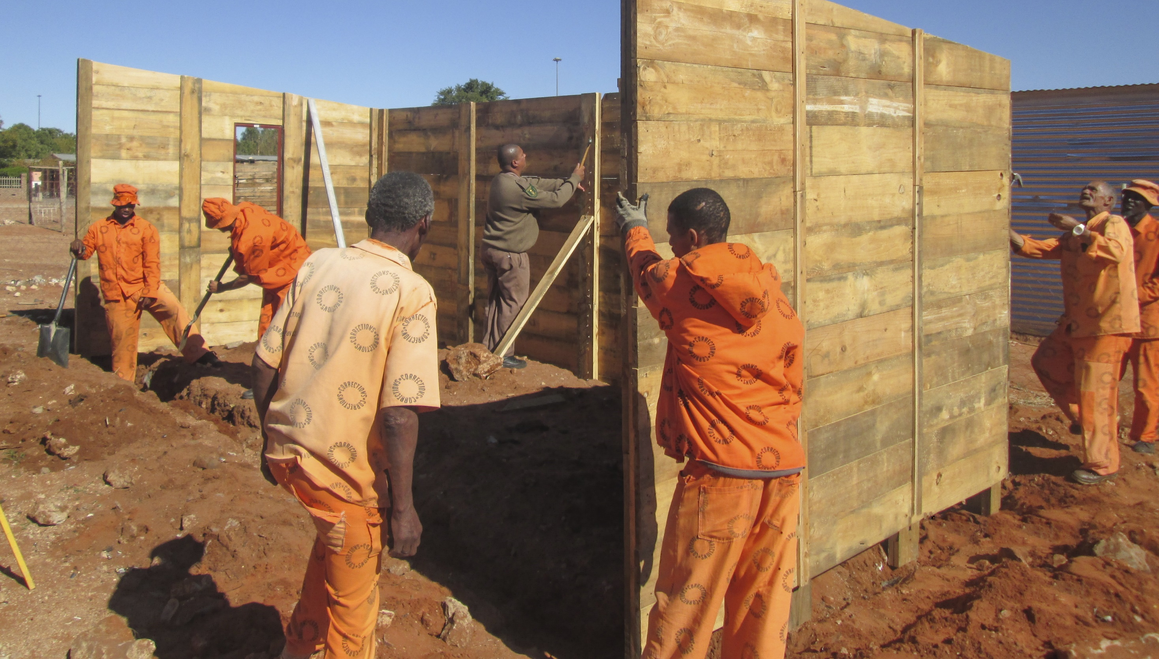
2021 STRATEGIC PLANNING SESSION
DELIVERY PRIORITIES

Slide 2
HIGH LEVEL PROBLEM STATEMENT
Lack of economic transformation, continued economic exclusion, skewed ownership patterns and slow land redistribution
High levels of unemployment, poverty and hunger exacerbated by COVID 19
Weaknesses in building a capable state and implementing NDP priorities
Insufficient reach and impact of government programmes and public
Expenditure
Persistence of wealth, income and gender inequality
Imbalance between redistribution and productive capacity
Spatial disparity and persistence of apartheid spatial planning
Continued inequality in access to and quality of public services, education & health systems
Low growth rates, economic contraction and decline in revenue
Lack of digital readiness
Persistence of GBVF and violent crime
Corruption threatening moral and ethical basis of democracy and undermining public trust
“The state has
not adequately
utilized the levers
at its disposal to
fundamentally
entrench the
economic rights
of the historically
disadvantaged
and reverse the
apartheid legacy”
Notes:
The Framework for 2021 mid-year Cabinet Lekgotla characterises current period as mid-term/mid-point of 6th Administration. Which requires proper review of performance on the country’s main plans, i.e NDP 2030 and MTSF 2019-2024 anchored on 6th Administration priorities.
Which, in turn, will inform priorities for remainder of medium-term to 2024, and pathway to 2030. In line its mandate as long term planning and advisory think tank, the NPC undertook a review of implementation and progress with NDP top goals since adoption in 2012
Priorities for remainder of medium-term to 2024, and pathway to 2030 should reflect the review of performance on NDP, review of MTSF, and plans responding to COVID 19 pandemic and sectoral plans (ERRP, Infrastructure Plan, etc) remaining towards 2030.

Slide 3
FACTORS SHAPING SA’s DEVELOPMENT
It is imperative to take account of internal and external driving factors that impinge SA’s development trajectory (as risks and opportunities), and not all adequately reflected in NDP:
Vulnerabilities of globalisation to cycles of crises – and inequality in ability to respond among countries;
This evident in the current COVID-19 global health crisis (vaccine nationalism; implication for tourism); What lessons have we learnt for the future?
A multipolar world with China as emerging power, but US-China fallout had global repercussions, and threatened world trade system.
Anti-globalist/inward-looking shifts –e.g. Brexit, with implications SA as UK is a major trade partner.
Climate change.
Rising African economy and continental integration, yet, remaining instability (e.g. Swaziland and Mozambique).
Population growth (currently outpacing GDP growth); Turn the youth bulge into a demographic dividend .
Technological advances (4IR opportunities; digital divide).
Migration.
Notes:
Globalisation is under significant threat as governments scramble to reduce their vulnerability to the virus by limiting global trade and flows of people. With the imposition of border closures and strict migration measures, there have been major disruptions in Africa’s global supply chains with adverse impacts on employment and poverty
The youth bulge is a common phenomenon in many developing countries, and in particular, in the least developed countries. It is often due to a stage of development where a country achieves success in reducing infant mortality but mothers still have a high fertility rate. In a country with a youth bulge, as the young adults enter the working age, the country’s dependency ratio-- that is, the ratio of the non-working age population to the working age population—will decline. If the increase in the number of working age individuals can be fully employed in productive activities, other things being equal, the level of average income per capita should increase as a result. The youth bulge will become a demographic dividend. However, if a large cohort of young people cannot find employment and earn satisfactory income, the youth bulge will become a demographic bomb, because a large mass of frustrated youth is likely to become a potential source of social and political instability. Therefore, one basic measure of a country’s success in turning the youth bulge into a demographic dividend is the youth employment rate

Slide 4
DESIRED INCLUSIVE GROWTH NOT ACHIEVED
Significant improvements in employment, income support and growth over the decade up to 2008, since then progress has stalled;
High structural unemployment and a lack of economic participation have impacted on efforts to raise living standards, eradicate poverty and achieve greater equity;
Performance in meeting NDP objectives for industrial dynamism over the past decade has been poor;
South Africa still has high levels of market concentration, significant presence of collusive behaviour and legacy barriers to market access for new players, especially those that were historically disadvantaged;
Significant asset poverty amongst the majority of the population contributes to vulnerability and constrains intergenerational class mobility - slowing overall economic and employment growth - the suite of challenges relates to land ownership in rural, township and urban areas, home ownership, access to finance, and the ability to build up household savings.
Insufficient efforts to address the youth and gender dividend and focus on higher levels of economic inclusion
Notes:
Income poverty
Those living below poverty line fell from 51% of population in 2006 to 36.4% in 2011, reversing to 40% in 2016.
Social wage playing important, but diminishing role. Rising employment, stronger service delivery and reduced cost of living will address this.
Asset poverty is deep. Central concerns are related to land redistribution, low-income housing; too few people have a pension; and high indebtedness.
Income inequality
GINI fell slightly but returned to 2009 level of 0.69, hence South Africa remains the most unequal society.
Wealth inequality
90%-95% of wealth concentrated in top decile, compared to global average of 55-60%.
5% of wealth in bottom 40% of population.
Most significant difference in SA is that middle class (decile 5-9) have such a small asset base.
This will have significant impact on pathways for inter-generational class mobility.

Slide 5
DESIRED INCLUSIVE GROWTH NOT ACHIEVED
Public infrastructure investment most notably in respect of energy, water, ICT, and transport is central to achieving greater productivity and competitiveness, reducing spatial inequality and supporting the emergence of new job creating sectors;
Electricity shortages are still a key constraints, despite a slowdown in economic activity Electricity shortages will continue to hamper economic activity and deter people from making new investments;
Evidence suggests that the social wage has made a significant impact on the quality of life, with the multi dimensional poverty headcount falling from 17.9% in 2001 to 8.0% by 2011 and then to 7.0% in 2016 but there are limits to the contribution of the social wage;
Although education outcomes have improved, we still lag behind based on international benchmarks there is a very close correlation between improvement in education and employment and incomes;
The quality of delivery from public infrastructure to skills development is determined by the capability of the state. A capable state implements policies effectively, uses state resources efficiently, and builds the confidence of citizens and the private sector;
The COVID 19 pandemic has worsened economic growth unemployment, poverty and inequality;
Notes:
Four worrying trends:
•By 2019, employment shortfall was 1.5m, or about 60% of the target. Will be much lower from 2020.
•Falling employment in manufacturing–2010-2019 -313,000 jobs lost.
•Share of small firms in total employment fell from 64% to 55% between 2008 and 2015. Absolute numbers hardly grew.
•Youth employment stagnated.
Trends of unemployment since 2012 has been upward.
•The original target of full employment by 2030 can no longer be achieved.
•Vulnerable and informal workers need social protection
•Covid will make it even harder, given that the jobless rate is 32.5%.
•It is still imperative to commit to full employment as the top priority even if the timing changes.

Slide 6
THE SA ECONOMY
NDP target by 2020 was to lift growth to an average 4,6% (employment expands about 0,6% to 0,7% for every 1% GDP growth).
NDP implementation would have led to above average growth rate while economy was bouncing back from the global economic crisis.
Instead, average growth was 2,2%; falling to 0,2% in 2019. In COVID it regressed further, growth declined by -6,96% for 2020.
This is a significant loss of economic capacity making a rebound challenging.
Population is growing by 1,6% pa, so this means that we are in a decline.
SA pattern of economic growth does not generate jobs at required scale to overcome unemployment and poverty.
SA’s central challenge is structural. The economy has high levels of concentration across many sectors, and is vulnerable to external shocks, including commodity prices.
Public finances are constrained, limiting the ability of government to expand its investment in economic and social development.
Electricity supply has become a physical constraint on growth.
SA remains one of the most unequal country in the world, with highly polarised incomes.
The economy remains untransformed.

Slide 7
MACRO-ECONOMIC INTERVENTIONS AND ENABLERS FOR GROWTH
Restore and strengthen revenue collection capacity
01
Achieve macro-stabilization through policy framework
02
03
Increase stability in the labour market
Stimulate the creation of jobs
04
05
Skills strategy reorientation to increase skills essential for economic development
Support to distressed workers
06
07
Increase investment in infrastructure projects
Support distressed State Owned Entities
08
Notes:
Economic Reconstruction and Recovery Plan

Slide 8
BUILDING SAFER COMMUNITIES AND FIGHTING CORRUPTION
NDP envisages a corruption free South Africa where people feel safe and have no fear of crime; and a society in which key values, such as integrity, transparency and accountability, guide the actions and behavior of its citizens.
Crime and corruption have become prevalent in SA. If left unchecked, they undermine democracy and impact negatively on service delivery, human and socio-economic development, job creation and public trust in government as well as investor confidence in the country.
The adoption of National Anti-Corruption Strategy by Cabinet in November 2020 is a positive step, but key is its effective implementation.
Strengthening criminal justice system is a long standing and urgent priority, with cooperation between all departments in the JCPS cluster.
The realization of the NDP goals on crime and corruption depend on collaborative efforts across sectors including civil society.

Slide 9
BUILDING SAFER COMMUNITIES AND FIGHTING CORRUPTION
Transparency International Corruption Perceptions Index (2019) ranked South Africa the 70th most corrupt country out of 180 countries globally.
StatsSA Victims of Crime Survey (2018/19) reported an increase in incidences of crime in the country.
There were about 70000 incidences of deliberate damage of residential property and arson; 88% of reported at least one incident of sexual offence in 2018/19, an increase from 73% in 2017/18.
According to the report, incidences of deliberate damage of residential property and arson, theft of personal property and street robbery increased. According to South African Police Services (SAPS) data, there were about 32 000 murders and 500 000 incidences of assault during the same period.

Slide 10
COURSE CORRECTION: IMPLEMENTING BETTER
Urgently
and decisively re-invigorate implementation of the NDP, with greater strategic coherence.
Enhance accountability and clearly articulate roles and responsibilities in the state and among social partners.
STEP
01
STEP
02
START
STEP
03
Have a renewed consensus on how the economy can be built to create broader and more inclusive growth.
Confront the deep-seated structural causes of poor growth and job-creation, low inclusivity, low competition and competitiveness, and the inequities in ownership, wealth, and income distribution.
Prioritise vulnerable people, especially those living with high levels of poverty, and be deliberate in narrowing the gap between the rich and poor.
STEP
04
STEP
05

Slide 11
THE NDP AND ELECTORAL MANDATE
The MTSF is the five year building block of the NDP and gives effect to the electoral mandate of the governing party for the electoral term
Both seek to achieve a better life for all South Africans by addressing the triple challenges of the unemployment, poverty and inequality
The electoral mandate is derived from the 2019 Manifesto Let’s Grow South Africa together: A people’s plan for a better life for all
The Electoral Mandate seeks to
Transform the Economy to serve the people
Advance Social Transformation
Build Safer Communities
Fight Corruption and Promote Integrity
Strengthen Governance and Public Institutions
Build National Unity and Embrace Diversity
Promote a Better SA, Africa and World
Notes:
Concern over weak inclusion which was further exacerbated by COVID 19
1. NDP MTSF implementation aimed at inclusive development incl the following
2. Employment opportunities incl public employment programmes, youth and women employment and stimulating employment generating industries
3. Localisation SMME cooperatives support and active measures to integrate SMMEs etc in public and private sector value chains and improved access to markets
4. Land redistribution and support and expanded participation in and ownership of agricultural production
5. Preferential procurement targets, including for women, youth and persons with disabilities
6. A focus on township and rural economies and support for township and village enterprises, including informal sector
7. Industrial strategy to accelerate industrialization by supporting enterprises including black, women and youth owned enterprises
8. A review of BBBEE for worker empowerment
9. Establishment of HDI ownership thresholds
10. Infrastructure investment incl labour intensive jobs

Slide 12
THE SEVEN APEX PRIORITIES REMAIN IN PLACE
PRIORITY 4
Consolidating the Social Wage through Reliable and Quality Basic Services
PRIORITY 5
Spatial Integration, Human Settlements and Local Government
PRIORITY 3
Education, Skills and Health
04
PRIORITY 2
Economic Transformation and Job Creation
05
PRIORITY 6
Social Cohesion and Safe Communities
03
06
PRIORITY 4
PRIORITY 5
02
PRIORITY 3
PRIORITY 1
A Capable, Ethical and Developmental State
07
PRIORITY 2
PRIORITY 6
PRIORITY 7
A better Africa and World
MTSF
01
PRIORITY 1
PRIORITY7

Slide 13
MTSF OUTPUTS FOR SELECTED PRIORITIES
01
03
A capable and ethical government
Improved leadership, governance and accountability
Functional, efficient and integrated government
Professional, meritocratic and ethical public administration and
Mainstreaming of gender, youth and persons with disabilities
Access to early childhood development
More children in foundation phase and ten year olds read for meaning
Youth better prepared for further study and contribution to development
Improved school infrastructure and teaching environment
Expanded access to PSET opportunities
02
More decent jobs sustained and created
Investing in accelerated inclusive growth
Support industrialisation and localisation Innovation and research
Competitive and accessible markets and
Improved quality and quantum of infrastructure investment
empower youth, women, SMMEs and Co operatives
06
Reduced corruption
Reduced organized crime
Increased safety in communities
Secured cyber space and
Defended and protected borders
Reduction in gender based violence and femicide
Notes:
Overview
Priority 1 focuses on building a capable, ethical and development state which underpins the achievement of the other
priorities of the MTSF 2019 2024
Priority 2 focuses on building an inclusive economy that supports job creation Faster and inclusive growth is key to
improving prosperity, reducing inequality and unemployment
The first component of Priority 3 Education and Skills focuses on developing the capabilities of South Africans
Through investments from ECD to post school skills development
The second component of Priority 3 Health focuses on improving the quality of life and productive capacity of
South Africans
The second component of Priority 6 Safe Communities seeks to strengthen criminal justice platforms, police
services, border management and community participation

Slide 14
IMPLICATIONS AND STRATEGIC IMPERATIVES
Noting commitments, context, performance so far and reasons for under performance; Noting that we are currently planning for the last two years of the 6th administration, the strategic focus will be on
Stabilization and recovery to reverse impact of pandemic and economic decline
Prioritise and accelerate programmes and interventions that are fit for purpose to deliver results towards tangible outcomes in 2022/23 and 2023/24 including those that enhance the state’s capacity to deliver better and faster
Process issues incl. planning, policy, legislation and new institutional arrangements to be completed by the end of the current FY March 2022 to ensure readiness for implementation and execution.
Interventions to be assessed on basis of impact to support employment creation and inclusive growth. Prioritise efforts to improve ease of doing business to ensure that private investment supports job creation.
Government to crowd-in private investment in sectors where there is no market failure or source strategic equity partners. Put in place appropriate regulatory frameworks.
Interventions and funding to prevent regression in developmental outcomes (e.g. to education and health) as improving performance again can be very costly.

Slide 15
STABILISATION AND RECOVERY REQUIRES
Reduce crime and violence, including GBVF.
Reduce poverty and hunger
Imperative 1
Imperative 3
Imperative 5
Imperative 2
Imperative 4
Inclusive economic growth and job creation
Effective public health system
Optimise state capacity incl. SOEs.

Slide 16
IMPLICATIONS AND STRATEGIC IMPERATIVES
Maintain an equitable share of resourcing in line with Constitutional and intergovernmental mandates. Support to stabilise local government finances.
Continue to fund public goods: In the context of severe fiscal constraints, need to prevent regression in developmental outcomes achieved by key social and basic service delivery sectors, including education, social development, health, basic services and peace security (~71% of current budget)

Slide 17
CRITERIA ONE
STABILISATION
CRITERIA TWO
RECOVERY
CRITERIA THREE
EFFICIENCY AND EFFECTIVENESS
CRITERIA FIVE
SUSTAINABILITY
CRITERIA FOUR
TRANSFORMATION AND INCLUSION
Notes:
The Budget Prioritisation Framework proposes the following criteria
Stabilisation
Support the stabilisation given the significant disruptions caused by the COVID-19. The highest priority is given to saving lives by reducing health risks while also protecting those that are most at risk from socio-economic hardship. Public employment programmes remain key in supporting household incomes.
Recovery
Support economic recovery and employment through the ERRP. Focus on least cost interventions and crowding private investment. Entities that operate within competitive markets that don’t have significant market failures should be considered for rationalization or should source strategic equity partnerships to support sustainability. Appropriate regulatory frameworks should be put in to place to manage these markets and promote transformation
Support sectors that have a higher potential for job creation and export potential. These include manufacturing, construction, agriculture and trade. Public employment programmes should be more targeted and support household incomes during the crisis.
Efficiency and effectiveness
Prioritise interventions that are most cost-effective and impactful, especially in promoting inclusive growth and job creation. Improved efficiency and effectiveness is essential given that resources are constrained. This includes reducing regulatory redtape, freeing up sectors that support private investment (supported by appropriate regulatory frameworks) and leverage private financing. Most of these issues are dealt within the ERRP. National Treasury has adopted zero-based budgeting and expenditure reviews to support this process.
Transformation and inclusion
Improve equity and inclusion across society to reduce high levels of poverty and inequality. Economic transformation and redistribution are vital for a more inclusive and equitable society, with a particular emphasis on black people, women, youth and persons with disabilities. Government should ensure that inclusion and transformation remains a cross-cutting priority.
Sustainability
Enhance medium to long-term social, economic and environmental benefits. Lays the basis for long term resilience, while building capability to deal with future needs and challenges. Support a sustainable fiscal strategy, increase access to education and develop skills, reform long-term structural impediments, conserve natural capital and that build adaptive capacity all help improve socio-economic resilience.

Slide 18
KEY PRIORITIES FOR 2022 Mitigate the impact of COVID-19 and support recovery
Manage the pandemic
Interventions that save lives and support the health sector
Rollout of the National COVID-19 Vaccine Programme
Support food security within households
Enhance state capability to deliver
Supporting implementation capacity and capability for reforms;
Reforms and restructuring of key SOEs;
Combatting corruption and fraud;
Managing the public sector wage bill.
01
04
Drive economic recovery
Implement ERRP priorities
Network industries reforms, esp. energy, water, transport, telecoms;
Localisation, empowerment, inclusion and job creation
Skills strategy to support economic recovery and Master Plans.
Employment support and relief
Given unemployment levels, public employment programmes should
continue to support household incomes while the economy recovers.
02
03
18

Slide 19
MATTERS TO NOTE IN COMMISSIONS
Four key focus areas have been identified to provide a strategic focus to priorities.
The current social, economic and fiscal environment remains constrained and there will be a need for ongoing reprioritisation.
These priority areas ensure that government continues to manage and mitigate the impact of the pandemic, but also plans towards recovery.
State capability remains vital for the implementation of the priorities and the MTSF.

Slide 20
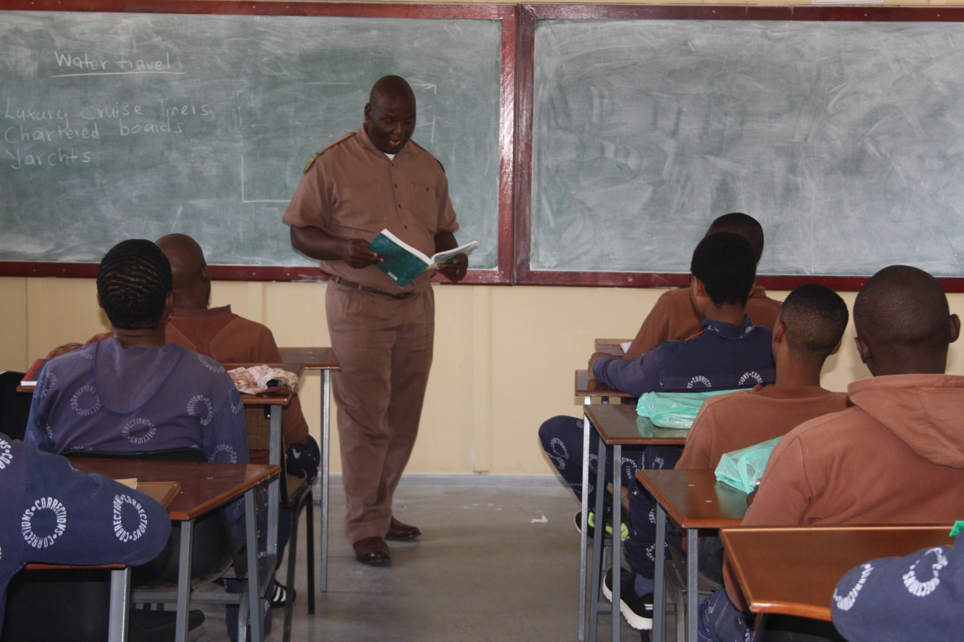
Department of Correctional Services
124 WF Nkomo Street WF Nkomo & Sophie De Bruyn Streets Pretoria Central Private Bag X136 Pretoria 0001
Website: http://www.dcs.gov.za

