Slide 1
DEPARTMENT OF CORRECTIONAL SERVICES
2021 STRATEGIC PLANNING SESSION
PROGRAMME
07 – 09 DEC 2021
VENUE:
VIRTUAL SESSION

Slide 2
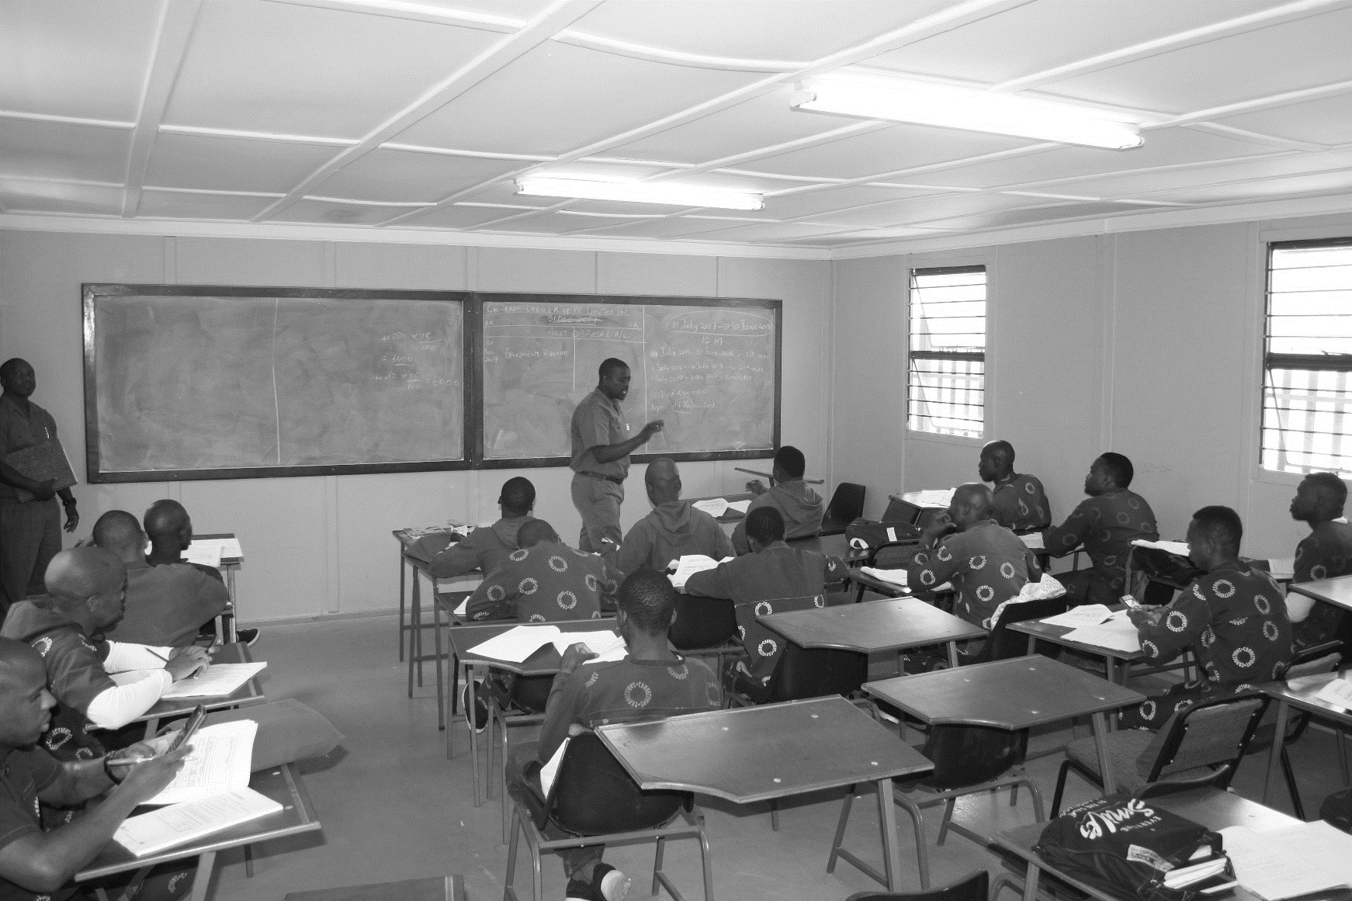
DAY 1
CONTEXTUAL ISSUES
PROGRAMME
07 DEC 2021

Slide 3
Adaptation of Corrections Internationally in light of the global new normal
01
Objectives and expectations of the session.
06
Acting National Commissioner.
UNISA
12:30
09:00
Attendance register and apologies.
Day 1 Programme.
Lunch
02
07
Facilitator.
09:30
13:15
Statement by the Minister of Justice and Correctional Services
Status of COVID-19 in the country
03
08
09:45
CDC INCO (Healthcare services) .
14:15
Statement by the Deputy Minister of Correctional Services
Presentation by the Audit Committee
04
09
10:45
Audit Committee Chair
15:00
Input from the National School of Government
05
Delivery priorities for the 2022/23 financial year
National School of Government.
10
11:45
CDC Strategic Management.
15:45
Notes:
Item 1: Introduce the facilitator

Slide 4
MTEF Budget Prioritisation Framework and Budget
11
Acting CFO
16:30
12
Agriculture Internal Market Analysis.
CDC INCO
17:15
Closing remarks
13
Facilitator.
18:00

Slide 5
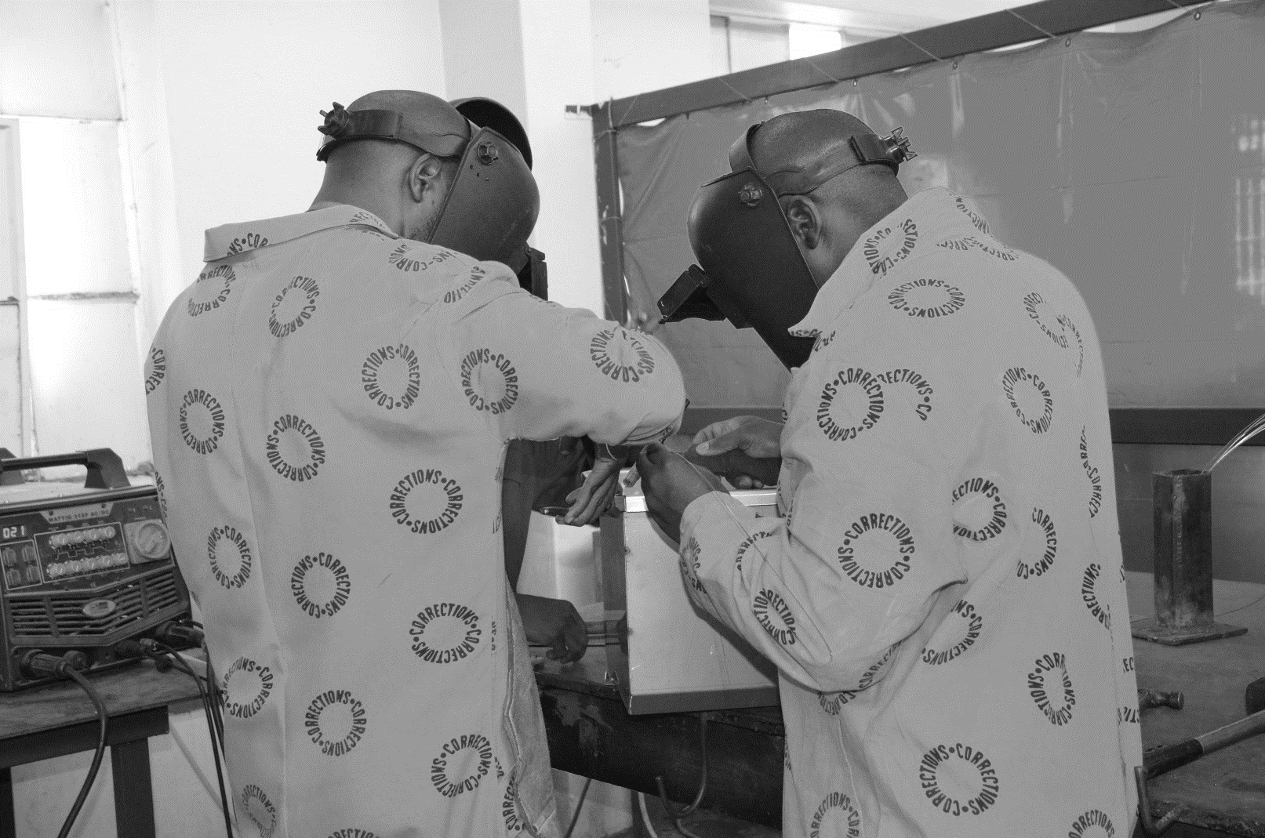
DAY 2
CONTEXTUAL ISSUES CONTINUED
PROGRAMME
08 DEC 2021

Slide 6
Opening and welcome.
Breakaways into six Outcomes
01
06
Facilitator
08:30
All
11:30
02
Attendance register and apologies.
Lunch
07
Facilitator.
08:45
13:00
Recap of Day 1
Breakaway Sessions into five Workstreams
03
08
Facilitator.
All.
14:00
09:00
Legislative Review update (CSA, CPA and inputs into review of JCPS legislation)
Closing remarks
04
09
Legal Services
09:30
Facilitator
17:45
Update on management of overcrowding in Correctional Facilities
05
CDC INCO, CDC RD, CDC ComCor.
10:30

Slide 7
DAY 3
MTEF PLANNING
PROGRAMME
09 DEC 2021

Slide 8
Opening and welcome.
Lunch
01
06
Facilitator
08:30
13:00
Attendance register and apologies.
Operations Management Framework (Phase II)
02
07
Facilitator.
Workstream Leaders (1-4).
14:00
08:45
Recap of Day 2
Way forward on the 2022/23 APP
03
08
Facilitator.
CDC Strategic Management
09:00
16:30
Presentation on MTEF Plans
Closing Statement
04
09
Outcome Leaders
Acting National Commissioner
16:45
09:30
2022/23 Strategic Risk Register
End of the Strategic Planning Session
05
10
Chief Risk Officer
12:00
18:00

Slide 9
Outcome 1:
Security and Facilities
01
Outcome 2:
Incarceration and Remand Detention
02
03
Outcome 3:
Rehabilitation
Outcome 4:
Social Reintegration
04
05
Outcome 5:
Healthcare
Outcome 6.1
HR
06
07
Outcome 6.2
Finance
Outcome 6.3
GITO
08
09
Outcome 6.4:
Management (DIU, CE and Comm)

Slide 10
Workstream 5:
INCO and Finance
01
Workstream 2:
GITO and Strategic Management
02
03
Workstream 1:
HR
Workstream 3:
ICC
04
05
Workstream 4:
Communications

Slide 11
Department of Correctional Services
Head Office 124 WF Nkomo Street WF Nkomo & Sophie De Bruyn Streets Pretoria Central Private Bag X136 Pretoria 0001
Website: http://www.dcs.gov.za

